Slide 1
THE HOMEBUYER STRATEGY GUIDE
T H E H O M E B U Y E R S C H E C K L I S T ₁
GETTING READY TO BUY A HOME?
8 1 6 - 6 5 1 - 1 9 4 3

Slide 2
T H E H O M E B U Y E R S T R A T E G Y G U I D E
2
We are here to help you through the process of buying a home. Buying a new house is one of the most important investments that a person can make in their life. This can be extremely stressful.
We've compiled this checklist for you so that you can be in control every step of the way and feel conﬁdent in the process.
Here are the steps:
BUILDING A FOUNDATION
THE FINANCIALS
FINDING YOUR NEW HOME
INSURING YOUR HOME
THE HOME STRETCH
8 1 6 - 6 5 1 - 1 9 4 3

Slide 3
BUILDING A FOUNDATION
T H E H O M E B U Y E R S T R A T E G Y G U I D E
3
Step 1: Find a Realtor
Interview a few agents and see if their personality matches your needs/wants. You want to “click”!
Qualiﬁcations your agent should have:
Local market knowledge
Good reviews or testimonials
Financial Knowledge - they can walk you through the numbers!
Find an agent who works full time in the industry and has a track record.
Great time management and communication skills:
Did they show up on time & prepared?
Do they communicate with you in a way that you understand and feel comfortable with?
Network connections:
Effective real estate agents rely on their relationships.
Do they work with other agents regularly?
Share your Housing Goals
8 1 6 - 6 5 1 - 1 9 4 3

Slide 4
T H E H O M E B U Y E R S T R A T E G Y G U I D E
4
Step 2: Know your Financials
Maintain great credit
Pay off as much debt as you can before proceeding (Discuss
with lender)
Your lender will be pulling your credit in the future as a part of the pre-approval process so don't worry about that just yet
Compile and save any important ﬁnancial documents
2 months worth of pay stubs & bank statements
2 years of tax returns & W-2’s or 1099 statements
Step 3: Find a Lender
Compare different lenders to understand the beneﬁts and advantages of working with each. Something as simple as a lower rate or term can save you thousands of dollars over the life of the loan.
Make sure to tell EACH LENDER not to pull your credit until you're fully committed to working with one
If your credit isn't where you want it to be, work on creating a plan with your chosen lender
Your agent may also be able to help you ﬁnd someone
trustworthy that they have worked with before.
8 1 6 - 6 5 1 - 1 9 4 3

Slide 5
THE FINANCIALS
T H E H O M E B U Y E R S T R A T E G Y G U I D E
5
Step 4: Establish a Budget
Saving up 20% of a home's purchase price as a down payment is suggested, but often hard to do in high-priced markets
If saving up 20% isn't feasible, work with your lender to create the best plan for your needs
Remember that just because you're approved for a certain amount doesn't mean that you have to spend that amount. Work with your lender and agent to establish a price point and monthly payment that you will be comfortable with.
Step 5: Get Pre-Approved for a Mortgage
Ask the lender if you qualify for any special loans, such as VA, USDA, or FHA.
Get Pre-Approved; this gives you, your agent, and the lender an estimate of how much you can afford based off of your credit score and past ﬁnancial documents
Work with your lender and real estate agent to determine
if your ﬁle should be underwritten before submitting any offers. This will help to avoid any potential disappointments or delays during the transaction
8 1 6 - 6 5 1 - 1 9 4 3

Slide 6
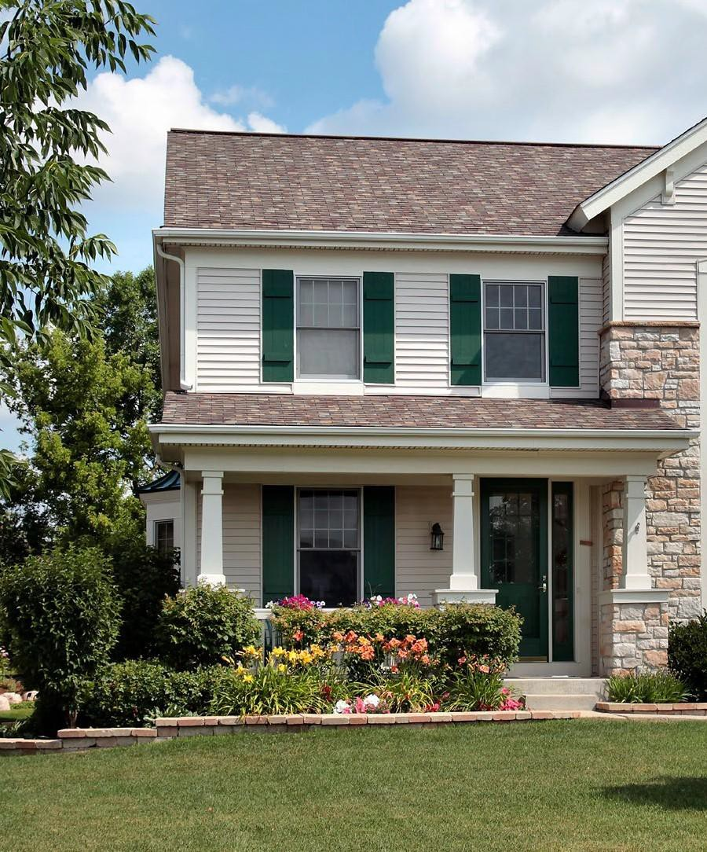
FINDING YOUR NEW HOME
T H E H O M E B U Y E R S T R A T E G Y G U I D E
6
Step 6: The Fun Part
Meet with your chosen real estate agent to discuss your home buying wish list. Make sure to include:
Must haves: bed/bath number, garage, etc.
Nice to have: pool, jacuzzi, smart home capabilities, etc.
Things to avoid: pools, busy streets, etc.
Bring along your pre-approval and lender contact information so you can discuss budget and have your agent connect with your chosen lender.
Determine different neighborhoods you might want to live in.
Step 7: Find a Home
Keep your "Must Haves" Checklist in mind.
Keep a journal or guide of the different houses you're interested in.
Take plenty of pictures to look back at.
Stay within your price range!
Provide your agent with ANY feedback regarding the properties that you view. Both positive and negative feedback can be very helpful for an agent to ﬁnd exactly what you want
Step 8: Make an Offer
Work with your agent to establish a strategy to get the most from your offer
and have the best chance of it getting accepted.
Sign the offer and any additional documents!
8 1 6 - 6 5 1 - 1 9 4 3

Slide 7
INSURING YOUR HOME
T H E H O M E B U Y E R S T R A T E G Y G U I D E
7
Step 9: Do your Due Diligence
Find a reputable and thorough home inspector, if you need suggestions ask your agent.
A good home inspector will help to ensure that you don't end up in a "money pit," for example, a property with lots of electricity, plumbing or foundation issues.
An inspector will also report any issues found with the home that will allow you to ask for repairs during negotiations.
If work is needed to be done on the property, strategize with your agent to submit a request for repairs.
Review disclosures and paperwork with your agent.
If you will be making any additions or construction to the property, such as adding a pool or a guest house, check with the city building department to ensure zoning allows for those upgrades.
Review title report with title representative and agent to ensure that there are no unknown easements or liens on the property.
Step 10: Arrange for Homeowners Insurance
Search for a homeowner's insurance policy with great coverage at a reasonable cost. Ask your lender for suggestions if necessary.
Some lenders require a year's worth of homeowner's insurance up front before approving a mortgage
8 1 6 - 6 5 1 - 1 9 4 3

Slide 8
THE HOME STRETCH
T H E H O M E B U Y E R S T R A T E G Y G U I D E
8
Step 11: Finalize Financing with Your Lender
The lender will order an appraisal on the home to verify that the market value supports the purchase price.
Double check that your interest rates and mortgage payments are what you agreed upon.
Step 12: Final Walkthrough of the Home
Go through the house with your agent to double check everything you agreed upon in your offer is present.
Ensure that any repairs that were agreed upon in the transaction were completed.
If repairs are difﬁcult to visually inspect, call back your home inspector or a specialist to ensure the repairs were completed correctly.
Turn on all lights and appliances to make sure that they still are in good working order.
Step 13: Closing the Deal
Bring everything you might need:
Form of identiﬁcation
Any additional payment you may need
Sign the mortgage documents!
Step 14: Move In!
Meet with your real estate agents to get the keys to your new home.
Celebrate! You now own your new home!
8 1 6 - 6 5 1 - 1 9 4 3

Slide 9
T H E H O M E B U Y E R S C H E C K L I S T ₉
HAVE ANY QUESTIONS?
The home buying process can be confusing and stressful, but I’m here to help!
We strive to make the process as fun and exciting as possible as we guide you through the transaction from start to ﬁnish.
Let us know how we can help you ﬁnd your dream home!
LET'S CHAT!
8 1 6 - 6 5 1 - 1 9 4 3

