Slide 1
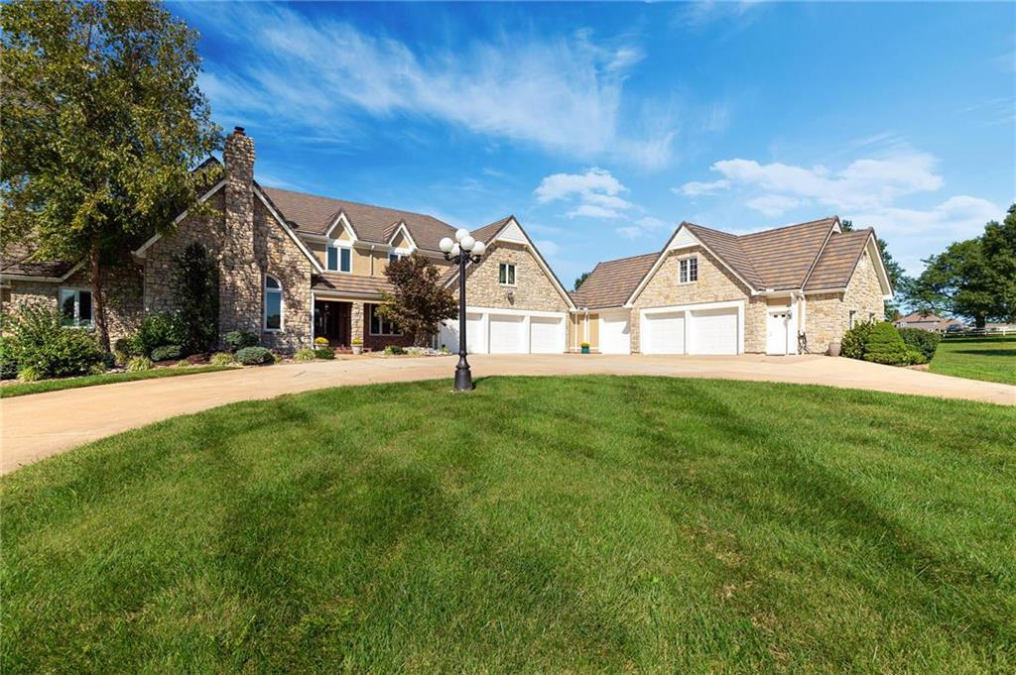
THE HOME SELLING STRATEGY GUIDE
T H E H O M E S E L L I N G C H E C K L I S T ₁
READY TO SELL YOUR HOME?
8 1 6 - 6 5 1 - 1 9 4 3

Slide 2
T H E H O M E S E L L I N G S T R A T E G Y G U I D E
2
Deciding whether or not to sell your home is one of the biggest decisions you'll ever make. While it seems like a complicated process, it doesn’t have to be.
This guide is designed to help you navigate your way through the selling process without any trouble.
Here are the pieces:
GETTING STARTED
RESEARCHING THE MARKET
PREPARING FOR A SALE
NEGOTIATING OFFERS
CLOSING AN OFFER
THE FINAL STAGES
8 1 6 - 6 5 1 - 1 9 4 3

Slide 3
GETTING STARTED
T H E H O M E S E L L I N G S T R A T E G Y G U I D E
3
Step 1: Find a Real Estate Agent
Interview several agents to see if their personality and expertise matches your needs and wants
Great real estate agents have these qualifications:
Local market knowledge.
Great reviews and testimonials.
Financial Knowledge.
Avoid "hobby agents" - find an experienced agent who works full time!
Great agents are punctual and communicative
Did your agent show up on time & prepared?
Do they communicate in a way that you understand and that you feel comfortable with?
Does your agent have network connections? Great agents work with other agents on a regular basis?
Ask about their marketing processes: How are they marketing other properties?
Are they utilizing social media?
Do they have marketing plans for their listings?
Create a list of 10 things you LOVE about your home, and share this with your agent.
Step 2: Plan Your Timeline
Determine when would be the best time to put your house on the market with your agent.
Meet with an agent to discuss the best listing strategy based on the local market.
Have an idea of where you'd like to move before you put your home on the market.
8 1 6 - 6 5 1 - 1 9 4 3
8 1 6 - 6 5 1 - 1 9 4 3

Slide 4
RESEARCHING THE MARKET
T H E H O M E S E L L I N G S T R A T E G Y G U I D E
4
Step 3: Walk through
Walk through your home with your agent.
Show them the 10 things you love about your home.
Ask your agent for advice on repairs, upgrades, and staging.
If you are unsure, ask your agent if a general pre-inspection should be scheduled before the sale.
Step 4: Determine the Listing Price & Marketing Plan
Work with your real estate agent to determine the best listing price - every home is different! If you overprice a property, it could potentially hurt your chances of getting top dollar for your home.
Review a comparative market analysis with your agent, which determines price point based on the sale price of
similar homes in your neighborhood.
DID YOU KNOW...?
The listing price of your home is based on many factors. This includes the lot size, the square footage, location, home's condition, style, the year the home was built, and many others.
8 1 6 - 6 5 1 - 1 9 4 3
8 1 6 - 6 5 1 - 1 9 4 3

Slide 5
PREPARING FOR A SALE
T H E H O M E S E L L I N G S T R A T E G Y G U I D E
5
Step 5: Prepare Your House for Viewing
Clean & Declutter
While we love the memories that your home represents, we suggest hiding anything that might be considered "clutter".
Try to keep decorations as neutral as possible - we want potential buyers to be able to imagine themselves in this
space.
Deep clean forgotten places (baseboards, light switches, etc.) OR hire a cleaning crew - a few hundred dollars on
cleaners can help get you thousands in the sale!
Improve Curb Appeal.
Maintain landscaping.
Clear out the side yard area.
Hide eyesores like trash cans or compost bins.
Hire a professional stager or ask your real estate agent for suggestions.
Step 6: Market Your Home
Discuss your agent's marketing plan with them to create the best strategy for your unique home.
Have your agent schedule high-quality real estate photography for your home. Professional photography can
get you thousands more in a sale!
Schedule a time with your agent to do the pre-listing marketing they need - video walkthroughs, social media
blasts, etc.
8 1 6 - 6 5 1 - 1 9 4 3
8 1 6 - 6 5 1 - 1 9 4 3

Slide 6
T H E H O M E S E L L I N G S T R A T E G Y G U I D E
6
Step 7: Showing Your Home
Decide whether you want to have a lock box or schedule appointments.
Prepare for open houses.
Store important financial documents and valuables in a safe place away
from the public eye.
Step 8: Negotiate Purchase Offers
Discuss the offers with your real estate agent.
Prepare for multiple offers.
PRO TIP:
Don't get hung up on only the offer price! There are many terms within an offer that should be taken into consideration.
Step 9: Sign a Purchase Sale Agreement
After selecting the strongest offer, sign the purchase sale agreement and any additional paperwork.
Buyers will put down a deposit.
Step 10: Open Escrow and Order Title
Your real estate agent will open escrow on your behalf and have a title representative pull the property's title report.
Discuss the timeline of the transaction with your agent based on the
accepted offer.
NEGOTIATING OFFERS
8 1 6 - 6 5 1 - 1 9 4 3
8 1 6 - 6 5 1 - 1 9 4 3

Slide 7
CLOSING AN OFFER
T H E H O M E S E L L I N G S T R A T E G Y G U I D E
7
Step 11: Buyer's Due Diligence Period
Be prepared to allow the buyer reasonable access to your home and property for them to conduct inspections.
After the home inspection, do not be alarmed if the buyer wants to schedule specialists like electricians or plumbers to come in and inspect the home
If the buyer submits a request for repairs, work with your agent to negotiate a solution between both parties.
If any reports were required in the accepted offer (ex: a termite report),
provide the buyer with them.
Step 12: Bank Ordered Appraisal
The buyer's lender will conduct an appraisal to verify that the market value of the home supports the contract price.
Step 13: The Home Stretch
Once the buyer has lifted contingencies and their deposit is locked in, complete any requested repairs before closing.
Expect the buyer to schedule a final walk-through, where they will verify that the condition of the property is the same as when they made the offer. This also allows the buyer to ensure that any agreed upon repairs have been completed.
8 1 6 - 6 5 1 - 1 9 4 3
8 1 6 - 6 5 1 - 1 9 4 3

Slide 8
THE FINAL STAGES
T H E H O M E S E L L I N G S T R A T E G Y G U I D E
8
Step 14: Closing a Deal
Both parties will pay any settlement fees and documents are recorded.
Titles are officially transferred to the new owners.
Step 15: CELEBRATE!
Congratulations! You sold your home!
8 1 6 - 6 5 1 - 1 9 4 3
8 1 6 - 6 5 1 - 1 9 4 3

Slide 9
T H E H O M E S E L L I N G C H E C K L I S T ₉
8 1 6 - 6 5 1 - 1 9 4 3
HAVE ANY QUESTIONS?
The home selling process can be confusing and stressful, but I’m here to help!
I strive to make the process as fun and exciting as possible as I guide you through the transaction from start to finish.
Let me know how I can help you find your dream home!
LET'S CHAT!
8 1 6 - 6 5 1 - 1 9 4 3

