Slide 1


International
POWERED
BY EXPERTS®
Prepared for
JOHN & JANE DOE
Listing Address
Optional: replace with photo of seller's home

Slide 2

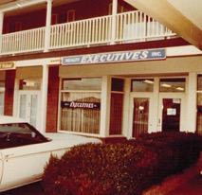
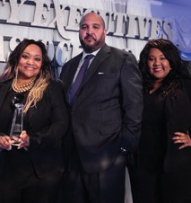
OUR
COMPANY
BROKERAGE NAME
Founded in 1965, Realty Executives is one of the largest and most established real estate franchise systems, with over 8,000 agents and 500 offices across the globe. Headquartered in Phoenix, Arizona, we are a privately held company that attracts and retains the most productive, efficient and successful real estate professionals in the industry through unparalleled brand, technology, training and concierge services. We pride ourselves on being the local experts in each area served. Our agents are there for every step in the home selling process, connecting with you, understanding your needs and knowing your community better than any other professional in your area.
Our network is steeped in experience and commitment to serving home buyers and sellers across the world. Backed by one of the largest privately held investment firms in the country, Outlier, Realty Executives continues to recruit top talent that outperforms other brands. With a global network of like-minded individuals and deep resources, Realty Executives offers a dynamic set of proprietary tools and integrated technology, providing our customers with friendly and professional service every step of the way. By providing the best to our Executives- we provide the best to you.

Slide 3
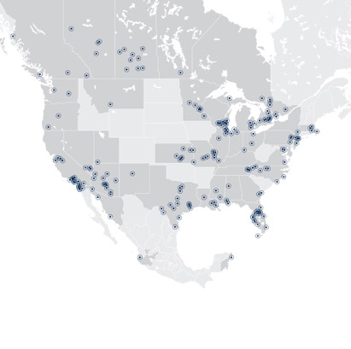
Our Amazing Network
OUR NORTH AMERICA
LOCATIONS
Our agents close 49% more transaction sides compared to the average agent*
55+
500
8k
Years Realty Executives has been in business
Over 500 offices located throughout North America
8,000 Executives in
our network
*The data shown is provided by RisMedia

Slide 4




Local Leaders
At Realty Executives International, we are your local experts. Our agents work and live in your community, working to provide friendly and professional service. Our brokerage serves [enter your service areas here] all Arizona communities from Tucson to northern towns of Prescott, Pinetop, Sedona and surrounding areas. We also work to give back to the communities that provide our livelihood. We support many local charities and organizations llie New Beginning, Casa de Los Ninos, Senior Village, just to name a few. Working with Realty Executives gives you the best of both worlds: hometown feel and service backed by resources and expertise of a stable, international brand.
WE HAVE 39 OFFICES IN ARIZONA TO SERVE YOU
WE HAVE 500 OFFICES IN NORTH AMERICA.
WE HAVE OVER 8,000 REALTORS
OUR OFFICE
6760 North Oracle Road
Tucson, AZ 85704
(520) 500-7238

Slide 5
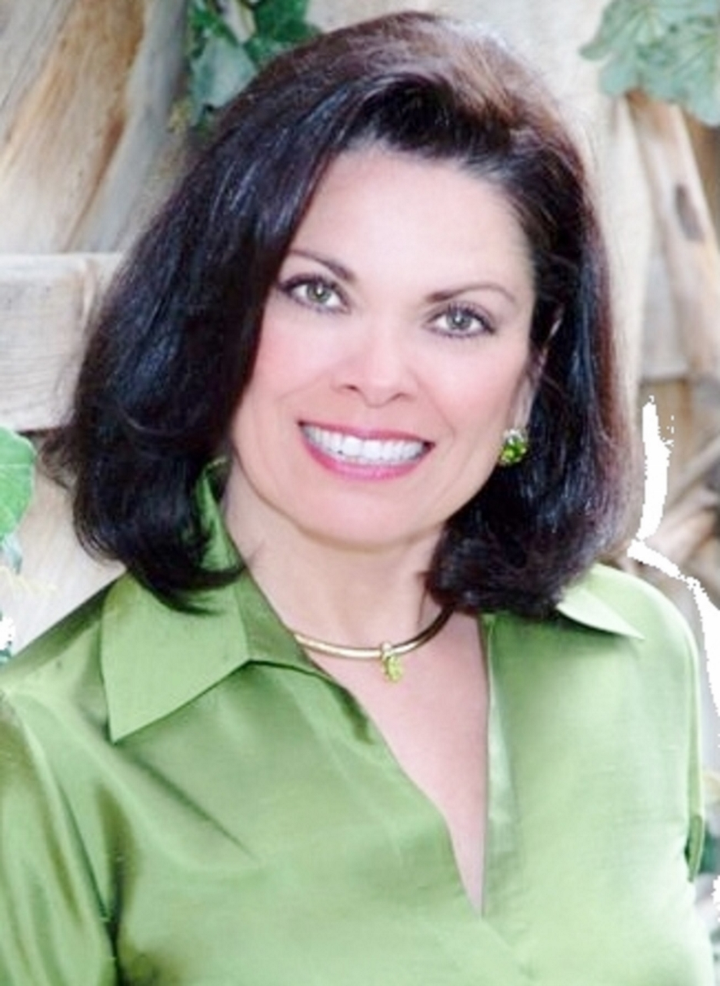







Lexi
Clark
Prior to receiving my real estate license in 2000, I was a paralegal with the most prestigious law firm in Tucson. I have over a decade of expertise and knowledge. With a focus on customer service and marketing strategies, I work my hardest to make the home selling journey not only simple but enjoyable! I’ve lived and worked in your community for years. I understand the ins and outs of your neighborhood and know what buyers are looking for in the area.
I was awarded Rookie of Year in 2001 and have not stopped there. I have all the designations and awards necessary to be your Realtor. As a local and neighborhood expert, I want you to know that I will consistently look for the best ways to market and sell your home to potential buyers. As a specialist in luxury and vacation properties, I am here to win you top dollar for your beautiful home.
Thank you for taking the time to meet with me today, I can’t wait to get started!
MY HIGHLIGHTS
48
Number of homes sold in 2022
23
Average length of home of market
2000 Rookie of the Year Award
CLHMS
I am a Certified Luxury Home Marketing Specialist
GRI
I am a Graduate of the REALTOR® Institute
MRE
I earned the Master of Real Estate designation

Slide 6


Stories
of Success Testimonials
I have the privilege of helping families start a new adventure everyday...here are a few success stories from my clients.
“My business relocated across the country and I gave gave Jane a month to sell my ranch. By golly, she did it! And she negotiated the price that I needed to cover all my expenses. I highly recommend Jane – I hope she has a clone in my new neighborhood!”
- Bob Jenkins, Texas
“Lexi covered all the bases from the start. She was clear and direct and thorough. Having very strict HOA regulations, the sale of my Marana home was not an easy one, but Lexi handled every aspect with grace and true professionalism. Thanks Lexi!”
- Betty Fryeburg, Marana
“Trying to sell my parents’ house while they were living in it sounded hard to do. My parents are both very ill and I had lots of anxiety over selling their home. But Lexi made it very easy for me! She turned a tedious chore into such a pleasant, smooth transition. She coordinated with the estate sale people for us. She knows how to handle every family member.”
- Jack & Jill Duncan, SaddleBrooke

Slide 7
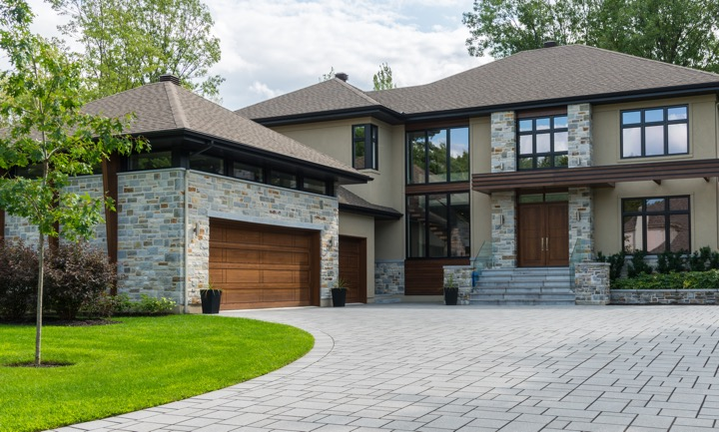

YOUR HOME SELLING JOURNEY
Selling your home is likely the largest financial decision you’ll make in life; there are many things to consider while preparing for the home sale process. However, it’s also an exciting new chapter. Now is the time to dream big! What is important to you as you think about your next step and creating lifelong memories in a new home? Your home is your sanctuary, and through all the emotions of this process, I’m here as your guide. It’s important to know what to expect as we go through each step and what you can expect of me. With proper preparation and strategy, I can transition your home from fresh on the market to SOLD!
During this presentation we will go through each stage of selling your home, from staging to pricing. As your local expert, it is my passion to find the right buyer to maximize your profit. My service and knowledge is here as an asset to you as we work through the process and open the door to your future.

Slide 8
Tell Me about Your Home
It’s important that I learn the features of your home and its unique character. This will help me prescribe the best marketing strategy as we aim to sell your home. We’ll review timelines and how I can make this process as streamlined as possible.
1
2
3
What do you love about your home?
Why did you
decide to move?
If you could change something about your home, what would it be?
4
5
6
Is there a date you would like to move by? Are the dates flexible?
Have you done any recent upgrades or are there unique features that aren’t common in the neighborhood?
Is there anything that you think a buyer may dislike or use to alter their offer price?

Slide 9
Top Priorities In Marketing Your Home
Below is a list of factors that will contribute to the sale of your property. It is important that I understand your priorities, so I know how to customize and better manage that process. Please list your priorities in order of importance low to high.
Low
Medium
High
Preparation
Broker Qualifications
Communications
Pricing
Escrow & Transaction Management
After Sales Follow-Up
Current Market Conditions
Time on the Market
Walk-Away Dollars
Open Houses
Target Marketing
Marketing & Advertising
Internet Exposure
Staging & Merchandising
Other: ___________________________
Other: ___________________________

Slide 10
Home Showing Protocol
To ensure the health and well-being of homeowners, our team and you, we are committed to providing safe home showing practices.
1
2
3
All showings will
be booked by the listing agent
No more than 2 visitors inside the home at once
If ill, buyers will not be able to visit the home, but will be encouraged to use our virtual tour option
4
5
6
All hard surfaces and door knobs will be sanitized before and after the showing
To limit contact, all doors and cabinets should be opened by agent
Signage enforcing a "no touch" policy will be provided for use inside the home during visits
ALL TOURS WILL BE BRIEF
Our virtual services include but are not limited to:
Virtual
appointments
Listing video /
3D Matterport tour
Electronic
signing

Slide 11
Comprehensive Strategy
As a Realty Executives agent, I provide a comprehensive plan to my clients outlining how we are going to gain serious buyers and attractive offers. My custom marketing plan includes integrating traditional, proven methods with progressive modern tactics to sell your home in a timely and seamless manner.
The Right Price
Custom
Marketing Plan
Sold!

Slide 12
Today’s Market
Let’s start with talking the housing market and what home buyers are expecting in today’s real estate world. This will be a key part in creating our comprehensive strategy to prepare and market your home.
(insert local data and citation)
$350,000
Local average sold price
79
500
National average days on market
Number of homes for sales in local market
*The data shown is provided by the National Association of REALTORS®

Slide 13
Today’s
Home Buyers
44%
87%
10
The first step 44% of recent home buyers took in the home buying process was to look online at properties for sale.
87% of recent buyers found their real estate agent to be a very useful information source.
Buyers typically search for 10 weeks and looked at a median of 9 homes.
“Highly Important”
Home Characteristics
“Highly Important”
Neighborhood Characteristics
1
Within initial budget: 83%
1
Feeling safe: 82%
2
Air conditioning: 78%
2
Walkable: 60%
3
Preferred number of bedrooms: 76%
3
Preferred neighborhood: 56%
*The data shown is provided by the National Association of REALTORS®

Slide 14


HOME PREPARATION
It is important to put your best foot forward when it comes to preparing your home for sale. Common wear and tear, despite being an easy fix, can lessen its appeal and sales value. We will go through your home and determine what, if any, improvements each space could benefit from and then decide if it makes economic sense to update them. We’ll talk about which improvements are easy enough to handle on your own and which may require hiring a professional. Most importantly, I can help guide you on what home upgrades often have the best return on investment. As your Realtor, I have many contacts in the local community to help you tackle any project!
Curb appeal is always key for potential buyers... so make sure to give them a memorable first impression!

Slide 15



Presenting Your Home to Buyers
Is staging a good option for your home?
Professional staging is a great option for preparing your home for potential buyers. You’ve made this beautiful space your home, and now it’s time to show it off! By decluttering, deep cleaning and renovating items that may bring down profitability, you are putting your best foot forward. Staging your home can add that extra pizazz to help us sell your home faster and for more money. You want buyers to envision themselves in your home!
Make your home stand out with professional photos and video
Once your home is perfectly prepared, I will set up professional photography to capture your property. Using professional photography will allow us to show off what your home has to offer and also allow me to create custom marketing pieces. Additionally, video tours are a great strategy to give buyers a real feel to your space, compelling them to come give it a look in person.

Slide 16
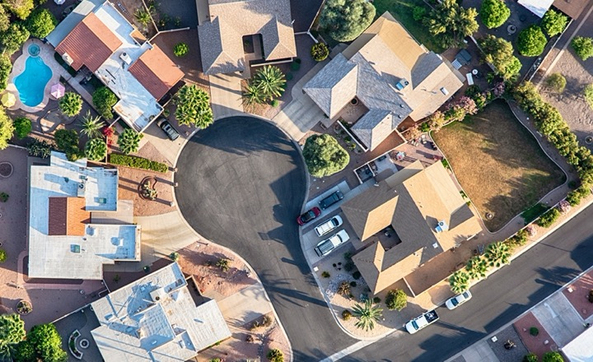
STRATEGIC
PRICING
Pricing your home is both a science and an art. Your home’s exposure is highest when it initially hits the market. For this reason, it’s vital that we develop a thorough pricing strategy.
To do this, we must consider the prices of homes in the neighborhood (comparables), adjustments that should be made (increases or decreases) to account for the condition of your home and the timeframe in which you are wanting to sell. If priced accurately, we increase the chances of attracting a qualified, driven buyer quickly. My goal is to maximize your sales price while closing within a timeframe that is reasonable for you.
Activity
Pricing correctly helps strike a deal when there is more competition for your home.
Weeks on Market
*The data shown is provided by the National Association of REALTORS®

Slide 17
Prime Pricing
When discussing price, we will need to decide what is most important to you- timeframe or profit? The amount of time your home is on the market can affect market value.
Above Market Value
Maximize your possible profits but you’ll dramatically reduce the number of interested buyers and increase the time it takes to sell.
Fair Market Value
Increases your chances of a faster sale without sacrificing your profits.
Below Market Value
You’ll get a lot more interest, but you’ll be cutting your potential on the profits from your property.
*The data shown is provided by the National Association of REALTORS®

Slide 18
Pricing vs Potential Buyers
Properly pricing your home will give you the best possibility of bringing more buyers to look and compete for your home. The better the asking price fits with the local market value, the higher the percentage of potential buyers.
Asking Price Compared
to Market Value
Percentage of Potential Buyers
Who Will Look for Property
-15%
90%
-10%
75%
Market
Value
60%
+10%
30%
+15%
10%
*The data shown is provided by the National Association of REALTORS®

Slide 19

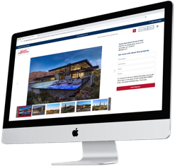
MARKETING YOUR PROPERTY INTERNATIONALLY
Now that we’ve gone over prepping, pricing and presenting your home, let’s discuss how we are going to market your property to the best buyers. As your agent, it’s my job to market through highly targeted messaging and various channels. Working with Realty Executives, we have access to a wide network of online marketing domains that increase home buyer views through search engines and social media.
Your listing will be featured on my Executive and Brokerage website. Our websites are designed to be easy-to-navigate and respond on any device on any platform.
RealtyExecutives.com

Slide 20


The Whole Package
Our Realty Executives websites are just the beginning of where your property will be displayed. With our large network of industry sites and social platforms, we can ensure maximum global and network exposure.

Slide 21





The Whole Package: Social
Social media is becoming one of the best platforms to use to advertise your home. We will use photos, videos, virtual tours and floor-plans on several social media channels. Facebook and other social media platforms are invaluable mediums that encourage interaction with prospective buyers. By using eye-catching visuals, targeted demographics, property-related hashtags and keywords, your listing will be only seen by those seriously considering buying a home in your area.

Slide 22




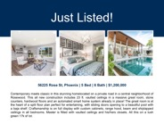
The Whole Package: Print
Although the digital age is upon us, it is still important to recognize the impact well-designed and clearly written print advertising can have. We use several types of print materials to market locally and create awareness of your listing. These materials will address important details of your home including size, price and floor-plans, along with unique features your home has to offer.

Slide 23
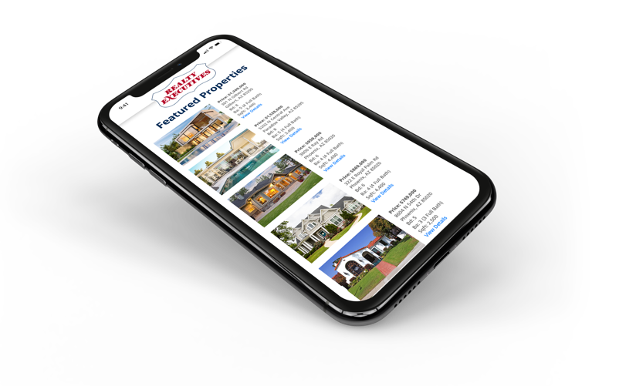
The Whole Package: Email
Keeping in contact with past, current and potential consumers is another great way I can market your home and reach potential buyers. Our customizable and automated email campaigns allow me to showcase your listing to my sphere of influence quickly and efficiently. Landing directly in their inbox, my email campaigns are able to inform consumers of new listings, price reductions, upcoming open houses and more.
a
Through our in-house technology, I am able to track interest and monitor views by evaluating clicks and open rates of various viewers. By engaging the network, your listing can be seen by hundreds of potential buyers in the matter of seconds.

Slide 24


Thank You
Thank you for taking the time to speak with me today. Everything discussed today is to help you get through the home selling process with ease. I am confident that I am the right fit to find the perfect buyer for your home. This isn’t just about the sale for me...this is about creating trust and loyalty that will last beyond the closing transaction. Please feel free to reach out anytime with questions or just to check in!
Lexi Clark
RealtyExecutivesArizona@gmail.com
520.500.7238
LexiClark.com

