Slide 1

THINGS TO CONSIDER WHEN
BUYING A HOME
Spring 2017
EDITION

Slide 2
TABLE OF CONTENTS
3
4 REASONS TO BUY A HOME THIS SPRING!
WHAT’S HAPPENING IN THE HOUSING MARKET?
5
THE COST OF RENTING VS. BUYING [INFOGRAPHIC]
6
BUYING IS NOW 37.7% CHEAPER THAN RENTING IN THE US
7
HOME PRICES OVER THE LAST YEAR
8
BUYING A HOME? CONSIDER COST, NOT JUST PRICE
WHAT YOU NEED TO KNOW BEFORE YOU BUY
9
STARTING TO LOOK FOR A HOME? KNOW WHAT YOU WANT
VS. WHAT YOU NEED
10
2 MYTHS THAT MAY BE HOLDING YOU BACK FROM BUYING
12
WHY PRE-APPROVAL SHOULD BE YOUR FIRST STEP
13
HOW LOW INTEREST RATES INCREASE YOUR PURCHASING POWER
14
5 REASONS HOMEOWNERSHIP IS A GOOD FINANCIAL INVESTMENT
WHAT TO EXPECT WHEN BUYING A HOME
15
WHAT YOU NEED TO KNOW ABOUT THE MORTGAGE PROCESS
16
GETTING A MORTGAGE: WHY SO MUCH PAPERWORK?
17
READY TO MAKE AN OFFER? 4 TIPS FOR SUCCESS
19
WHAT TO EXPECT WHEN HOME INSPECTING
20
HAVE YOU PUT ASIDE ENOUGH FOR CLOSING COSTS?

Slide 3

4 REASONS TO BUY A HOME THIS SPRING!
Here are four great reasons to consider buying a home today instead of waiting.
1. Prices Will Continue to Rise
CoreLogic’s latest Home Price Index reports that home prices have appreciated by 7.2% over the last 12 months. The same report predicts that prices will continue to increase at a rate of 4.7% over the next year.
The bottom in home prices has come and gone. Home values will continue to appreciate for years. Waiting no longer makes sense.
2. Mortgage Interest Rates Are Projected to Increase
Freddie Mac’s Primary Mortgage Market Survey shows that interest rates for a 30-year mortgage have remained around 4%. Most experts predict that they will begin to rise over the next 12 months. The Mortgage Bankers Association, Fannie Mae, Freddie Mac & the National Association of Realtors are in unison, projecting that rates will increase by this time next year.
An increase in rates will impact YOUR monthly mortgage payment. A year from now, your housing expense will increase if a mortgage is necessary to buy your next home.
3

Slide 4

3. Either Way You are Paying a Mortgage
There are some renters who have not yet purchased a home because they are uncomfortable taking on the obligation of a mortgage. Everyone should realize that, unless you are living with your parents rent-free, you are paying a mortgage - either yours or your landlord’s.
As an owner, your mortgage payment is a form of ‘forced savings’ that allows you to have equity in your home that you can tap into later in life. As a renter, you guarantee your landlord is the person with that equity.
Are you ready to put your housing cost to work for you?
4. It’s Time to Move On with Your Life
The ‘cost’ of a home is determined by two major components: the price of the home and the current mortgage rate. It appears that both are on the rise.
But what if they weren’t? Would you wait?
Look at the actual reason you are buying and decide if it is worth waiting. Whether you want to have a great place for your children to grow up, you want your family to be safer or you just want to have control over renovations, maybe now is the time to buy.
If the right thing for you and your family is to purchase a home this year, buying sooner rather than later could lead to substantial savings.
4

Slide 5
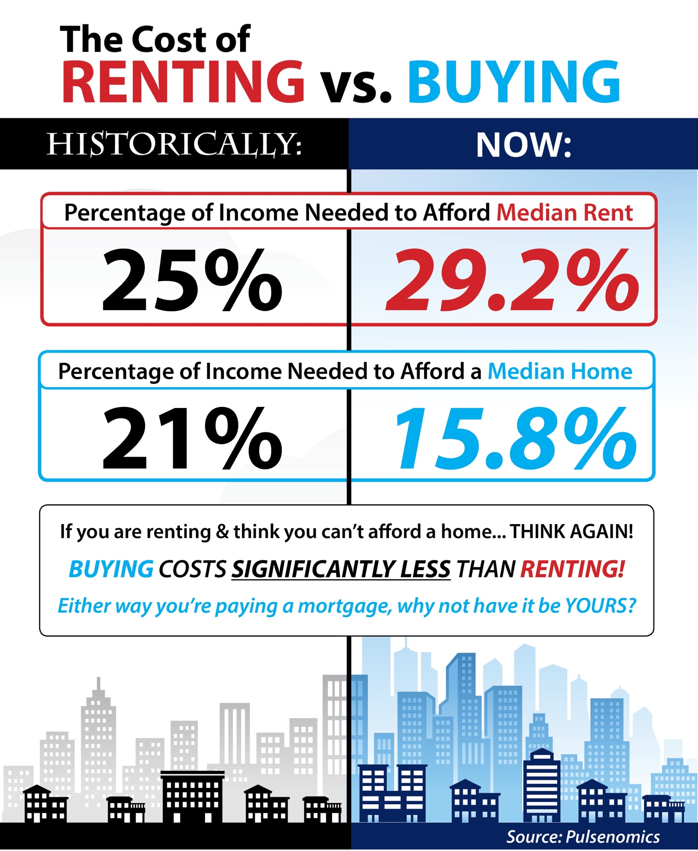
5

Slide 6

BUYING IS NOW 37.7% CHEAPER THAN
RENTING IN THE US
The results of the latest Rent vs. Buy Report from Trulia show that homeownership remains cheaper than renting with a traditional 30-year fixed rate mortgage in the 100 largest metro areas in the United States.
The updated numbers actually show that the range is an average of 17.4% less expensive in Honolulu (HI), all the way up to 53.2% less expensive in Miami & West Palm Beach (FL), and 37.7% nationwide!
Other interesting findings in the report include:
Interest rates have remained low and, even though home prices have appreciated around the country, they haven’t greatly outpaced rental appreciation.
Home prices would have to appreciate by a range of over 23% in Honolulu (HI), up to over 45% in Ventura County (CA), to reach the tipping point of renting being less expensive than buying.
Nationally, rates would have to reach 9.1%, a 145% increase over today’s average of 3.7%, for renting to be cheaper than buying. Rates haven’t been that high since January of 1995, according to Freddie Mac.
Bottom Line
Buying a home makes sense socially and financially. If you are one of the many renters out there who would like to evaluate your ability to buy this year, let's get together to find your dream home.
6

Slide 7
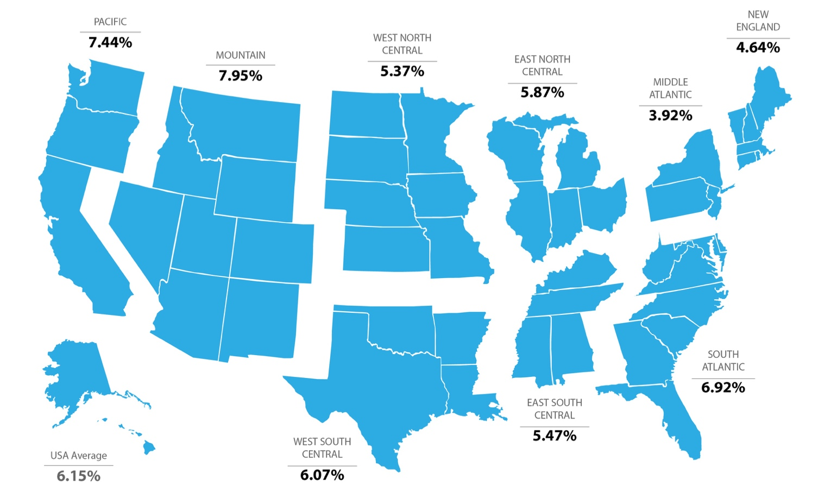
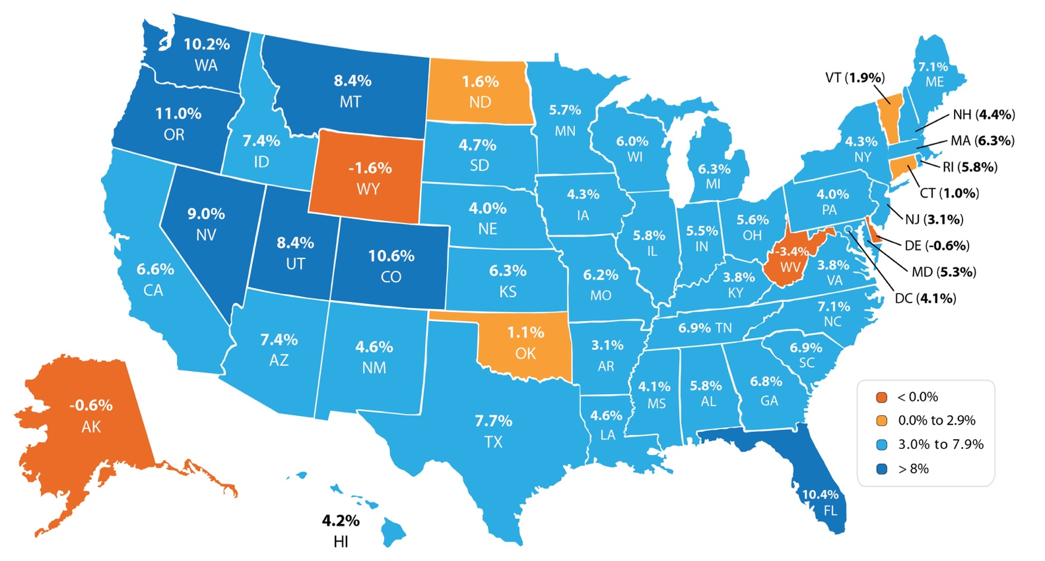
HOME PRICES OVER THE LAST YEAR
Every quarter, the Federal Housing Finance Agency (FHFA) reports on the year-over-year changes in home prices. Below, you will see that prices are up year-over-year in every region.
Year-over-Year Prices Regionally
Looking at the breakdown by state, you can see that each state is appreciating at a different rate. This is important to know if you are planning on relocating to a different area of the country. Waiting to move may end up costing you more!
Year-over-Year Prices By State
7

Slide 8

BUYING A HOME?
CONSIDER COST, NOT JUST PRICE
As a seller, you will be most concerned about ‘short term price’ – where home values are headed over the next six months. As a buyer, however, you must not be concerned about price, but instead about the ‘long term cost’ of the home.
The Mortgage Bankers Association (MBA), the National Association of Realtors (NAR) and Freddie Mac all project that mortgage interest rates will increase by this time next year. According to CoreLogic’s most recent Home Price Index Report, home prices will appreciate by 4.7% over the next 12 months.
What Does This Mean as a Buyer?
If home prices appreciate by the 4.7% predicted by CoreLogic over the next twelve months, here is a simple demonstration of the impact an increase in interest rate would have on the mortgage payment of a home selling for approximately $250,000 today:
 | Mortgage | Interest Rate | Payment (P&I)**
Today | $250,000 | 4.16% | $1,216.71
Q2 2018 | $261,750 | 4.8% | $1,373.31
 |  |  | $156.60
Difference in Monthly Payment
*Rates based on Freddie Mac’s prediction at time of print
Monthly | Annually | Over 30 Years
$156.60 | $1,879.20 | $56,376
8

Slide 9

STARTING TO LOOK FOR A HOME? KNOW WHAT YOU WANT VS. WHAT YOU NEED
In this day and age of being able to shop for anything anywhere, it is really important to know what you’re looking for when you start your home search.
If you’ve been thinking about buying a home of your own for some time now, you’ve probably come up with a list of things that you’d LOVE to have in your new home. Many new homebuyers fantasize about the amenities that they see on television or Pinterest, and start looking at the countless homes listed for sale with rose-colored glasses.
Do you really need that farmhouse sink in the kitchen in order to be happy with your home choice? Would a two-car garage be a convenience or a necessity? Could the man cave of your dreams be a future renovation project instead of a make or break now?
The first step in your home buying process should be to get pre-approved for your mortgage. This allows you to know your budget before you fall in love with a home that is way outside of it.
The next step is to list all the features of a home that you would like & to qualify them as follows:
‘Must-Haves’ – if this property does not have these items, then it shouldn’t even be considered. (ex: distance from work or family, number of bedrooms/bathrooms)
‘Should-Haves’ – if the property hits all of the ‘must-haves’ and some of the ‘should-haves,’ it stays in contention, but does not need to have all of these features.
‘Absolute Wish List’ – if we find a property in our budget that has all of the ‘must-haves,’ most of the ‘should-haves,’ and ANY of these, it’s the winner!
Bottom Line
Having this list fleshed out before starting your search will save you time and frustration, while also letting your agent know what features are most important to you before he or she begins to show you houses in your desired area.
9

Slide 10

2 MYTHS THAT MAY BE HOLDING YOU BACK FROM BUYING
Fannie Mae’s article, “What Consumers (Don’t) Know About Mortgage Qualification Criteria,” revealed that “only 5 to 16 percent of respondents know the correct ranges for key mortgage qualification criteria.”
Myth #1: “I Need a 20% Down Payment”
Fannie Mae’s survey revealed that consumers overestimate the down payment funds needed to qualify for a home loan. According to the report, 76% of Americans either don’t know (40%) or are misinformed (36%) about the minimum down payment required.
Many believe that they need at least 20% down to buy their dream home, but many programs actually let buyers put down as little as 3%.
On the right are the results of a Digital Risk survey of Millennials who recently purchased a home.
As you can see, 64.2% were able to purchase their home by putting down less than 20%, with 43.8% putting down less than 10%!
How much was your down payment?
36% put 5% or less down
43.8% put < 10% down
MILLENNIALS
between the ages of 18 and 34
64.2% put < 20% down
10

Slide 11

Myth #2: “I Need a 780 FICO® Score or Higher to Buy”
The survey revealed that 59% of Americans either don’t know (54%) or are misinformed (5%) about what FICO® score is necessary to qualify.
Many Americans believe a ‘good’ credit score is 780
or higher.
To help debunk this myth, let’s take a look at Ellie
Mae’s latest Origination Insight Report, which
focuses on recently closed (approved) loans.
As you can see on the right, 54.7% of approved mortgages had a credit score of 600-749.
FICO® Score
Distribution
Bottom Line
Whether buying your first home or moving up to your dream home, knowing your options will make the mortgage process easier. Your dream home may already be within your reach.
54.7%
11

Slide 12

WHY PRE-APPROVAL SHOULD BE YOUR FIRST STEP
In many markets across the country, the amount of buyers searching for their dream home greatly outnumbers the amount of homes for sale. This has led to a competitive marketplace where buyers often need to stand out. One way to show you are serious about buying your dream home is to get pre-qualified or pre-approved for a mortgage before starting your search.
But even if you are in a market that is not as competitive, knowing your budget will give you the confidence to know if your dream home is within your reach.
Freddie Mac lays out the advantages of pre-approval in the ‘My Home’ section of their website.
“It’s highly recommended that you work with your lender to get pre-approved before you begin house hunting. Pre-approval will tell you how much home you can afford and can help you move faster, and with greater confidence, in competitive markets.”
One of the many advantages of working with a local real estate professional is that many have relationships with lenders who will be able to help you with this process. Once you have selected a lender, you will need to fill out their loan application and provide them with important information regarding “your credit, debt, work history, down payment and residential history.”
Freddie Mac describes the 4 Cs that help determine the amount you will be qualified to borrow:
Capacity: Your current and future ability to make your payments
Capital or cash reserves: The money, savings and investments you have that can be sold quickly for cash
Collateral: The home, or type of home, that you would like to purchase
Credit: Your history of paying bills and other debts on time
Getting pre-approved is one of many steps that will show home sellers that you are serious about buying and it often helps speed up the process once your offer has been accepted.
Bottom Line
Many potential home buyers overestimate the down payment and credit scores needed to qualify for a mortgage today. If you are ready and willing to buy, you may be pleasantly surprised at your ability to do so as well.
12

Slide 13

HOW LOW INTEREST RATES INCREASE YOUR
PURCHASING POWER
According to Freddie Mac’s latest Primary Mortgage Market Survey, interest rates for a 30-year fixed rate mortgage are currently around 4%, which is still very low in comparison to recent history!
The interest rate you secure when buying a home not only greatly impacts your monthly housing costs, but also impacts your purchasing power.
Purchasing power, simply put, is the amount of home you can afford to buy for the budget you have available to spend. As rates increase, the price of the house you can afford will decrease if you plan to stay within a certain monthly housing budget.
The chart below shows what impact rising interest rates would have if you planned to purchase a home within the national median price range, and planned to keep your principal and interest payments at or about $1,100 a month.
Buyer’s Purchasing Power
4.75 | $ 1,304 | $ 1,272 | $ 1,239 | $ 1,206 | $ 1,174
4.50 | $ 1,267 | $ 1,235 | $ 1,203 | $ 1,172 | $ 1,140
4.25 | $ 1,230 | $ 1,199 | $ 1,168 | $ 1,138 | $ 1,107
4.00 | $ 1,194 | $ 1,164 | $ 1,134 | $ 1,104 | $ 1,074
3.75 | $ 1,158 | $ 1,129 | $ 1,099 | $ 1,071 | $ 1,042
3.50 | $ 1,123 | $ 1,095 | $ 1,066 | $ 1,038 | $ 1,010
3.25 | $ 1,088 | $ 1,061 | $ 1,034 | $ 1,006 | $ 979
 | $ 250,000 | $ 243,750 | $ 237,500 | $ 231,250 | $ 225,000
 |  | -2.5% | -5% | -7.5% | -10%
RATE
Principal and Interest Payments
rounded to the nearest dollar amount.
With each quarter of a percent increase in interest rate, the value of the home you can afford decreases by 2.5%, (in this example, $6,250). Experts predict that mortgage rates will be closer to 5% by this time next year.
Act now to get the most house for your hard-earned money.
13

Slide 14

5 REASONS HOMEOWNERSHIP IS A GOOD
FINANCIAL INVESTMENT
According to a report by Trulia, “buying is cheaper than renting in 100 of the largest metro areas by an average of 37.7%.” That may have some thinking about buying a home instead of signing another lease extension, but does that make sense from a financial perspective?
In the report, Ralph McLaughlin, Trulia’s Chief Economist explains:
“Owning a home is one of the most common ways households build long-term
wealth, as it acts like a forced savings account. Instead of paying your landlord,
you can pay yourself in the long run through paying down a mortgage on a house.”
The report listed 5 reasons why owning a home makes financial sense:
• Mortgage payments can be fixed while rents go up.
• Equity in your home can be a financial resource later.
• You can build wealth without paying capital gains.
• A mortgage can act as a forced savings account.
• Overall, homeowners can enjoy greater wealth growth than renters.
Bottom Line
Before you sign another lease, let’s get together and discuss all your options.
14

Slide 15
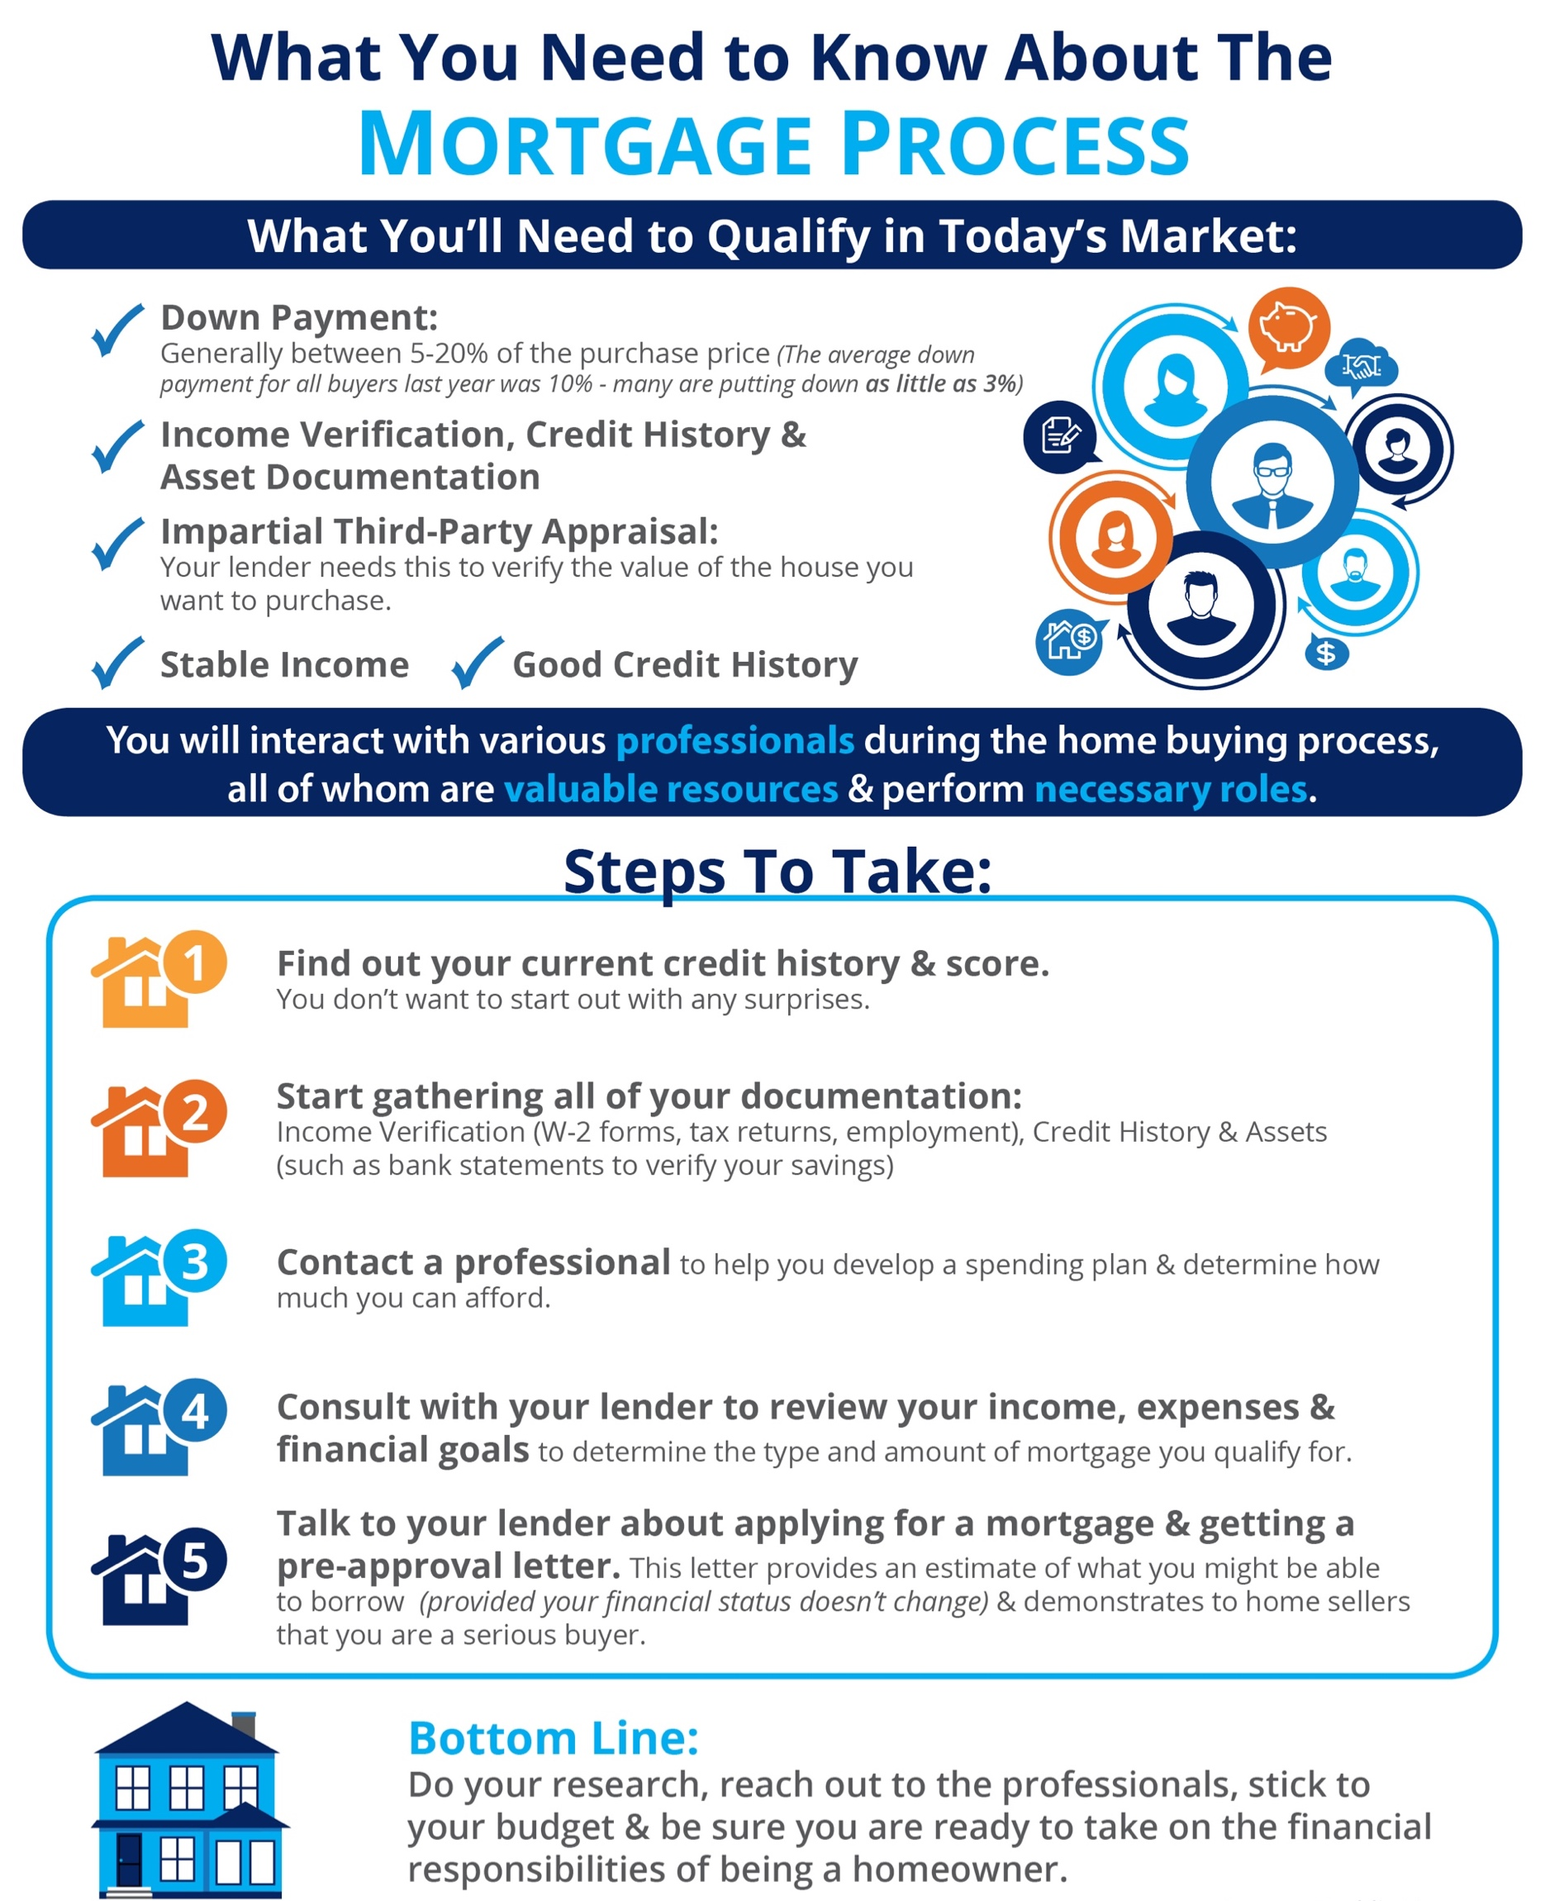
15

Slide 16

GETTING A MORTGAGE:
WHY SO MUCH PAPERWORK?
Why is there so much paperwork mandated by lenders for a mortgage loan application when buying a home today? It seems that they need to know everything about you and require three separate sources to validate each and every entry on the application form.
Many buyers are being told by friends and family that the process was a hundred times easier when they bought their home ten to twenty years ago.
There are two very good reasons that the loan process is much more onerous on today’s buyer than perhaps any time in history.
1. The government has set new guidelines that now demand that the bank prove beyond any doubt that you are indeed capable of paying the mortgage.
During the run-up in the housing market, many people ‘qualified’ for mortgages that they could never pay back. This led to millions of families losing their homes. The government wants to make sure this can’t happen again.
2. The banks don’t want to be in the real estate business.
Over the last seven years, banks were forced to take on the responsibility of liquidating millions of foreclosures and also negotiating another million+ short sales. Just like the government, they don’t want more foreclosures. For that reason, they need to double (maybe even triple) check everything on the application.
However, there is some good news about this situation.
The housing crash that mandated that banks be extremely strict on paperwork requirements also allowed you to get a mortgage interest rate around 4%.
The friends and family who bought homes ten or twenty years ago experienced a simpler mortgage application process but also paid a higher interest rate (the average 30-year fixed rate mortgage was 8.12% in the 1990s and 6.29% in the 2000s).
If you went to the bank and offered to pay 7% instead of around 4%, they would probably bend over backwards to make the process much easier.
Bottom Line
Instead of concentrating on the additional paperwork required, let’s be thankful that we are able to buy a home at historically low rates.
16

Slide 17

READY TO MAKE AN OFFER? 4 TIPS FOR SUCCESS
So you’ve been searching for that perfect house to call a ‘home’ and you finally found one! The price is right, and in such a competitive market you want to make sure you make a good offer so that you can guarantee your dream of making this house yours comes true!
Freddie Mac covered “4 Tips for Making an Offer” in their latest Executive Perspective. Here are the 4 tips they covered along with some additional information for your consideration:
1. Understand How Much You Can Afford
“While it's not nearly as fun as house hunting, fully understanding your finances is critical in making an offer.”
This ‘tip’ or ‘step’ really should take place before you start your home search process.
Getting pre-approved is one of many steps that will show home sellers that you are serious about buying, and will allow you to make your offer with the confidence of knowing that you have already been approved for a mortgage for that amount. You will also need to know if you are prepared to make any repairs that may need to be made to the house (ex: new roof, new furnace).
2. Act Fast
“Even though there are fewer investors, the inventory of homes for sale is also low and competition for housing continues to heat up in many parts of the country.”
The inventory of homes listed for sale has remained well below the 6-month supply that is needed for a ‘normal’ market. Buyer demand has continued to outpace the supply of homes for sale, causing buyers to compete with each other for their dream home.
Make sure that as soon as you decide that you want to make an offer, you work with your agent to present it as soon as possible.
17

Slide 18

3. Make a Solid Offer
Freddie Mac offers this advice to help make your offer the strongest it can be:
“Your strongest offer will be comparable with other sales and listings in the neighborhood. A licensed real estate agent active in the neighborhoods you are considering will be instrumental in helping you put in a solid offer based on their experience and other key considerations such as recent sales of similar homes, the condition of the house and what you can afford.”
Talk with your agent to find out if there are any ways that you can make your offer stand out in this competitive market!
4. Be Prepared to Negotiate
“It's likely that you'll get at least one counteroffer from the sellers so be prepared. The two things most likely to be negotiated are the selling price and closing date. Given that, you'll be glad you did your homework first to understand how much you can afford.
Your agent will also be key in the negotiation process, giving you guidance on the counteroffer and making sure that the agreed-to contract terms are met.”
If your offer is approved, Freddie Mac urges you to "always get an independent home inspection, so you know the true condition of the home." If the inspection uncovers undisclosed problems or issues, you can discuss any repairs that may need to be made, with the seller, or cancel the contract.
Bottom Line
Whether buying your first home or your fifth, having a local real estate professional who is an expert in their market on your side is your best bet to make sure the process goes smoothly. Let’s talk about how we can make your dreams of homeownership a reality!
18

Slide 19
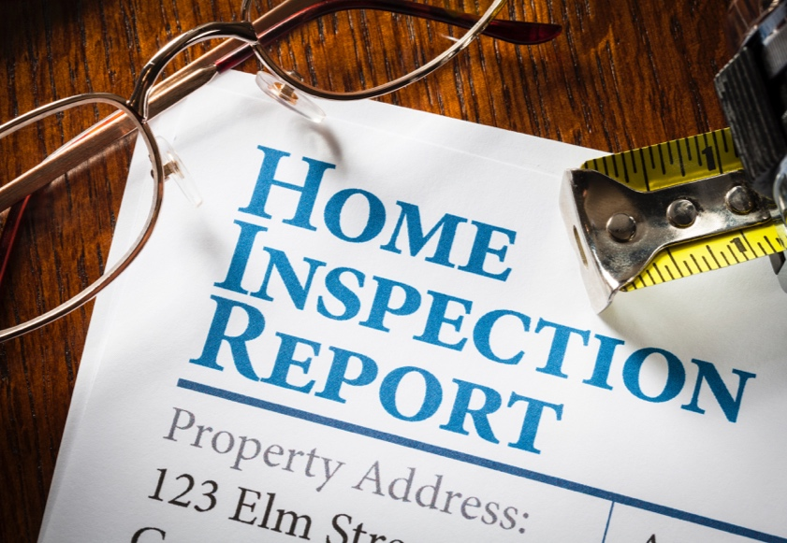
WHAT TO EXPECT WHEN HOME INSPECTING
So you made an offer, it was accepted, and now your next task is to have the home inspected prior to closing. More often than not, your agent may have made your offer contingent on a clean home inspection.
This contingency protects you in case the inspection reveals repairs that need to be made, or even if you need to walk away from the deal. Your agent can advise you on the best course of action once the report is filed.
How to Choose an Inspector
Your agent will most likely have a short list of inspectors that they have worked with in the past that they can recommend to you. Realtor.com suggests that you consider the following 5 areas when choosing the right home inspector for you:
Qualifications – Find out what’s included in your inspection & if the age or location of your home may warrant specific certifications or specialties.
Sample Reports – Ask for a sample inspection report so you can review how thoroughly they will be inspecting your dream home. The more detailed the report the better in most cases.
References – Do your homework – Ask for phone numbers and names of past clients that you can call to ask about their experience.
Memberships – Not all inspectors belong to a national or state association of home inspectors, and membership in one of these groups should not be the only way to evaluate your choice. Often membership in one of these organizations means that there is continued training and education provided.
Errors & Omission Insurance – Find out what the liability of the inspector or inspection company is once the inspection is over. The inspector is only human after all, and it is possible that they might miss something they should have seen.
Ask your inspector if it’s ok for you to tag along during the inspection. That way, they can point out anything that should be addressed or fixed.
Don’t be surprised to see your inspector climbing on the roof, crawling around in the attic, and on the floors. The job of the inspector is to protect your investment and find any issues with the home, including but not limited to: the roof, plumbing, electrical components, appliances, heating & air conditioning systems, ventilation, windows, the fireplace & chimney, the foundation & so much more!
Bottom Line
They say ‘ignorance is bliss,’ but not when investing your hard-earned money in a home of your own. Work with a professional you can trust to give you the most information possible about your new home so that you can make the most educated decision about your purchase.
19

Slide 20

HAVE YOU PUT ASIDE ENOUGH FOR
CLOSING COSTS?
There are many potential homebuyers, and even sellers, who believe that you need at least a 20% down payment in order to buy a home, or move on to their next home. Time after time, we have dispelled this myth by showing that there are many loan programs that allow you to put down as little as 3% (or 0% with a VA loan).
If you have saved up your down payment and are ready to start your home search, one other piece of the puzzle is to make sure that you have saved enough for your closing costs.
Freddie Mac defines closing costs as follows:
“Closing costs, also called settlement fees, will need to be paid when you obtain a mortgage. These are fees charged by people representing your purchase, including your lender, real estate agent, and other third parties involved in the transaction.
Closing costs are typically between 2 and 5% of your purchase price.”
We’ve recently heard from many first-time homebuyers that they wished that someone had let them know that closing costs could be so high. If you think about it, with a low down payment program, your closing costs could equal the amount that you saved for your down payment.
20

Slide 21

Here is a list of just some of the fees/costs that may be included in your closing costs, depending on where the home you wish to purchase is located:
Government recording costs
Appraisal fees
Credit report fees
Lender origination fees
Title services (insurance, search fees)
Tax service fees
Survey fees
Attorney fees
Underwriting fees
Is there any way to avoid paying closing costs?
Work with your lender and real estate agent to see if there are any ways to decrease or defer your closing costs. There are no-closing mortgages available, but they end up costing you more in the end with a higher interest rate, or by wrapping the closing costs into the total cost of the mortgage (meaning you’ll end up paying interest on your closing costs).
Home buyers can also negotiate with the seller over who pays these fees. Sometimes the seller will agree to assume the buyer’s closing fees in order to get the deal finalized.
Bottom Line
Speak with your lender and agent early and often to determine how much you’ll be responsible for at closing. Finding out you’ll need to come up with thousands of dollars right before closing is not a surprise anyone is ever looking forward to.
21

Slide 22



CONTACT ME TO TALK MORE
I’m sure you have questions and concerns…
I would love to talk with you more about what you read here, and help you on the path to buying a home. My contact information is below. I look forward to hearing from you!
Name
Company
Email Address
Website
(000) 000-0000
facebook.com/yourpage

