Slide 1
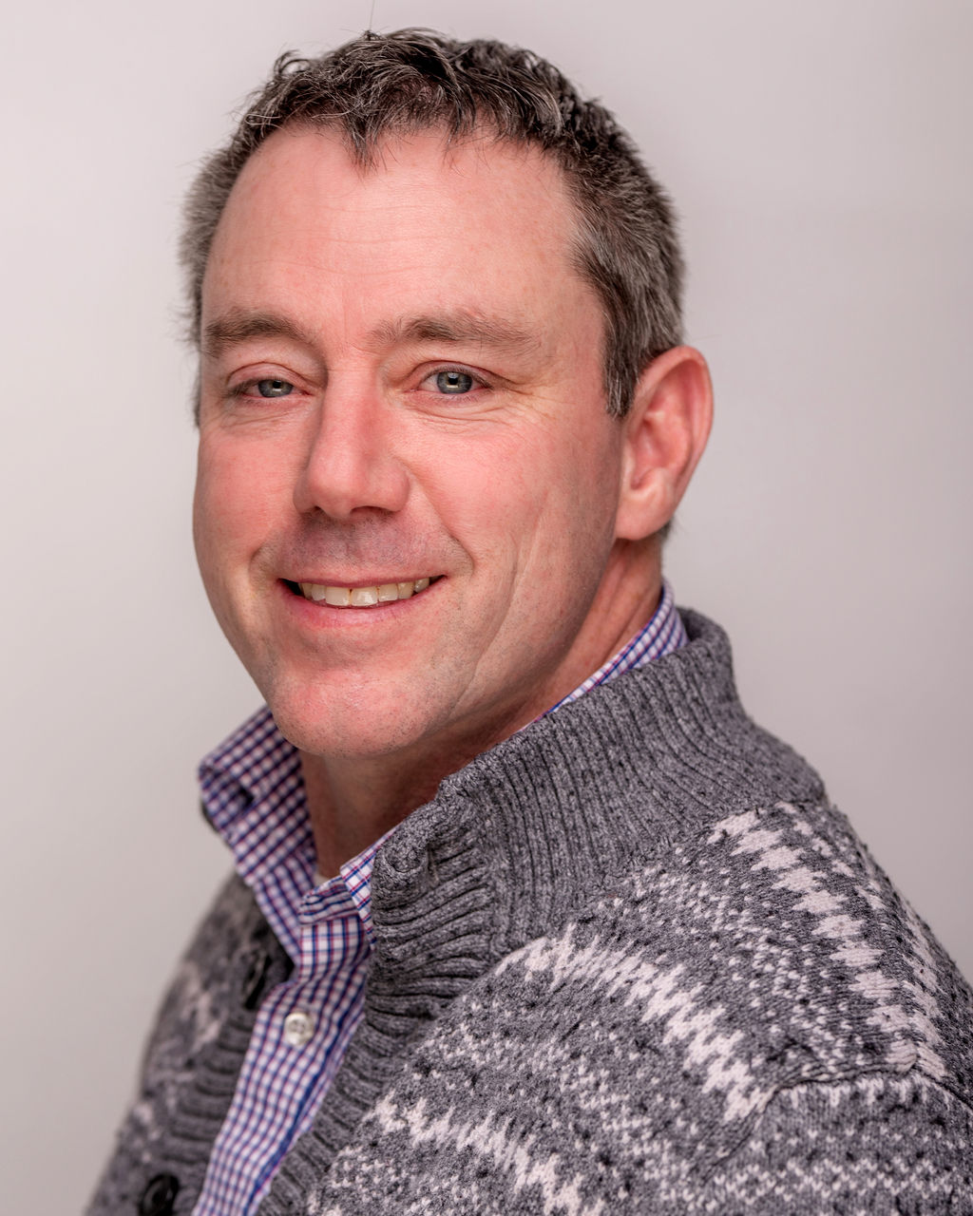
Your Buyer Presentation. Excited to help you. This will be Fun with moments of Stress.
“Helping you and giving to local Organizations is the Greatest Feeling I can Have”
“Served my Country now I want to serve my Community and to give back to others thru my Real Estate business.”

Slide 2
During my military career, I have been stationed around the world, and I understand the challenges and hardship of moving from one location to another location and buying and/or selling real estate. Rising to the rank of Navy Chief from a Navy Seaman, the principles of Honor, Courage, and Commitment were always there to guide me. While in the Navy, I may not have appreciated the gift of these principles, which humbled me at times and made me strong as well. The reinforcement of these principles throughout my career is part of what makes me who I am today. I am lucky to have been taught these principles, and I strive every day to live by these principles. I apply these principles as a Real Estate Broker to you. I will be fully committed to you!
Scott Hagues

Slide 3
ABOUT ME
Retired Navy Chief 21 YRS, 8 MTHS
Service Whidbey Island and surrounding areas
One Son
Enjoy the outdoors, landscaping , gardening , sports, cooking, art (drawing, photography and crafts), volunteering and my family.

Slide 4
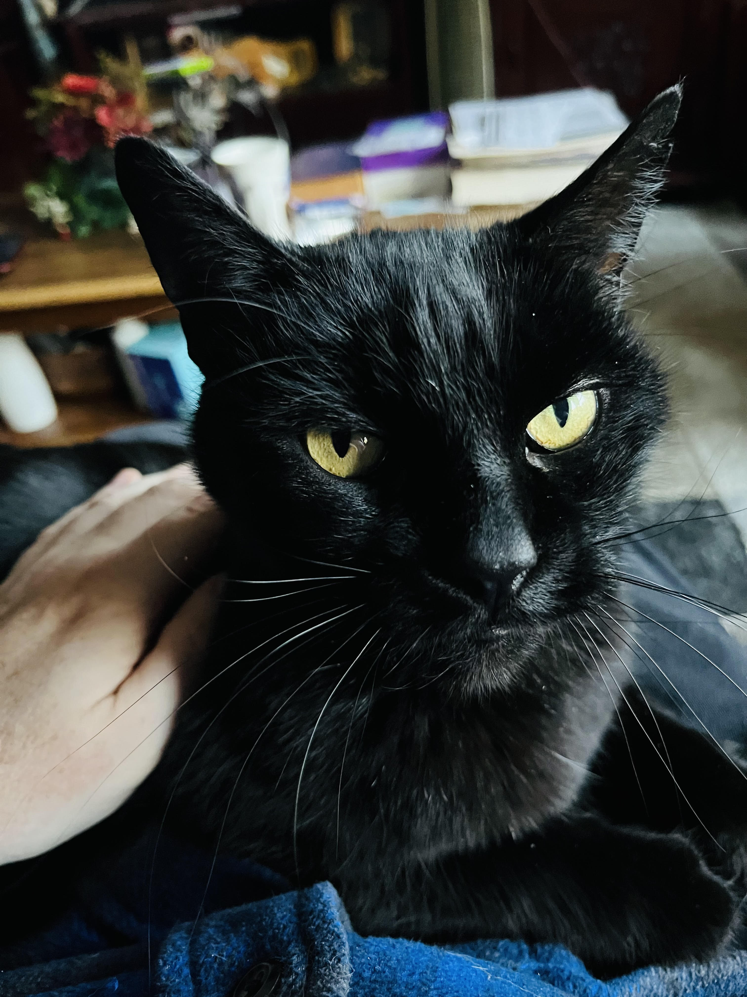
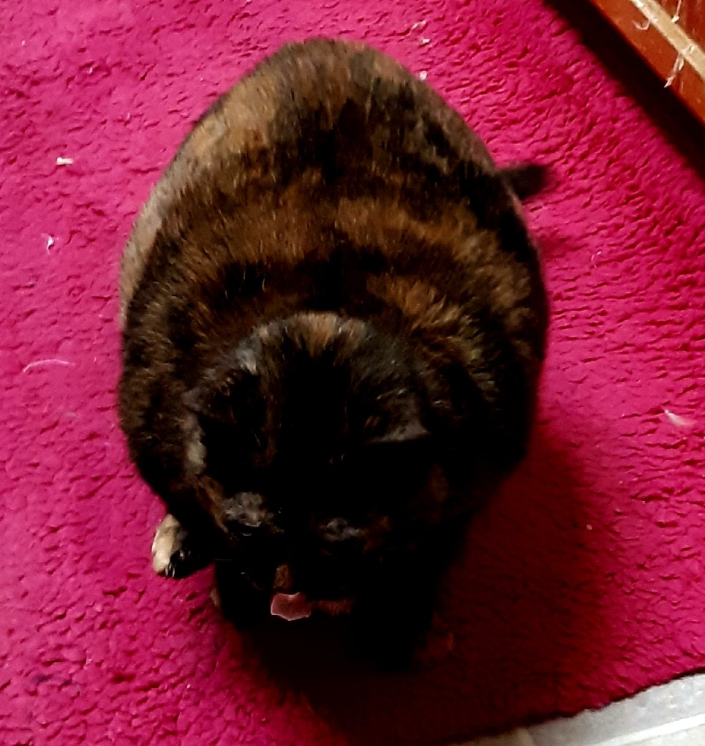
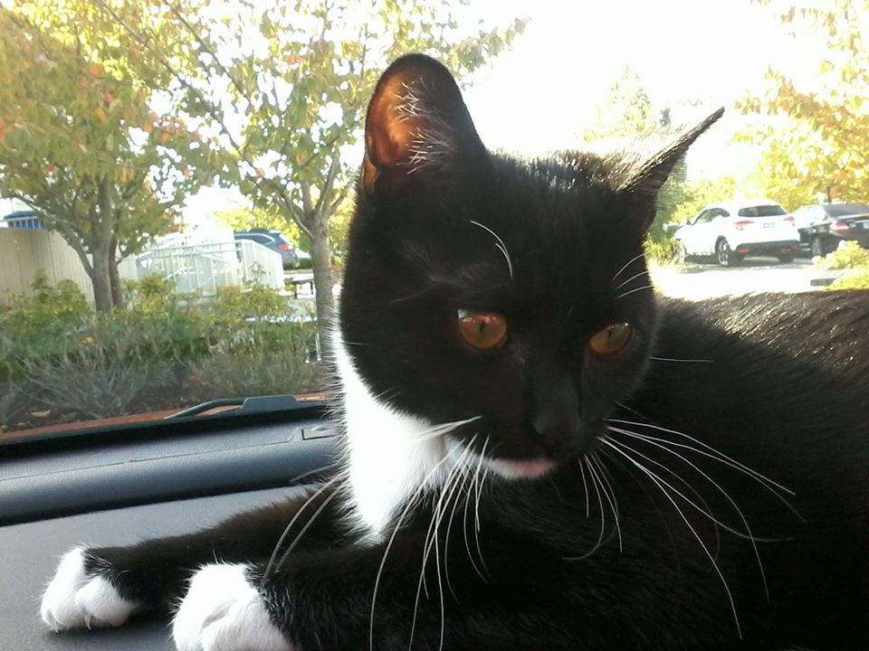
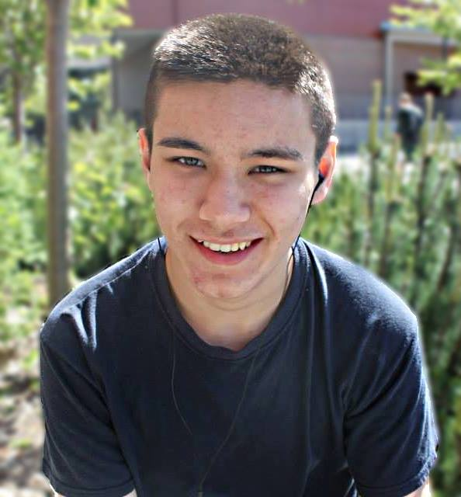
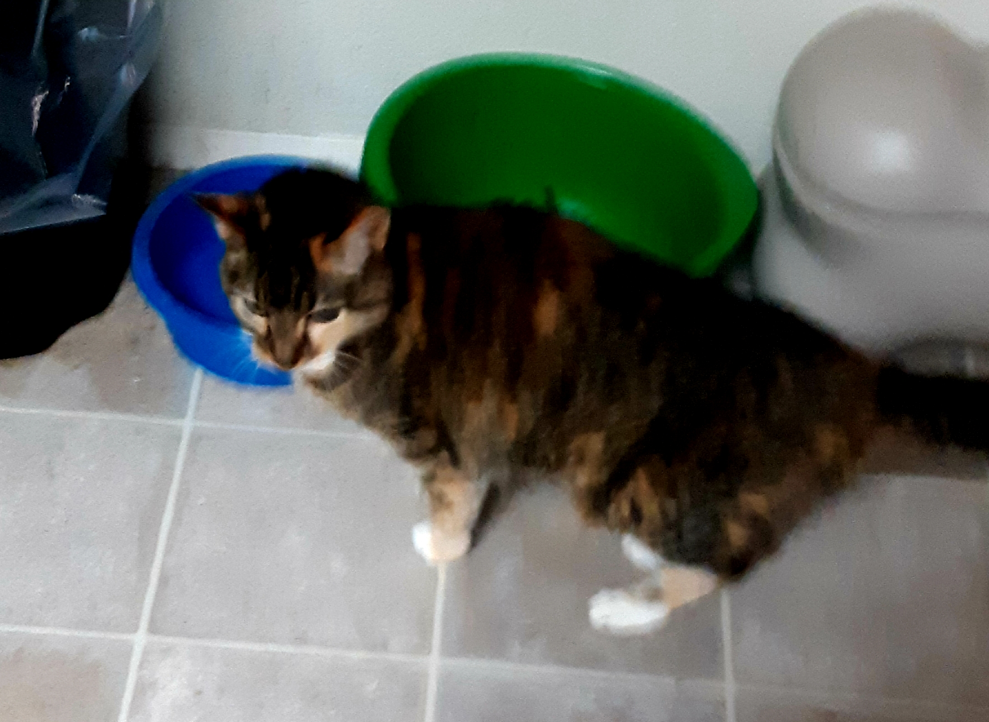
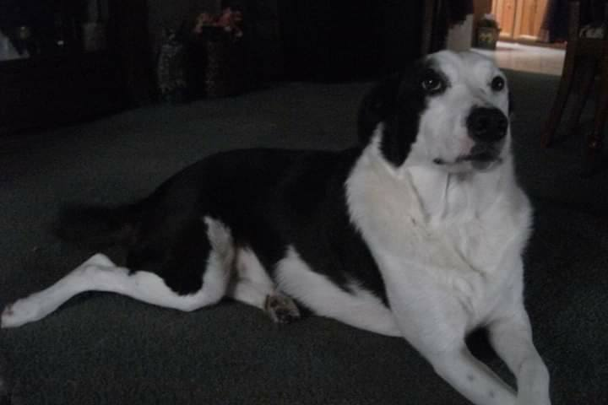
My family:

Slide 5
THE BUYER’S ROAD MAP
1
Meet With A Real Estate Professional
3
Search For Homes (in person and automated searches)
5
Negotiation And Contract
7
Final
Details
2
Get Pre-Approved
4
Make An Offer
6
Under Contract/In Escrow
8
Closing
Day

Slide 6
Being Ready to Buy!
Steady income
Low to medium debt
Cash for down payment/closing
Two months of pay stubs and bank statements
Two years with same company or in same industry

Slide 7
GETTING PRE-APPROVED (First Priority before anything else)
Choosing a lender
Filling out loan application
Approval document
Paystubs, bank statements, tax returns, proof of employment, 580+ credit score

Slide 8
YOUR HOME SEARCH
Understanding what you’re looking for is a top priority. Let’s talk about the features of your future home.
Location
Price
Square footage
Bedrooms
Baths
Style
Features
Schools

Slide 9
SEARCH TOOLS
AGENT
SEARCH
CUSTOMER
SEARCH
HIGH-TECH
TOOLS
MLS
Agent network
My website
Website
Yard signs, open houses, model homes, friends, FSBO
Automated home search system

Slide 10
MAKING AN OFFER
Falling in love with a home
Seller wants
Earnest money
Down payment/financed amount
Important dates
Inclusions in home
Offer will be accepted, counter-offered, or declined

Slide 11
WHEN YOUR OFFER IS ACCEPTED
Give earnest money to title company
Inspection and repairs
Appraisal
Home insurance
Finalize mortgage details
Final walkthrough

Slide 12
CLOSING COST BREAKDOWN
Property appraisal
Home inspection
Processing fee
Underwriting fee
Lender fee
Loan discount fee
Recording fee
Settlement officer fee
Title insurance
Document preparation fees
Escrow taxes and insurance
Prepaid interest
Credit report
Transfer taxes
Attorney/notary fee
(Warranty-I cover your basic warranty)
$

Slide 13
Resources
Inspectors……WIN Home Inspection (can get 18-month warranty with Residential Warranty Services Inc.)
Owner; Brian Fish
Phone; (360) 320-8133
Email; bfish@wini.com
Web Site; https://mountvernon.wini.com/
BNB Home Inspections
Owner; Brad Barbour
Phone; (360) 724-8180
Email; bradinspect@gmail.com
Web Site; http://bnbhomeinspections.com/
Higher Standards Home Inspection (Veteran Owned)
Owner; Terry Floyd
Phone; (360) 929-5334
Email; Hshipnw@gmail.com

Slide 14
Resources
Preferred Lenders…
Summit Funding
Loan Officer Robert Sanders
Phone: (360) 401-3338
Cell: (360) 720-3678
Email: robert.sanders@summitfunding.net
Web: https://summitfunding.net/sites/rsanders
Epic Finance LLC
Owner-Broker; Peter DeVries
Cell Phone; 360-791-8064
Fax; 877-352-2215
Email; PDeVries@EpicBroker.net

Slide 15
Preferred Lender cont.
Veterans United
(Team Effort with assigned loan officer from start to finish)
Phone: 855-258-3548
Web Site: www.veteransunited.com/
Bay Equity Home Loans
Dean Hayes
Phone: (360) 755-3689
Email: dean@deanhayes.com
Link- https://bayequityhomeloans.com/giving-to-heroes/hayes-hagues/

Slide 16
Resources
This is the big day! I’ll accompany you to closing, answer any questions, and verify the closing paperwork matches our purchase contract.
Bring your identification
Everyone who is purchasing the property must be present. If this is not possible, let me know in advance.
You will need to bring a certified check or wire your down payment/closing costs.

Slide 17
CONTACT INFORMATION
pinterest.com/HomeSmartScott/
360.969.5632
homesmartscotty@gmail.com
My Instagram
https://scotthagues.hsonerealty.com/
https://www.facebook.com/realtorScottHagues/

Slide 18
Lasting Thoughts
“Helping you and giving to local Organizations is the Greatest Feeling I can Have” ….Signed by Scott Hagues
“Served my Country and now I want to serve my Community, and I intend to give back to others thru my Real Estate business.” . ….Signed by Scott Hagues.

