Slide 1
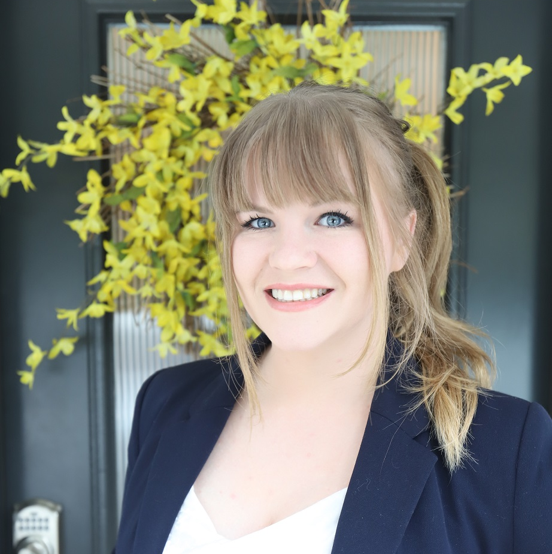
FINDING YOUR
NEW HOME
Amanda Taylor
Realtor | Washington State
360.271.3711
Amanda@meneesrealtygroup.com
Amanda.meneesrealtygroup.com
Menees Realty Group
5706 Bethel RD SE Suite 106
Port Orchard WA 98367

Slide 2
ABOUT ME
I was Born and raised in Kitsap County!
I am an Army Veteran, Combat Medic.
I am a Single mom to the best daughter who bought her own home in 2021 (Anything is possible! Let me help you!)
I participate in different community events with the goal to better the environment and community atmosphere!
Not only am I a Real Estate Broker for Menees Realty Group, but I am also:
The executive assistant for the owner Wanda Menees
The Office Manager For the company
I review all purchase and sale agreements and processes in the office working as a transaction coordinator
I am a full-time real estate broker, so you are my number one priority. I stay up to date with the market making sure to thoroughly research properties for you before we submit any offers. In 2021 I worked on over 70 transactions helping people buy and sell real estate
Amanda Taylor
Realtor | Washington State
Latest Review on Google
“Wanda and Amanda have gone to great lengths to help us find a house for our son, he has some very specific needs and they never gave up. They have created an excellent team of dedicated and trusted transaction coordinators, escrow, title partners, lenders, and service providers to make it all happen as smoothly as possible! On top of the professionalism, their just really nice people, I give them 5 stars but they really deserve more! I recommend them without hesitation.”

Slide 3
ABOUT Menees Realty Group
My firm is founded on the principles of Our Owner’s motto:
"There is a Destiny that makes us brothers, none goes his way alone, that which you send into the lives of others comes back into your own" - Edward Markham, Poet
The Owner Wanda Menees has worked as a Real Estate Broker for over 16 years specializing in helping my clients achieve the highest return on their investment when selling and finding the perfect home as a buyer. She also sits on the Board Of Commissioners
All our team members have worked in the customer service industry for a vast majority of their lives and have been in the Real Estate industry for a combined 30 years.
Our team goal is to find the perfect home AND the perfect location, depending on the needs of our clients. Many of our clients move from other areas and need expert local knowledge.
In addition to showing our clients homes, we educate them about the area they want to live in by introducing them to shopping, schools, recreation, and communities. We spend quality time with each of our clients and get to know them professionally, and as friends.

Slide 4
THE BUYER’S ROAD MAP
1
Get Pre-Approved
3
Search For Homes
5
Negotiation And Contract
7
Final
Details
2
Meet With A Real Estate Professional
4
Make An Offer
6
Under Contract/In Escrow
8
Closing
Day

Slide 5
ARE YOU READY TO BUY?
Steady income
Low to medium debt
Cash for down payment/closing
Two months of pay stubs and bank statements
Two years with same company or in same industry

Slide 6
GETTING PRE-APPROVED
Choosing a lender
Filling out loan application
Approval document
Paystubs, bank statements, tax returns, proof of employment, 580+ credit score

Slide 7
YOUR HOME SEARCH
Where do you want to buy property?
Do you have any pets? If so, Type and how many?
Have you bought a home in the past?
When are you wanting/needing to move into a new home by?
What are your MUST HAVES with a home?
What are your WANTS but not required with a home?
What do you need for parking/vehicle storage?

Slide 8
SEARCH TOOLS
AGENT
SEARCH
CUSTOMER
SEARCH
HIGH-TECH
TOOLS
MLS
Agent network
My website
Website
Yard signs, open houses, model homes, friends, FSBO
Automated home search system

Slide 9
MAKING AN OFFER
Falling in love with a home
Seller wants
Earnest money
Down payment/financed amount
Important dates
Inclusions in home
Offer will be accepted, counter-offered, or declined

Slide 10
WHEN YOUR OFFER IS ACCEPTED
Give earnest money to title company
Inspection and repairs
Appraisal
Home insurance
Finalize mortgage details
Final walkthrough

Slide 11
CLOSING COST BREAKDOWN
These are the items that will be included in your closing cost:
$
Property appraisal
Home inspection
Processing fee
Underwriting fee
Lender fee
Loan discount fee
Recording fee
Settlement officer fee
Title insurance
Document preparation fees
Escrow taxes and insurance
Prepaid interest
Credit report
Transfer taxes
Attorney/notary fee

Slide 12
CLOSING DAY
This is the big day! I’ll accompany you to closing, answer any questions, and verify the closing paperwork matches our purchase contract.
Bring your identification
Everyone who is purchasing the property must be present. If this is not possible, let me know in advance.
You will need to bring a certified check or wire your down payment/closing costs.
Amanda Taylor
Realtor | Washington State

Slide 13
CONTACT INFORMATION
Amanda Taylor
360-271-3711
Amanda@meneesrealtygroup.com
Amanda.meneesrealtygroup.com

