Slide 1
Joseph Rubeo
Lic. Associate Broker
C:(914) 804-3867
Email: joerubeo@kw.com
Website: joerubeo.kw.com
9 Bert Crawford Road Middletown, New York 10940
845.645.6065
Each Keller Williams Realty Office Is Independently Owned and Operated
Notes:
Cover Page. Update and customize the following items:
Your name, logo and market center logo
If you have a photo of your client’s home, you can include it here.
Your clients’ names and address
Your name, photo and contact information

Slide 2
YOUR NEEDS COME FIRST
Visualize your dream scenario for selling your home.
What's the one thing that has to happen to make that dream scenario a reality?
How can I make that happen for you?
Why is that important to you?
If we could add just one more thing to make this process even better, what would it be?
Why is that important to you?
And then, if we could add just one more thing to make this process even better than that, what would it be?
Why is that important to you?
Notes:
Your Needs Come First. This slide is designed to help you understand precisely what your clients need. Feel free to add anything other questions that will help you understand how to best serve them.

Slide 3
CLEAR COMMUNICATION
My real estate business is built on the concept of putting your needs first. And, an important part of that means that when you have a question or need support, I’m there.
When you choose to work with me, you can count on open and honest communication – in the frequency and medium (text, email, phone, etc.) you prefer.
Here’s how you can get in touch with me:
9 Bert Crawford Road Middletown, N.Y. 10940
(845) 610-6065 (O)
(914) 804-3867 (C)
Joerubeo@kw.com
www.joerubeo.kw.com
Notes:
Clear Communication
Update your contact information

Slide 4
AN INDUSTRY LEADER
When you work with me, you work with a trained agent with a proven track record that has the backing of the world’s largest real estate company, consisting of 180,000+ associates around the globe. That puts your listing within the largest real estate network with the furthest reach.
Keller Williams was built on a simple yet revolutionary principle: people are what matter most. To help cement this understanding, we’ve formalized a belief system that guides how we treat each other and how we do business.
Win-Win or no deal
Integrity do the right thing
Customers always come first
Commitment in all things
Communication seek first to understand
Creativity ideas before results
Teamwork together everyone achieves more
Trust starts with honesty
Success results through people
In 2017, Keller Williams was once again named the #1 TOP TRAINING ORGANIZATION in the world across all industries by Training magazine. In 2018, KW was inducted into the Training Hall of Fame. When you work with me, you directly benefit from this world-class training.
Notes:
An Industry Leader. This slide gives context around the benefit of working with Keller Williams Realty.

Slide 5
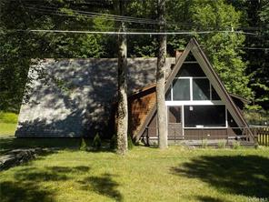
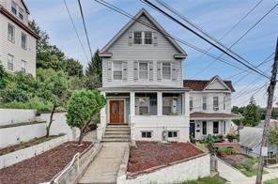
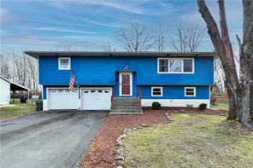
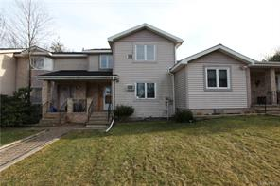
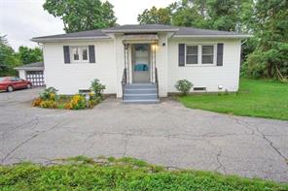
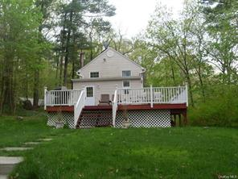
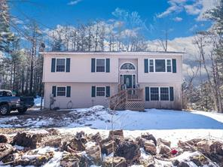
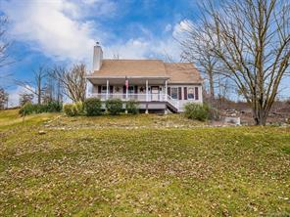
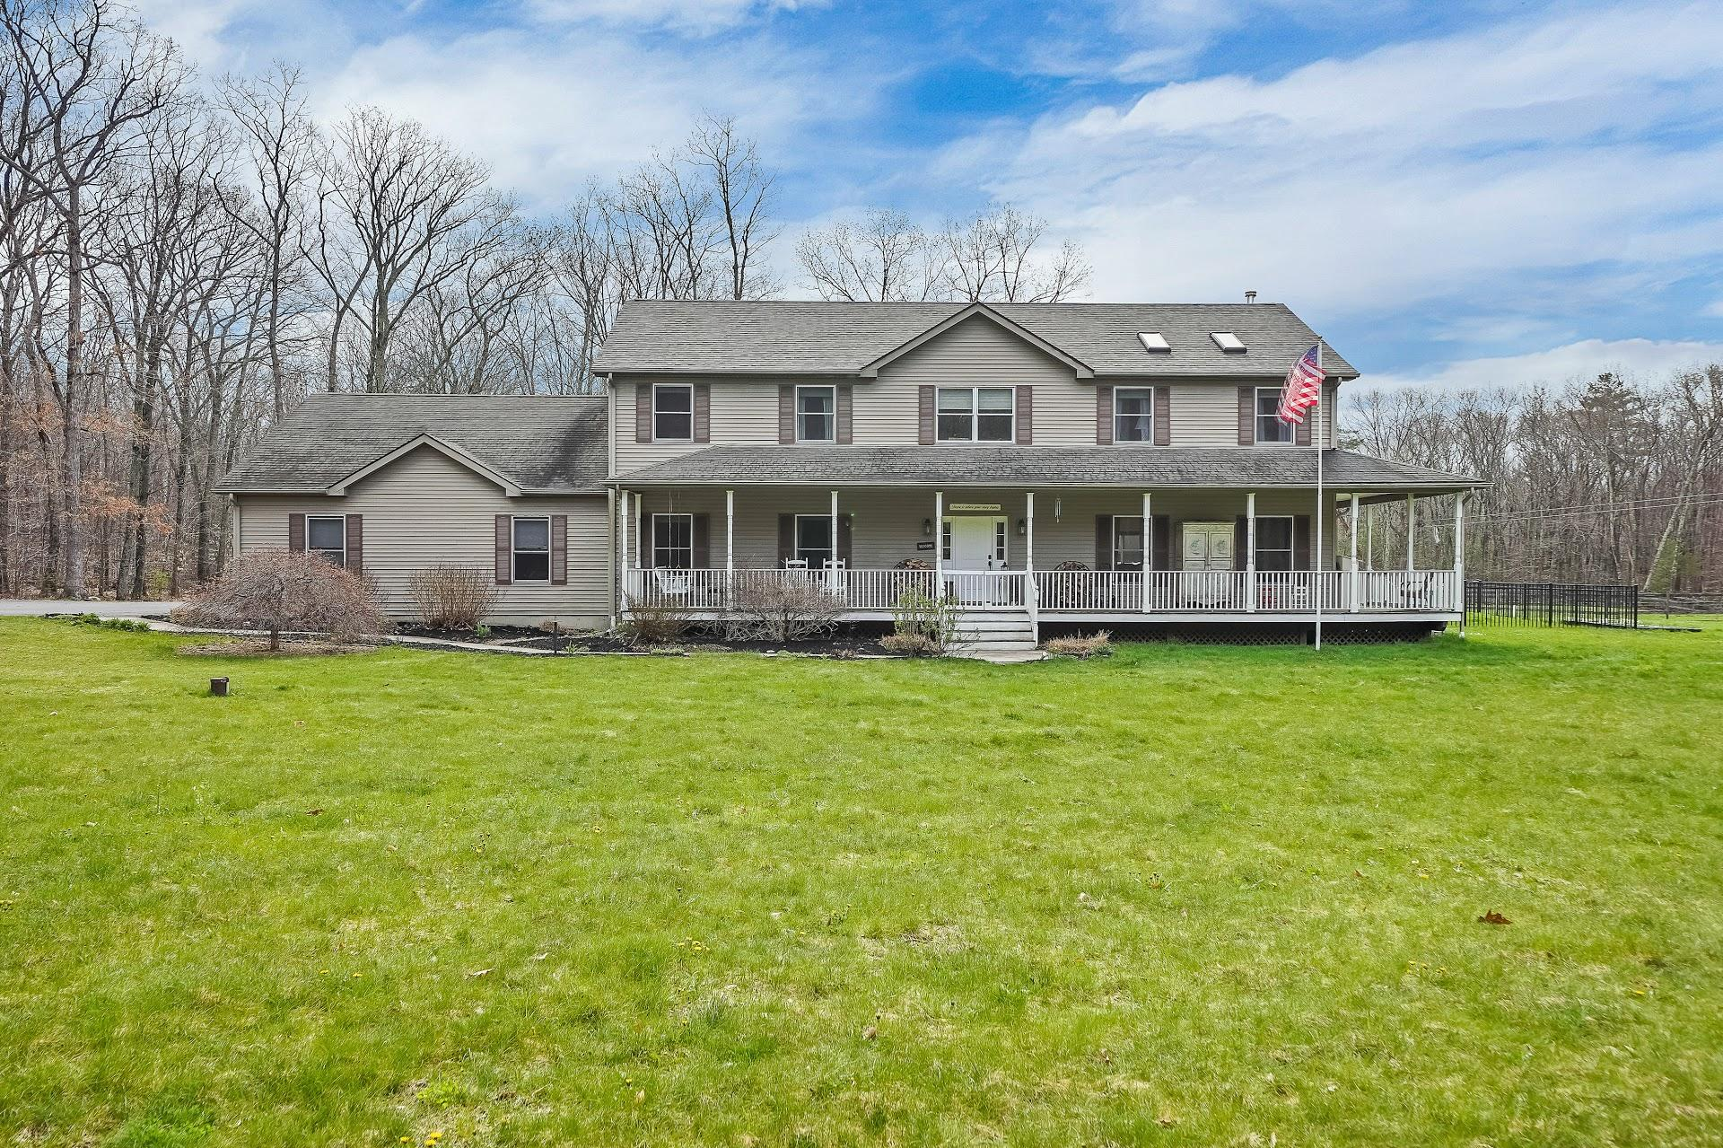
A PORTFOLIO OF EXCELLENCE
3 Forrest Park Place, Port Jervis
List: $185,000 /Sold: $170,000
Represented buyer
15 Crescent Place, Yonkers
List: $525000 / Sold $500,000
Represented buyer & seller
93 Winfred Ave, Yonkers NY
List: $690,000 /Sold $680,000
Represented buyer & seller
316 Lake Vue Drive, Montgomery
Price: $319,000 /Sold $320,000
Represented Buyer & Seller
359 Roosa Gap, Bloomingburg
List $235,000 /Sold $345,000
Represented seller & buyer
13 Deerfield Court, Rock Hill
Price 160,000 /Sold $155,000
Represented buyer
815 State Route 52 Walden
List 235,000 / Sold 226k
Represented buyer
29 Rumsey Rd Greenwood Lake
List: $275,000/ Sold: $245,000
Represented buyer
42 County Rt 48 Pine Bush
List: $219,900/Sold $219.900
Represented buyer
57 Ski Run Rd Bloomingburg
List$ $259,000/Sold $275,000
Represented buyer
477 Drexel Drive Pine Bush
List: $375,000 / Sold: $375,000
Represented buyer
416 Roosa Gap Bloomingburg
list 739,000 / Sold $725
Represented Seller & Buyer
more can be found on my website
Notes:
A Portfolio of Excellence. Use this slide to showcase your most successful listings.

Slide 6
THE PROCESS
The real estate transaction is complex – and navigating you through every step of the sale is my expertise.
Initial meeting, walk-through and needs analysis
Sign listing agreement
Prepare your property for sale: staging, photography, etc.
Launch “coming soon” marketing campaign
Establish a competitive price
Officially list your property
Launch “just listed” marketing campaign
Start showing your house and hold open house
Receive and present offers
Begin attorney review
Negotiate contract
Go under contract
Facilitate inspection process
Negotiate any issues
Oversee appraisal
Coordinate and prepare for further inspections
Final walk-through
Close!
Notes:
The Process. This slide presents the complexity of the real estate transaction and how you make it easier. If there are any adjustments you’d like to make, please feel free to add, delete or edit any of the steps.

Slide 7
YOUR CUSTOM MARKETING PLAN
Your home is unique – and so is the world-class marketing plan employed to sell it for top dollar.
Notes:
Your Custom Marketing Plan. This is the cover page to the marketing portion of the presentation.

Slide 8
FINDING YOUR BUYER
The savviest marketing plan is one that targets the channels buyers are already using to find homes. From optimized internet exposure to networking with local agents, I’ll work diligently to find your buyer as fast and efficiently as possible.
Notes:
How Buyers Find Their Home: This slide presents the latest data from the NAR Profile of Home Buyers and Sellers showing how the typical buyer finds the home they purchased.

Slide 9
YOUR CUSTOM MARKETING PLAN
Well-researched Pricing
Capturing the right price in any given market is one of the most critical elements in a successful real estate transaction. Correctly pricing your property means diligently studying the market to know what interested buyers are willing to pay and to price competitively within that range. This is what will position your house to stand out against other listings.
Captivating Staging
Staging is what creates a “wow factor” when a buyer walks through the door of your property. It’s what creates an emotional response and can often be an influence on whether or not an offer is made. From maximizing curb appeal to creating a clean and open interior, I will guide you on how to capture maximum buyer interest by highlighting the unique features of your house.
Eye-catching Yard Signs
Coming soon. For sale. Just sold. You have certainly seen these signs throughout your neighborhood – and their purpose is clear: to create excitement and interest around a listing. While much emphasis is placed on online advertisement these days, many buyers still look for their next home the old-fashioned way – by simply driving around their desired neighborhood. Professionally designed signage and property fliers will market your home 24/7 and capture attention from highly qualified buyers looking specifically in your area.
Open House Strategy
Whether or not an open house is where your buyer comes from, they serve a strategic purpose – aggregating interested buyers in a specific geographic area. By showcasing your property with an open house, or simply leveraging the leads generated at another nearby open house, we will create and target a highly-qualified, localized group of buyers.
Targeted Networking
In real estate it’s not only what you know, it’s who you know. As an active member in the real estate community and our community at large, I will market your listing to top agents and buyer specialists in the area, generating excitement and ensuring maximum exposure.
Your Listing, Amplified
When you list with me, we'll have access to the Keller Williams Listing System, or KWLS. This proprietary, exclusive system ensures your property is marketed online 24/7 through hundreds of the most popular search sites.
Notes:
Your Custom Marketing Plan. Read through each of the marketing activities and make sure that they are in line with what you offer. If there are any adjustments you’d like to make, please feel free to add, delete or edit any of the paragraphs.

Slide 10
YOUR CUSTOM MARKETING PLAN
Door-knocking
While online marketing is critical in today’s business environment, sometimes nothing beats grabbing a pair of comfortable shoes, some fliers, and pounding the pavement. You can rest assured that if selling your property quickly and for the best price possible requires knocking on a hundred doors, I’ll do it.
High-quality, Professional Photography
Crisp, clear photos will make your property pop online and maximize visual appeal. I work with highly qualified, professionally trained real estate photographers who specialize in making your house look its absolute best.
Engaging Videography
Video is at the heart of an effective digital marketing campaign and can provide a distinct advantage in a competitive market.
Best-in-class Print Marketing
From fliers to postcards to custom lookbooks, we’ll determine what professionally printed marketing pieces will move the needle to maximize the sale of your property.
Cutting-edge Digital Marketing
With nearly 44 percent of buyers starting their search online and 95 percent of buyers looking online at some point in their home search, mastering the digital space is a must. From Google AdWords to social media marketing to my SEO-optimized website and mobile search app, your listing will shine online. It is my goal to provide innovative digital marketing strategies to ensure the right buyers find your property and take action.
Effective Email Marketing
I maintain a database of approximately ### past clients, industry contacts and community influencers with whom I maintain regular communication with. Your listing will be blasted to these contacts, and any interest shown will be followed up with further, targeted communications.
Mass Mobile Marketing
When you choose to work with me, your home will be listed on my mobile app and will be put in the hands of millions of buyers!
Notes:
Your Custom Marketing Plan. Read through each of the marketing activities and make sure that they are in line with what you offer. If there are any adjustments you’d like to make, please feel free to add, delete or edit any of the paragraphs. Please be sure to customize the following:
Under “Effective Email Marketing” edit the first sentence to include the number of contacts in your database

Slide 11
THE PRICE IS RIGHT
When it comes to selling your house, the right price matters. Competitive pricing generates the most activity from buyers and agents, while a price that's too high can contribute to a longer stay on the market and, ultimately, a drop in price to compete with newer, well-priced listings.
A house that's priced at market value attracts the maximum amount of the market's potential buyers. Raise that asking price by just a bit above market value, and the percentage of potential buyers will decrease substantially.
Through my competitive market analysis, I'll help you find the pricing sweet spot for your home.
Notes:
The Price is Right. This slide addresses the importance of pricing a property. Feel free to add specifics regarding your pricing strategy.

Slide 12
YOUR OPEN HOUSE
Open houses have long played a crucial role in selling homes, but how can your home's open house be set apart from the rest?
Part of my comprehensive marketing plan includes creating an open house schedule to promote your property to prospective buyers and then systematically marketing it to the people most interested in homes like yours.
Here are a few ways I can market your open house to generate the maximum level of excitement around your home:
Placing a yard sign and directional signs on key corners, all with balloons and riders
Distributing fliers, email invites, and a website posting the week before the open house
Personally knocking on your neighbors' doors to invite them to attend and tell their friends
Getting on the phone the morning of the open house to remind everyone about attending
Scheduling other open houses in the area in various price ranges to attract the maximum amount of interested buyers
Notes:
Your Open House. This slide highlights the specific promotional plan around an open house. If there are any adjustments you’d like to make, please feel free to add, delete or edit any of the marketing activities listed.

Slide 13
A POWERFUL BARGAINING CHIP
Pricing your house right is paramount. So too is having an additional lever to pull when offers start rolling in.
As a Keller Williams agent, I have access to an unprecedented advantage – the ZeroPlus loan by Keller Mortgage. ZeroPlus means ZERO lender fees PLUS a $1,000 credit.*
Offered exclusively on transactions completed with me, this loan enables us to negotiate without compromising.
A WIN-WIN EXAMPLE
THE ZEROPLUS LOAN
Your buyer needs a loan and asks YOU to pay THEIR closing costs.
Instead of sacrificing your bottom line, we can provide your buyer an alternative solution:
WIN
Your buyer saves thousands of dollars*
$5,000 Saved
on a $250,000 Loan
$7,500 Saved
on a $500,000 Loan
$10,000 Saved
on a $750,000 Loan
WIN
You hold firm on your selling price!
*One percent in lender’s fees + earns a $1,000 credit
The loan amount must be at least $150,000 to qualify for the $1,000 credit.
Notes:
A Powerful Bargaining Chip. This slide presents the benefits of Keller Mortgage. Check here to see if Keller Mortgage is available in your area.

Slide 14
YOUR CUSTOM MARKETING PLAN
Coming soon campaign
Walk-through and needs analysis
Professional photography and videography
Professional yard signage
“Coming soon” email blast to database of ###
“Coming soon” social media touch on Twitter, Instagram, and Facebook
“Coming soon” callout campaign to highly qualified buyers
Just listed campaign
Launch listing on KWLS, MLS and other syndication websites
Professional yard signage and takeaway fliers
“Just listed” email blast to database of ###
Custom landing webpage and funnel campaign promoting open house
“Just listed” social media video on Twitter, Instagram, and Facebook
“Just listed” callout campaign to highly qualified buyers
Open house three days after listing
Just sold campaign
“Just sold” yard signage
“Just sold” email, social, and digital touches
Notes:
Your Custom Marketing Plan. Fill this page out with the specific marketing plan that you have in mind for your client. Make sure to update ‘###’ to the specific number of contacts you have in your database.

Slide 15
YOUR TRUSTED PARTNER
He is the first person to speak with me and he direct what to do to buy my first home.He always show up on time when I need to see a house.Not only show up on time but also direct me everything to get a home.
07/13/2021 - naingwinaung36682
Joe is a motivated, professional who has gone above and beyond in customer service. We experienced several ups and downs as sellers and renters. Joe remained calm and helped us do the same. There were several special "jobs," we requested and the answer was "YES I can do that." Thank you Joe for renewing our faith in realtors!
07/15/2021 - tausk22
I have known Joe Rubeo for well over a year now and met him for a different reason other then real estate. When I needed a real estate agent, he was there for me. His patience, knowledge of his career, attentiveness to my questions and his ability to really see what my vision was are all qualities that would make me recommend him to anyone. Joe is a phenomenal real estate agent and I am very happy I trusted him to help me through both the sale of one home and the purchase of another.
04/10/2021 - joseph j buchell
Joe was amazing to work with. He was very determined to find my family the right home and was on top of every milestone along the way. For buying our 1st home. Joe definitely made the process smooth and took so much stress away. My family and I are in our forever home and can’t thank joe enough! Highly recommend him as an agent!
03/23/2021 - heubachnicole93
Notes:
Your Trusted Partner. Fill this page out with all of the glowing reviews from your past clients!

Slide 16
To serve the community as a leader in the real estate industry and as a friend and neighbor
To always do the right thing, even if it isn’t what is easiest
To take care of your needs at the highest level through unparalleled professionalism and attention to detail. No request is too small
To serve as a trusted local expert and adviser by your side
To consistently and clearly communicate with you in the manner and frequency that you prefer
To treat you and your family with straightforwardness, integrity, and respect at all times
To answer your questions, ease your concerns, reduce your stress, and expertly handle the entire real estate transaction from listing to closing and beyond
To hold myself accountable to selling your home for top dollar – after all, that is what my business is built on
A PROMISE
Notes:
A Promise. This slide serves to highlight your value proposition and your promise of serve. Feel free to customize it as you see fit.

Slide 17
THE BOTTOM LINE
Real estate is complicated.
That’s where I come in.
At the closing table, my goal is for you to feel that the experience of selling your home exceeded all your expectations, so throughout all of our interactions – from listing to closing – I will work hard to achieve that goal.
When you choose me as your partner, you are not just getting a trusted, respected agent – you are getting a local expert who is passionate about serving our community and those who call it home.
Let’s get started.
Notes:
The Bottom Line. This is your final push! Feel free to customize this slide specific to your business, market and client.

