Slide 1
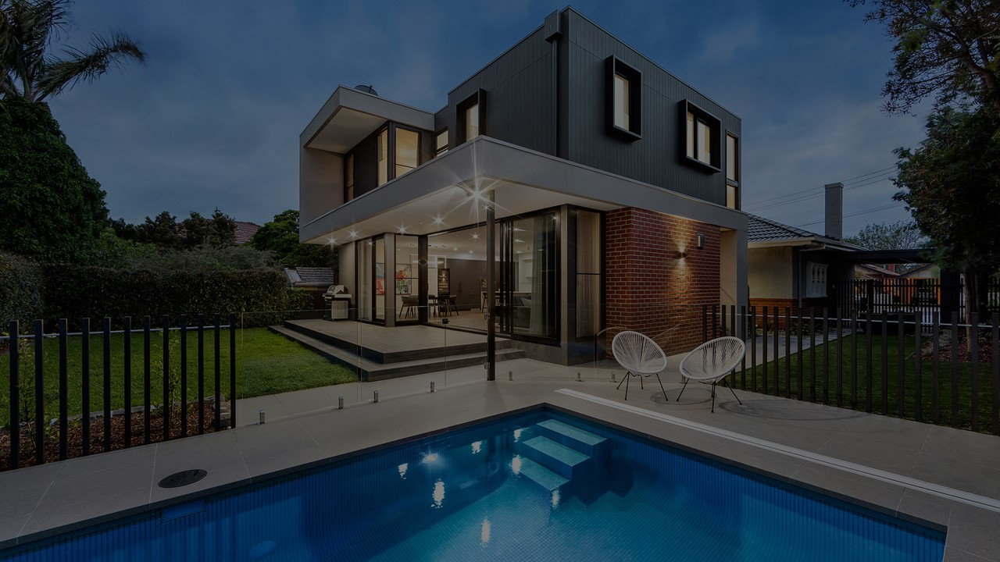
Your Listing Deserves More Than the Usual!

Slide 2
In 2020 consumer research suggested that at least 78% of all U.S. households used streaming TV devices like Roku, Amazon Fire TV, Apple TV, etc. It’s estimated that number to be around 232 million people. This number has been growing each year. List with me and I will feature your property on Roku, Amazon Fire TV, Apple TV, and Android/Google TV. How?

Slide 3
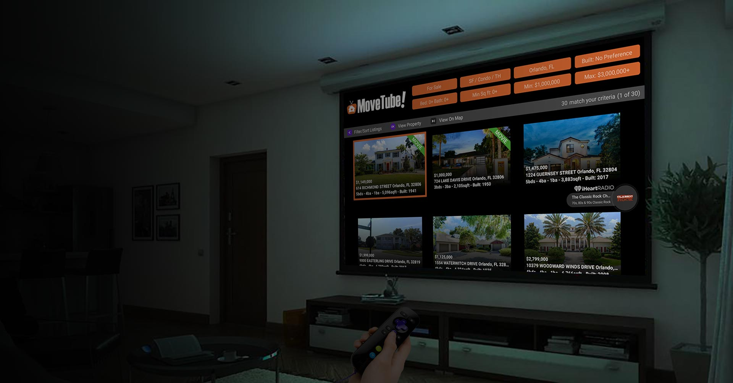
MoveTube® is the only interactive national real estate search portal available on all the popular streaming television devices. Why Consumers are preferring it over real estate website portals and mobile apps:
“Once we found MoveTube on Roku we stopped using Zillow. When we got used to the large photos on our 70 inch 4K TV screen we didn’t want to go back to using the phone or PC. Our home search is now a family entertainment event.” Tim Jensen
“We like this much better than real estate mobile apps or websites because the photos are much bigger on the TV. We can also do house search as a family now. The background music is so relaxing and house hunting is actually fun with this.”. Angela Schick
Music feature powered by
© 2022 iHeartMedia, Inc.

Slide 4
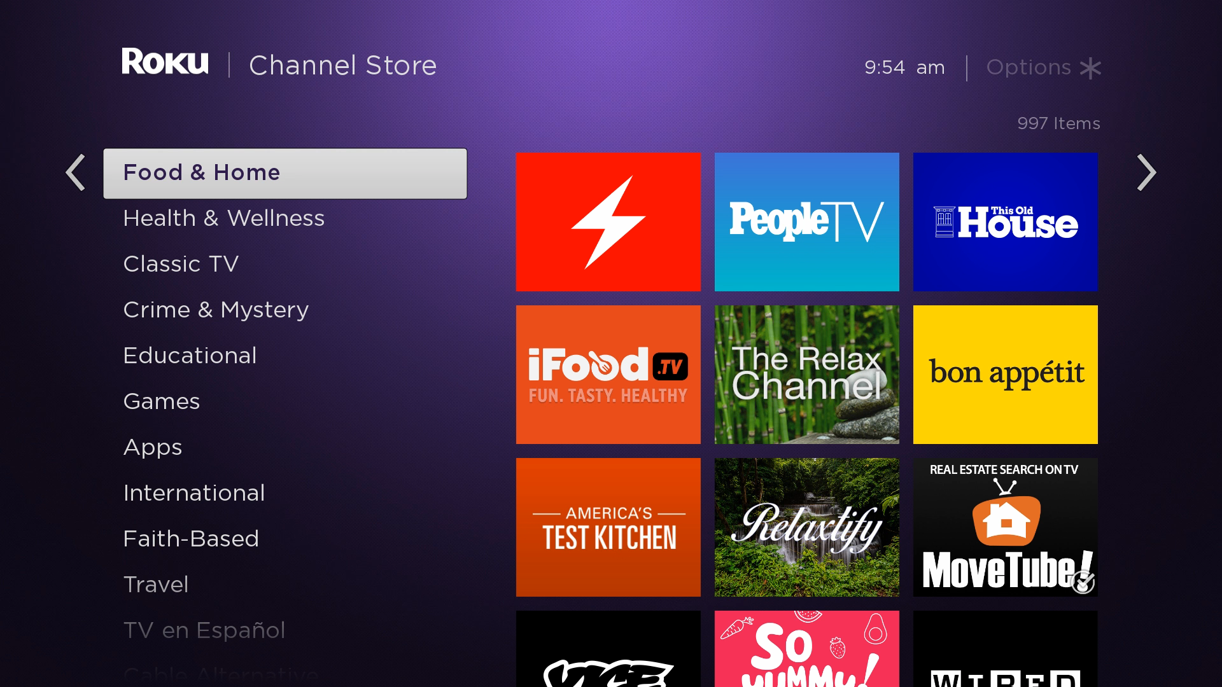
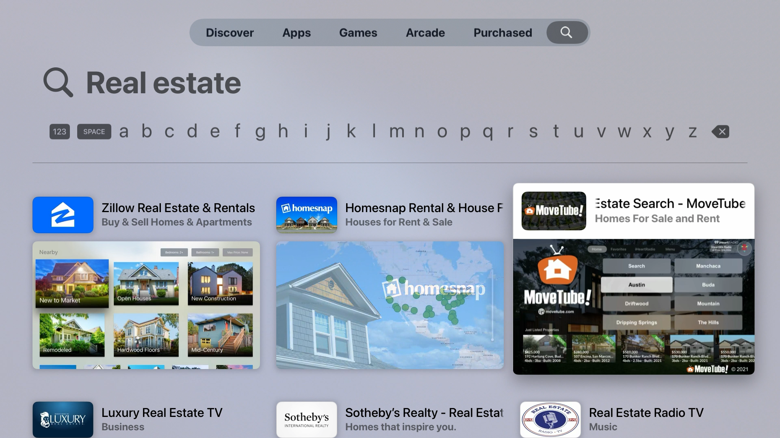
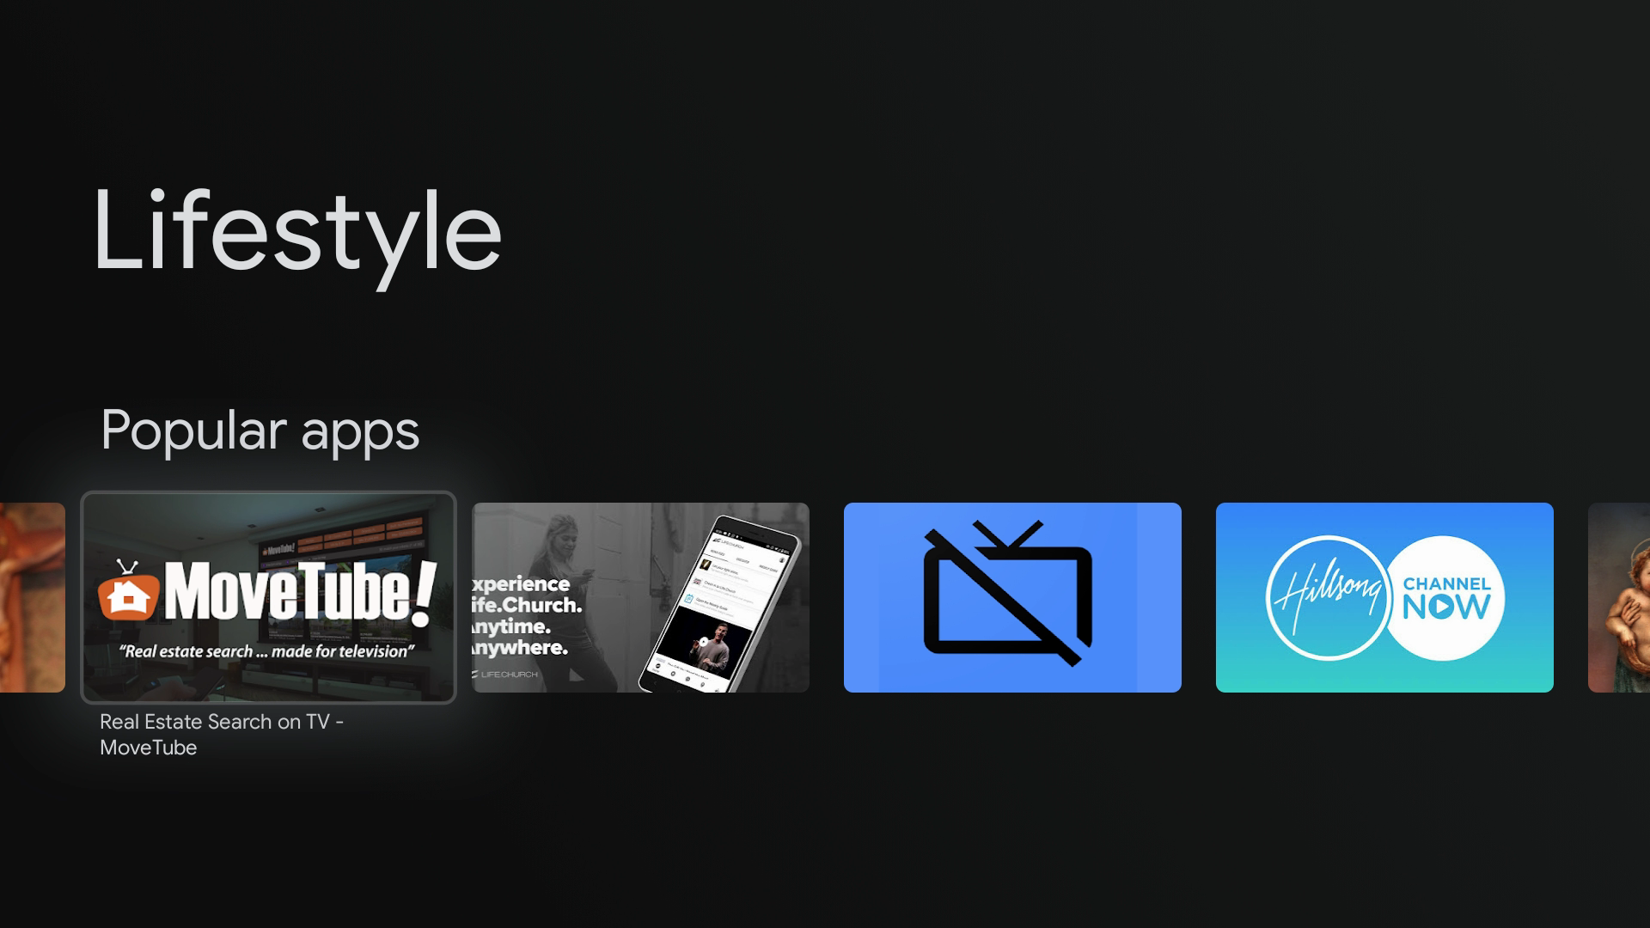
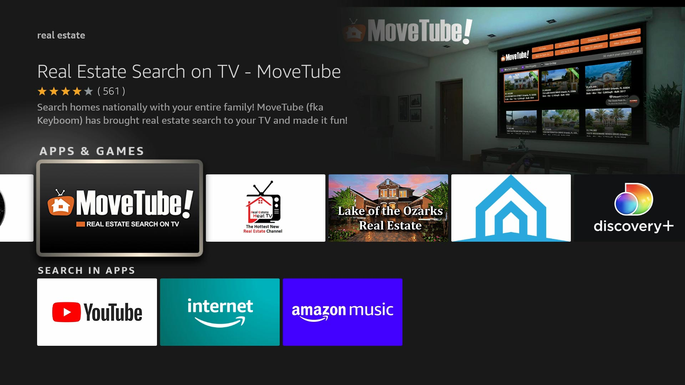
Where consumers are finding MoveTube on streaming television.
Roku: Always in the top 10 of its channel category and the only national real estate search app on Roku. Roku is the most popular TV device.
Apple TV: The highest rated real estate search app on Apple TV. Apple TV is very popular with iPhone and Mac users.
Google/Android TV: The only interactive national real estate search app
on this platform. Android TV is being built into many televisions today.
Amazon Fire: The only interactive national real estate search app on this platform. Amazon Fire TV is the second most popular device behind Roku.

Slide 5
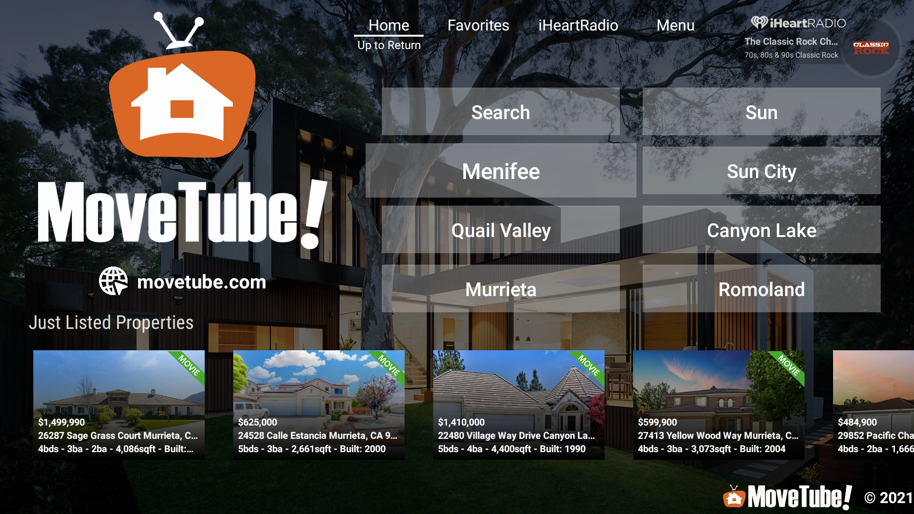
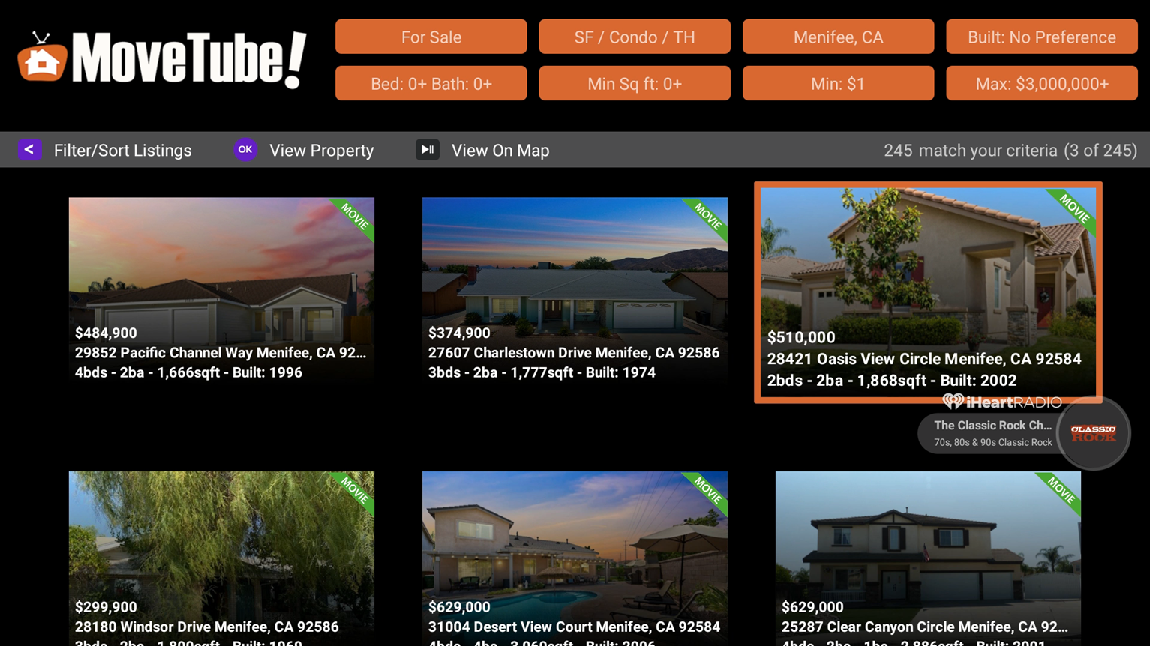
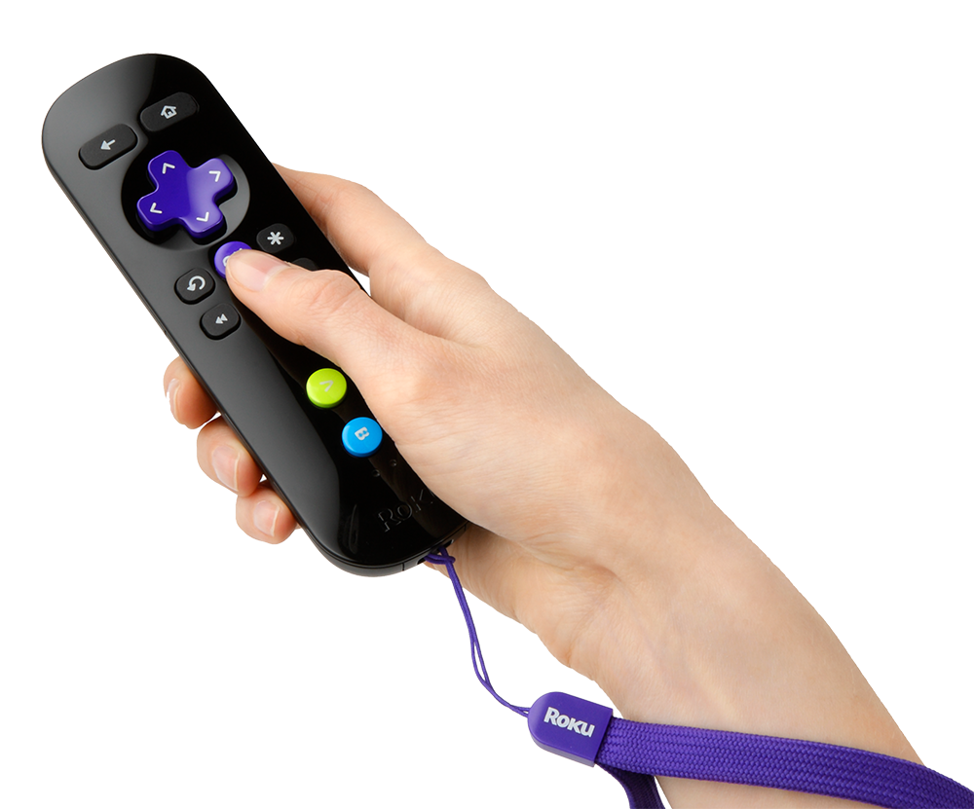
Your listing will get premier placement and will be enhanced with a “movie” on MoveTube. It will also appear on the home screen in the “Just Listed” area of people searching your location.

Slide 6
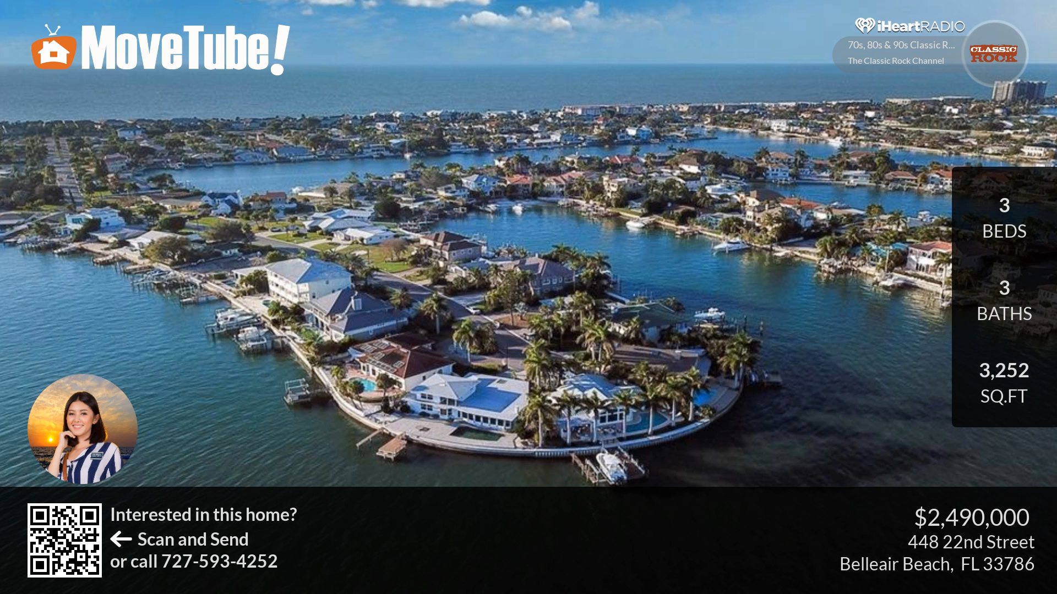
Your listing will also be featured in the screensaver that appears for when a user goes into screensaver mode. This is a very popular feature of MoveTube!

Slide 7
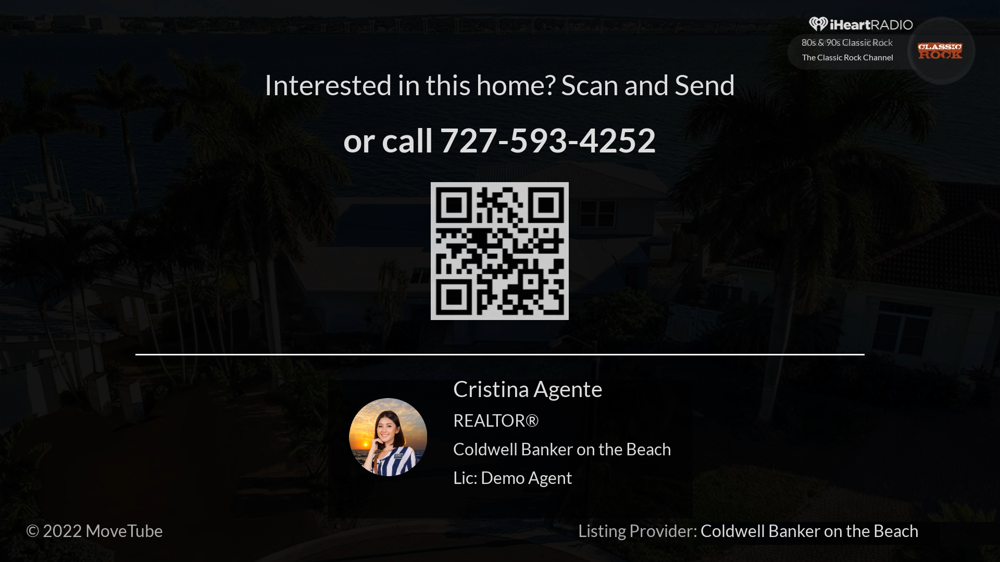
At the end of your movie and screensaver segment my contact information appears. This is so that an interested buyer can easily inquire on your property.

Slide 8
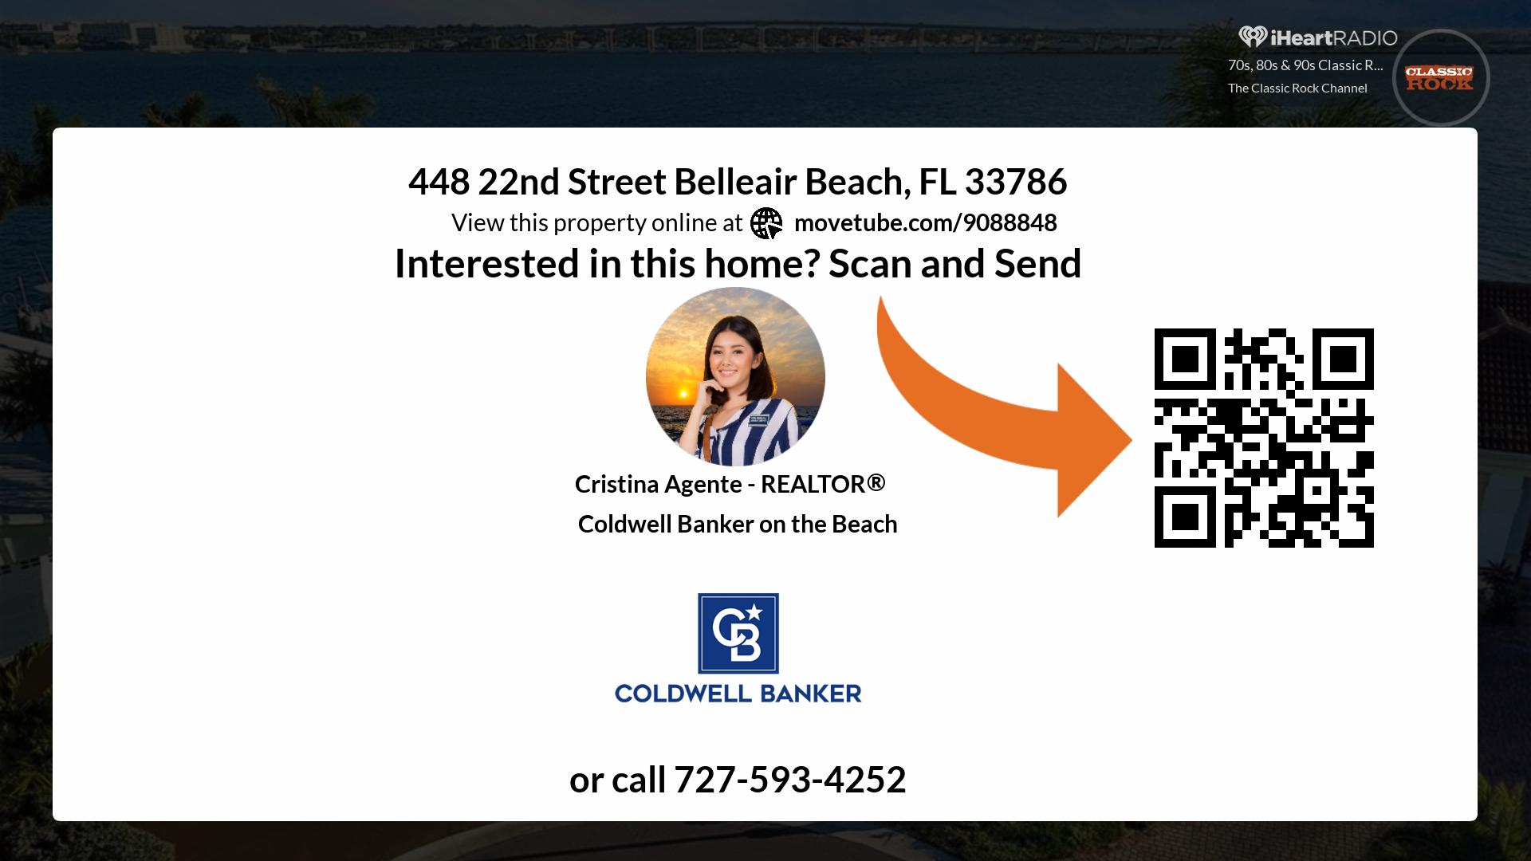
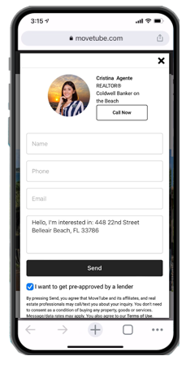
If a MoveTube viewer is interested in your property, they can send it right to their phone by scanning the QR code.

Slide 9
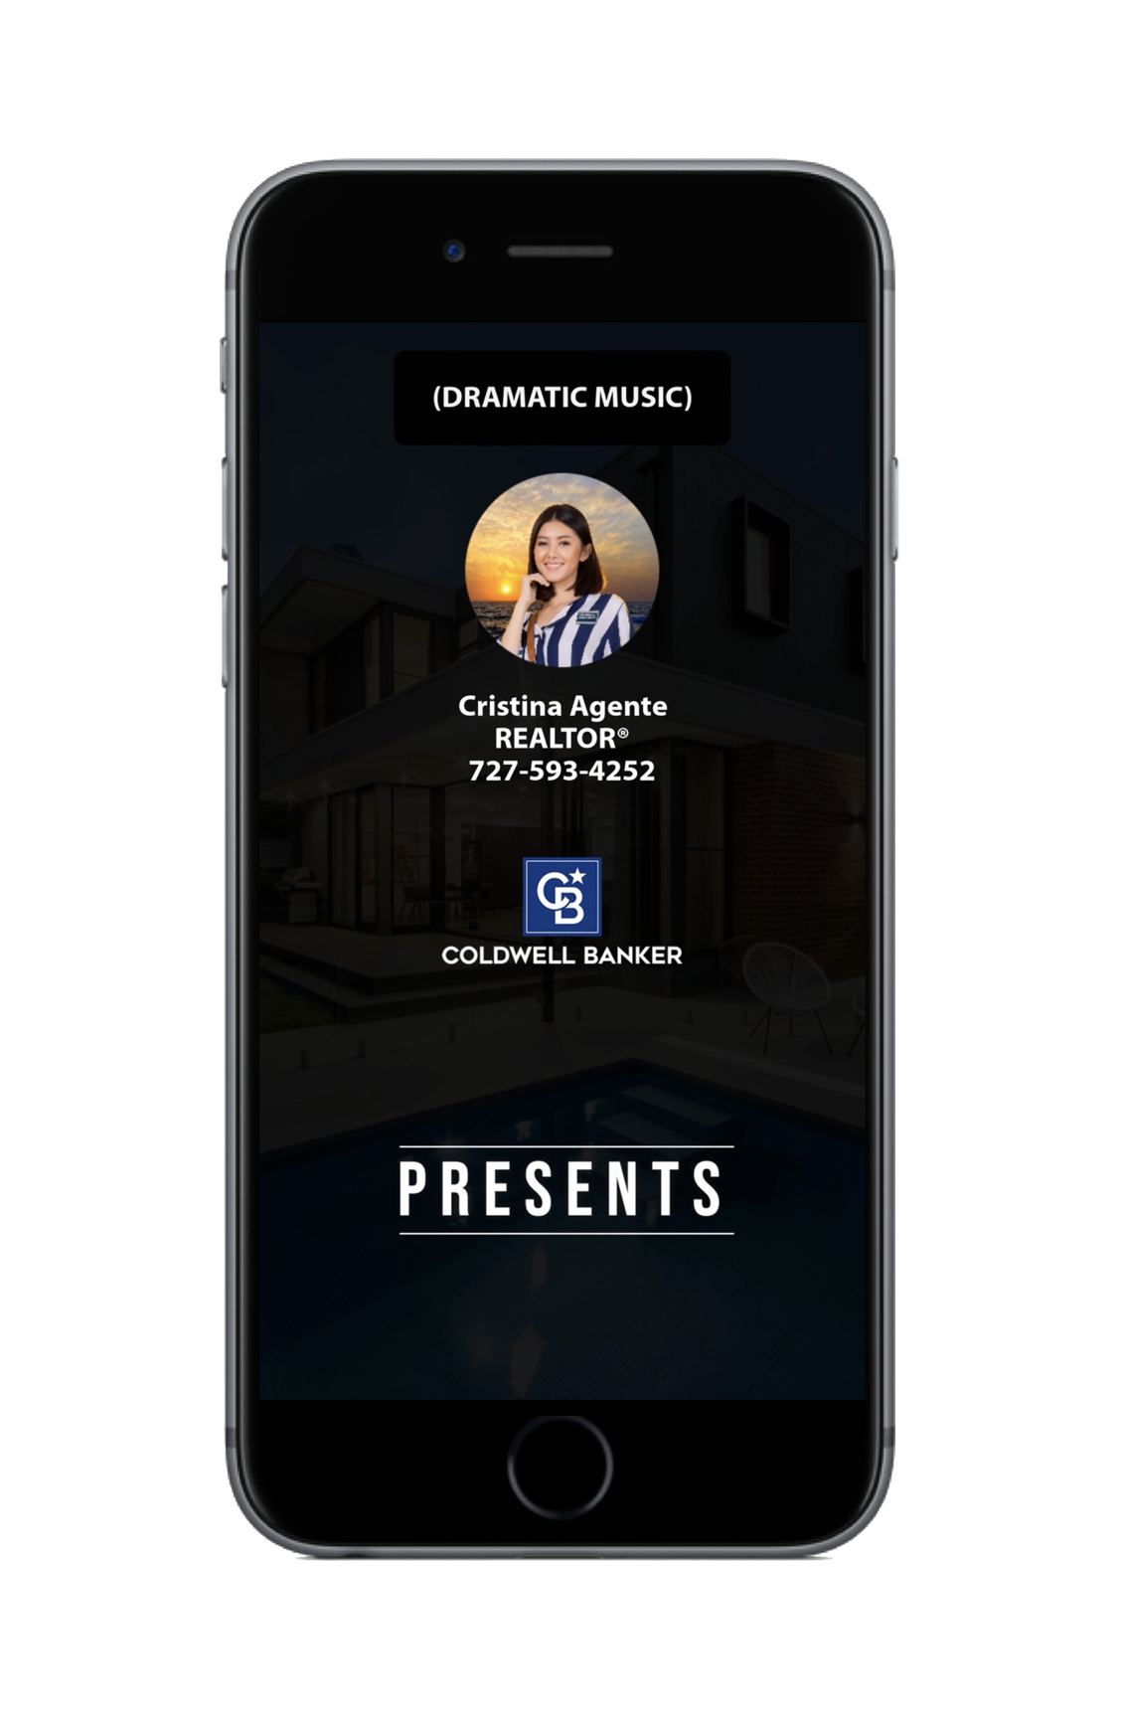
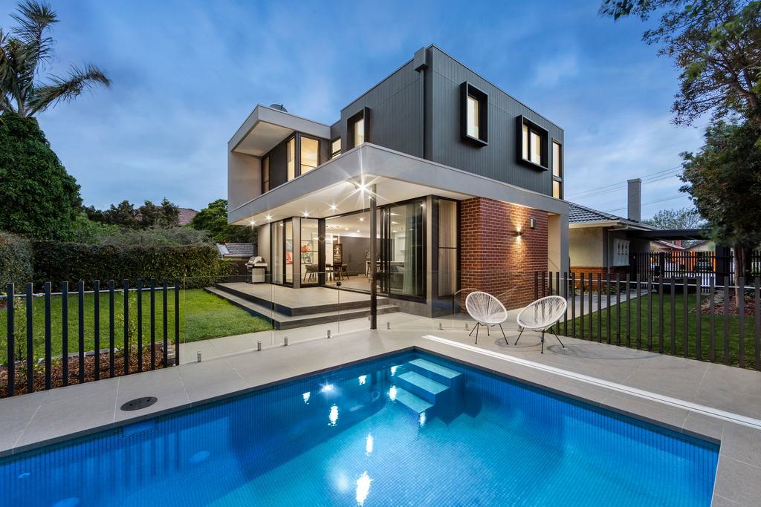
Once it’s live, I will announce your new listing with a Hollywood style 30 second “Trailer” with “movie trailer guy” narration and cinematic music. This is designed for platforms like TikTok, Facebook, and Instagram. You will be able to share it as well on social media. It’s an attention grabber! It’s also a fun/unique way to let everyone know that your property is on the market and television!

Slide 10
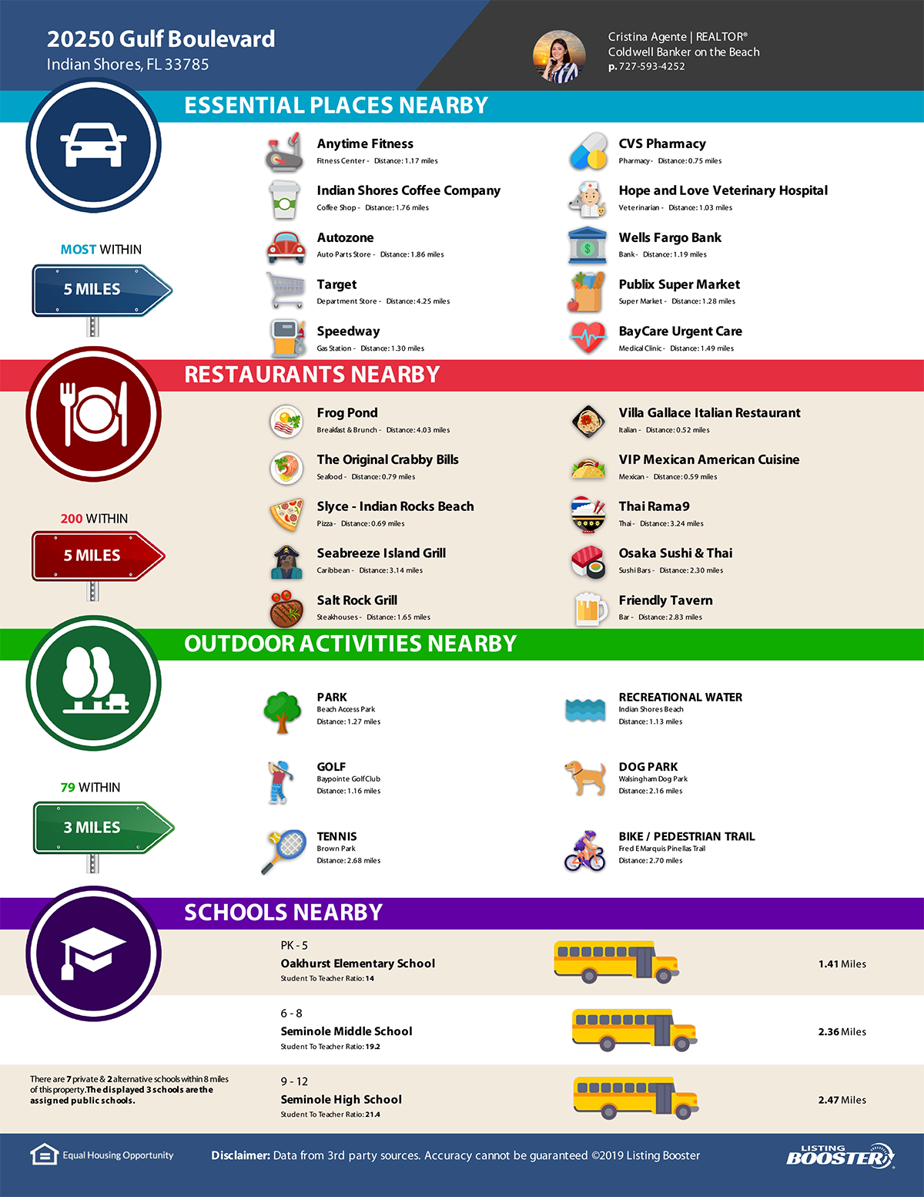
I will create and publish "Just Listed", "Open House", and "Sold" digital and print flyers. These contain local data that makes your listing stand out. These can be shared on social media and printed.

Slide 11
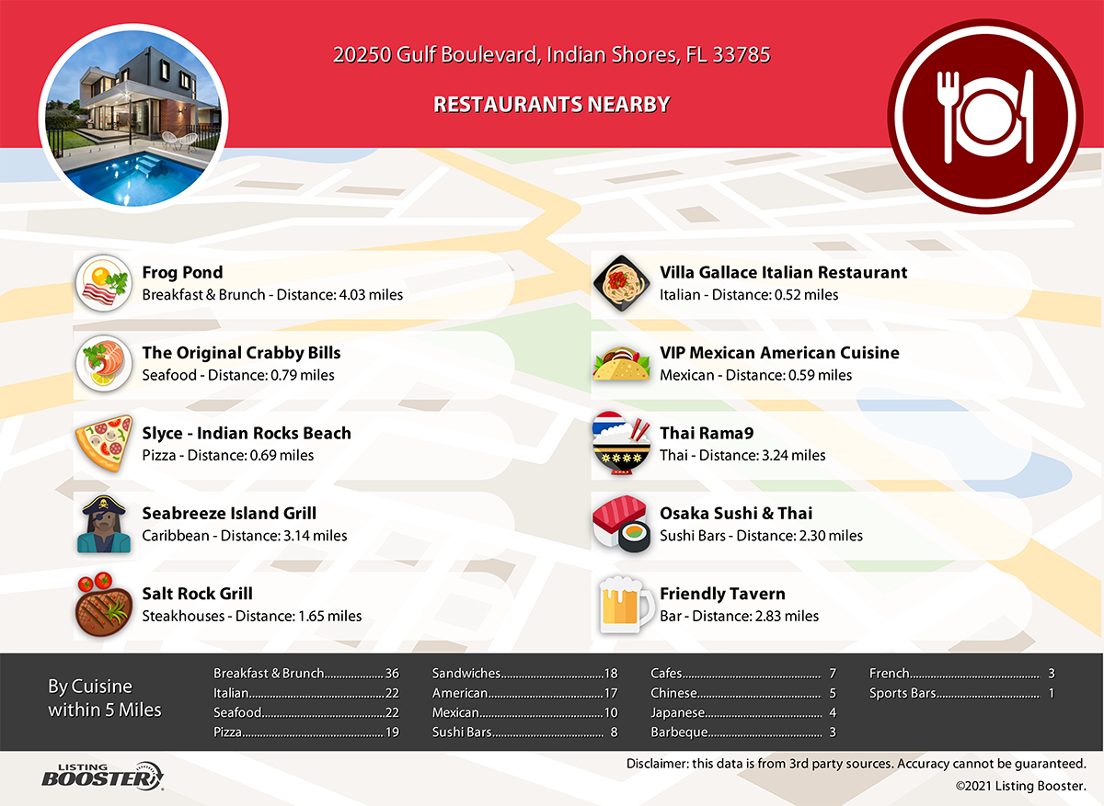
I will also create social media shareable digital property reports. These are designed to not only sell your property, but also the area which is equally as important to most buyers. We can feature all of your favorite places. What’s your 10 favorite restaurants nearby?

Slide 12
Is it becoming obvious that I am aware that social media is huge? Image there is everything. I’ll make sure that your property is featured in our social sphere with my arsenal of professional quality social media images.

Slide 13
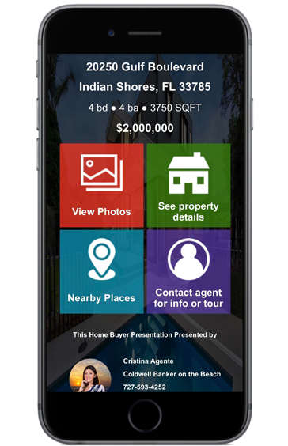
Your listing will also receive a dedicated SMS code that we add to all of our digital ads and sign riders. Perfect for instantly delivering listing data to prospects allowing us to capture their contact info so we can call them!

Slide 14
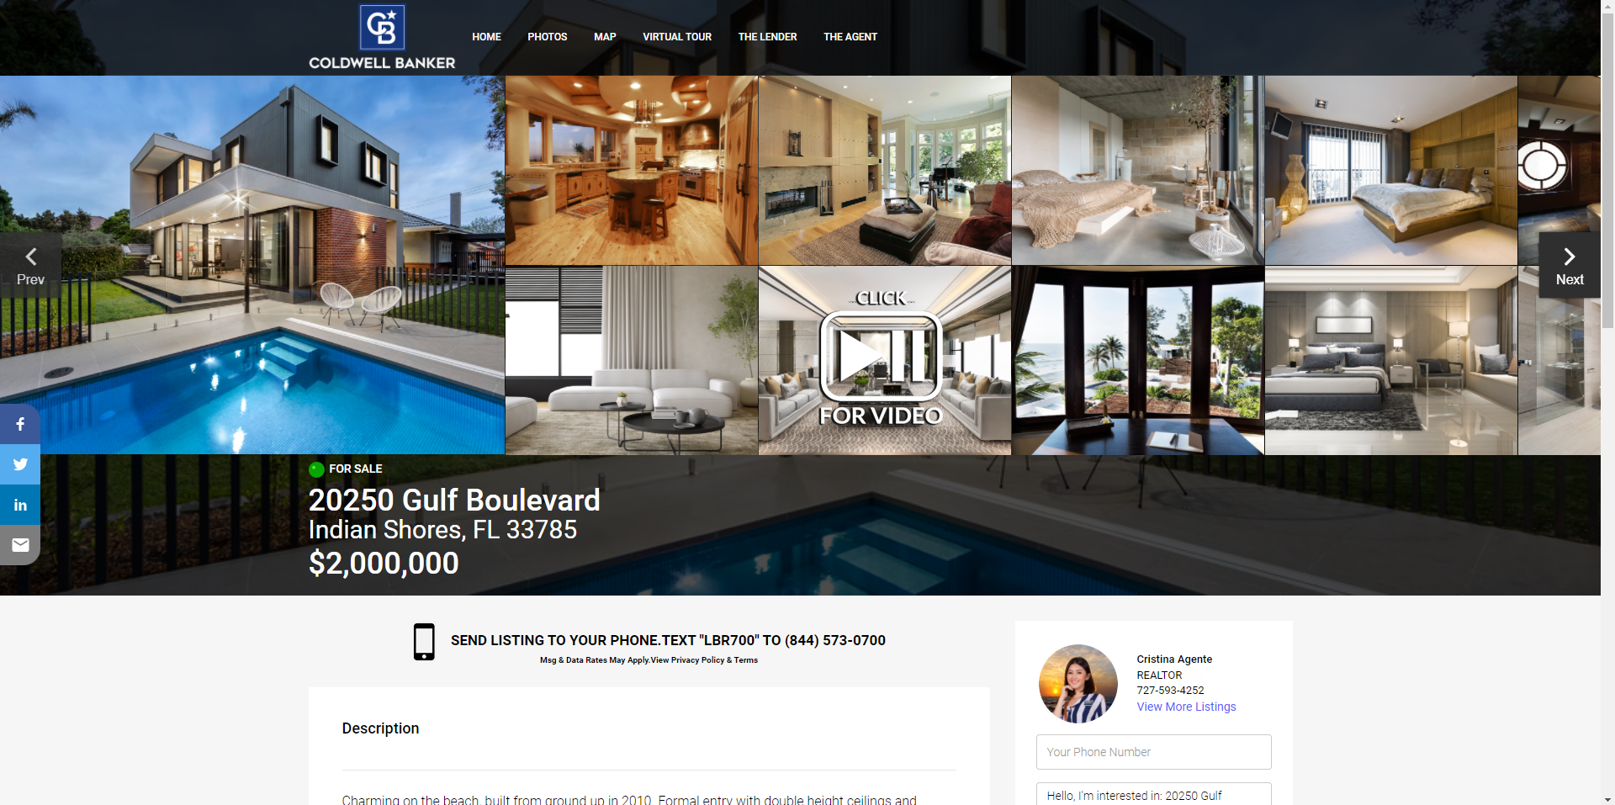
Not only will your property be on tons of websites, but I will also create a website specifically for your property. My property websites have buyer capture “opt-in” pop ups to capture the contact information of the person looking at your home for immediate follow up.

Slide 15
I will also show off your home with a full screen animated / virtual tour that we share in our MLS. This virtual tour gets syndicated to all of the big listing portals.

Slide 16
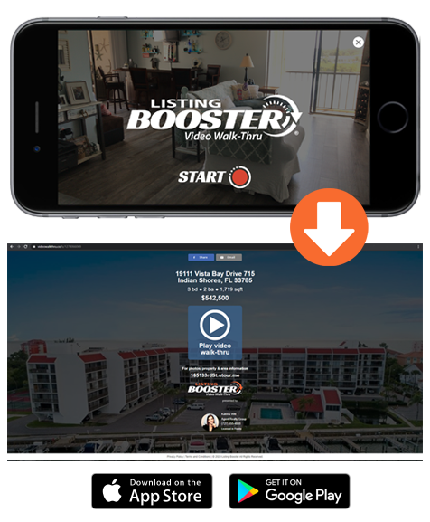
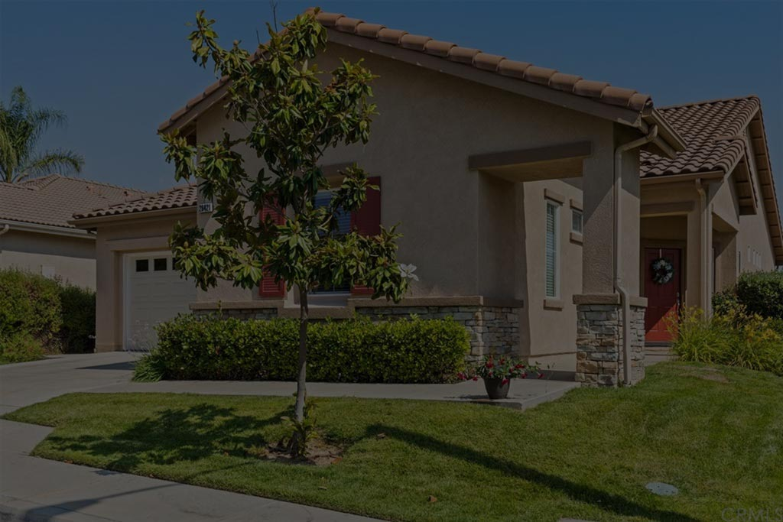
I can also create a video walk-thru with my mobile app. These walk-thru videos get the best response because they’re so personal and “real”. If one picture is worth a thousand words, what’s a video worth? Buyers appreciate these genuine walk-thru videos as they feel they get a genuine feel for your property.

Slide 17
Since no one else is going to offer you all of these unique things, let’s get started!

