Slide 1
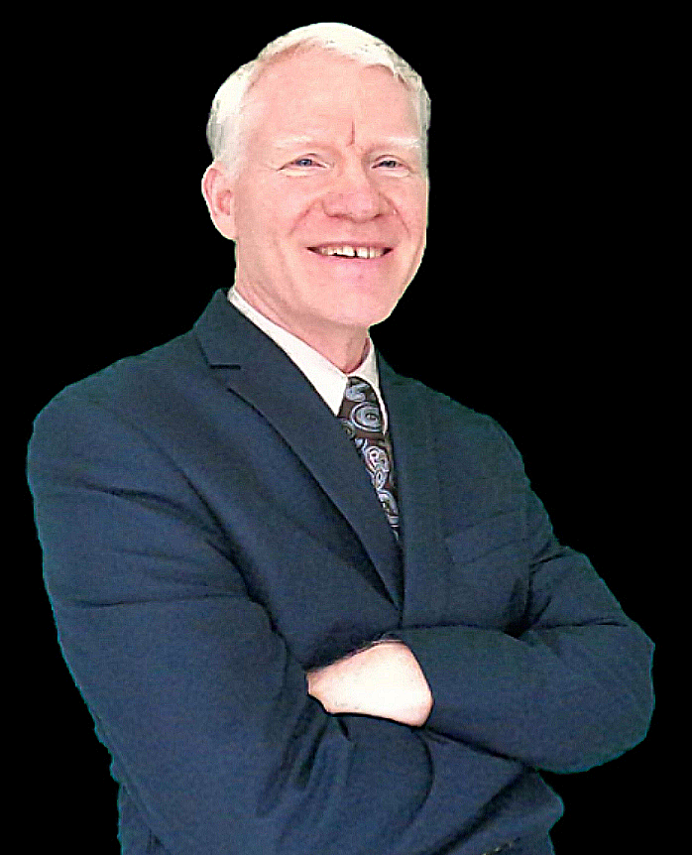
THE
BEST CHOICE
David Garofalo
FOR YOUR
Broker/Owner/Realtor | Salisbury, NC
david@Carolina4Sale.com
Carolina4Sale.com
HOME SALE
980-643-0405
Carolina4Sale (dba)
717 Ryan St. (HO)
Salisbury, NC 28144

Slide 2
ABOUT MY CAREER
2007
2008
2009
2018
Acquired my Real Estate sales license.
Acquired my Real Estate Brokers license.
Broker/Partner at Key Real Estate of WNY.
Broker/Owner/ Broker-In-Charge at Carolina4Sale
My prior and parallel experience is home improvement, repair and maintenance, and remodeling.

Slide 3
TELL ME ABOUT YOUR HOUSE
What drew you to this home when you bought it?
What is your favorite feature of this house?
What do you like about your neighborhood?
What are some nearby attractions and amenities?
What don’t you like about it?

Slide 4
IMPORTANT QUESTIONS
?
Why are you moving?
How soon do you need to move?
What are you looking for from your agent?
Do you anticipate any major challenges with selling your property?
What will you do if your house doesn’t sell?
This information will help me determine the best course of action as we go through the process of selling your property.

Slide 5
MY APPROACH
I believe in an upfront no-nonsense approach to selling real estate
I will tell you if either I or my company is not the best fit for your situation
I will be honest about the pricing of your property
STAYING ON TOP Education keeps me on top of the real estate industry. Both required and elective courses cover all aspects of the field.

Slide 6
WHAT DOES REALTOR MEAN?
Only Real Estate Agents who are members of the National Association of Realtors® can use this term.
Realtors subscribe to a higher code of ethics.
Realtors are required to have additional education.
I’m a member of the Local, State, and National Association.

Slide 7
ABOUT Carolina4Sale
We service Davie, Rowan, Cabarrus and the surrounding counties.
We have access to one of the states largest MLS systems, CanopyMLS.
We are locally owned and non-franchised.

Slide 8
NOW, I WANT YOU TO IMAGINE…
…That this is no longer your house. You have jumped forward in time and you now live in the home and the neighborhood where you plan on moving to next.

Slide 9
THE SELLER’S ROAD MAP
1
Meet With A Real Estate Professional
3
Prepare Your Home
5
Offers And Negotiation
7
Final
Details
2
Establish
A Price
4
List Your Home For Sale
6
Under Contract/In Escrow
8
Closing
Day

Slide 10
THE PRICE DERIVATIVE
Every property will sell and has the potential to sell quickly, and the price is the No. 1 factor controlling this outcome.

Slide 11
COMPETITIVE MARKET ANALYSIS
Comparables include sales from all real estate agents and companies
I check public records in addition to MLS
The best measure of value is sold listings
Active listings demonstrate supply and competition
Withdrawn/expired listings usually demonstrate an overpriced listing.

Slide 12
MARKETING YOUR PROPERTY
Much of my marketing starts today, when we agree on a price for your home. The best marketing in the world will never sell an overpriced home.

Slide 13
FACT VS. FICTION
When it comes to online marketing, many agents will try to convince you they have the “secret sauce.”
The fact is, every agent’s listing is syndicated out by the MLS to hundreds, if not thousands, of web sites.
The truth: If a buyer is house shopping online and your home matches their criteria, it would be almost impossible for them not to find your home.

Slide 14
MARKETING CHANNELS
Multiple branded websites including:
MLS site
Corporate site
Agent sites
Other marketing methods that we employ:
Virtual and Picture Tours
Yard Signs
Flyers
Social Media
Craigslist
Landing Pages

Slide 15
GETTING STARTED
Getting started is easy. Once we have agreed on a price and I have answered all of your questions, we have a little paperwork to complete. We can do pen and paper or better yet, go paperless with online documents. Then I can have your home on the market in as little as 48 hours.

Slide 16
Thank you!
Selling your home is a big deal and I take the task very seriously. The fact that you have considered me to help you accomplish this means the world to me!
David Garofalo
Broker/Owner/Realtor | Salisbury, NC

Slide 17
CONTACT INFORMATION
David Garofalo (Broker/Owner/Broker-in-Charge)
980-643-0405
david@Carolina4Sale.com
Carolina4Sale.com

