Slide 1
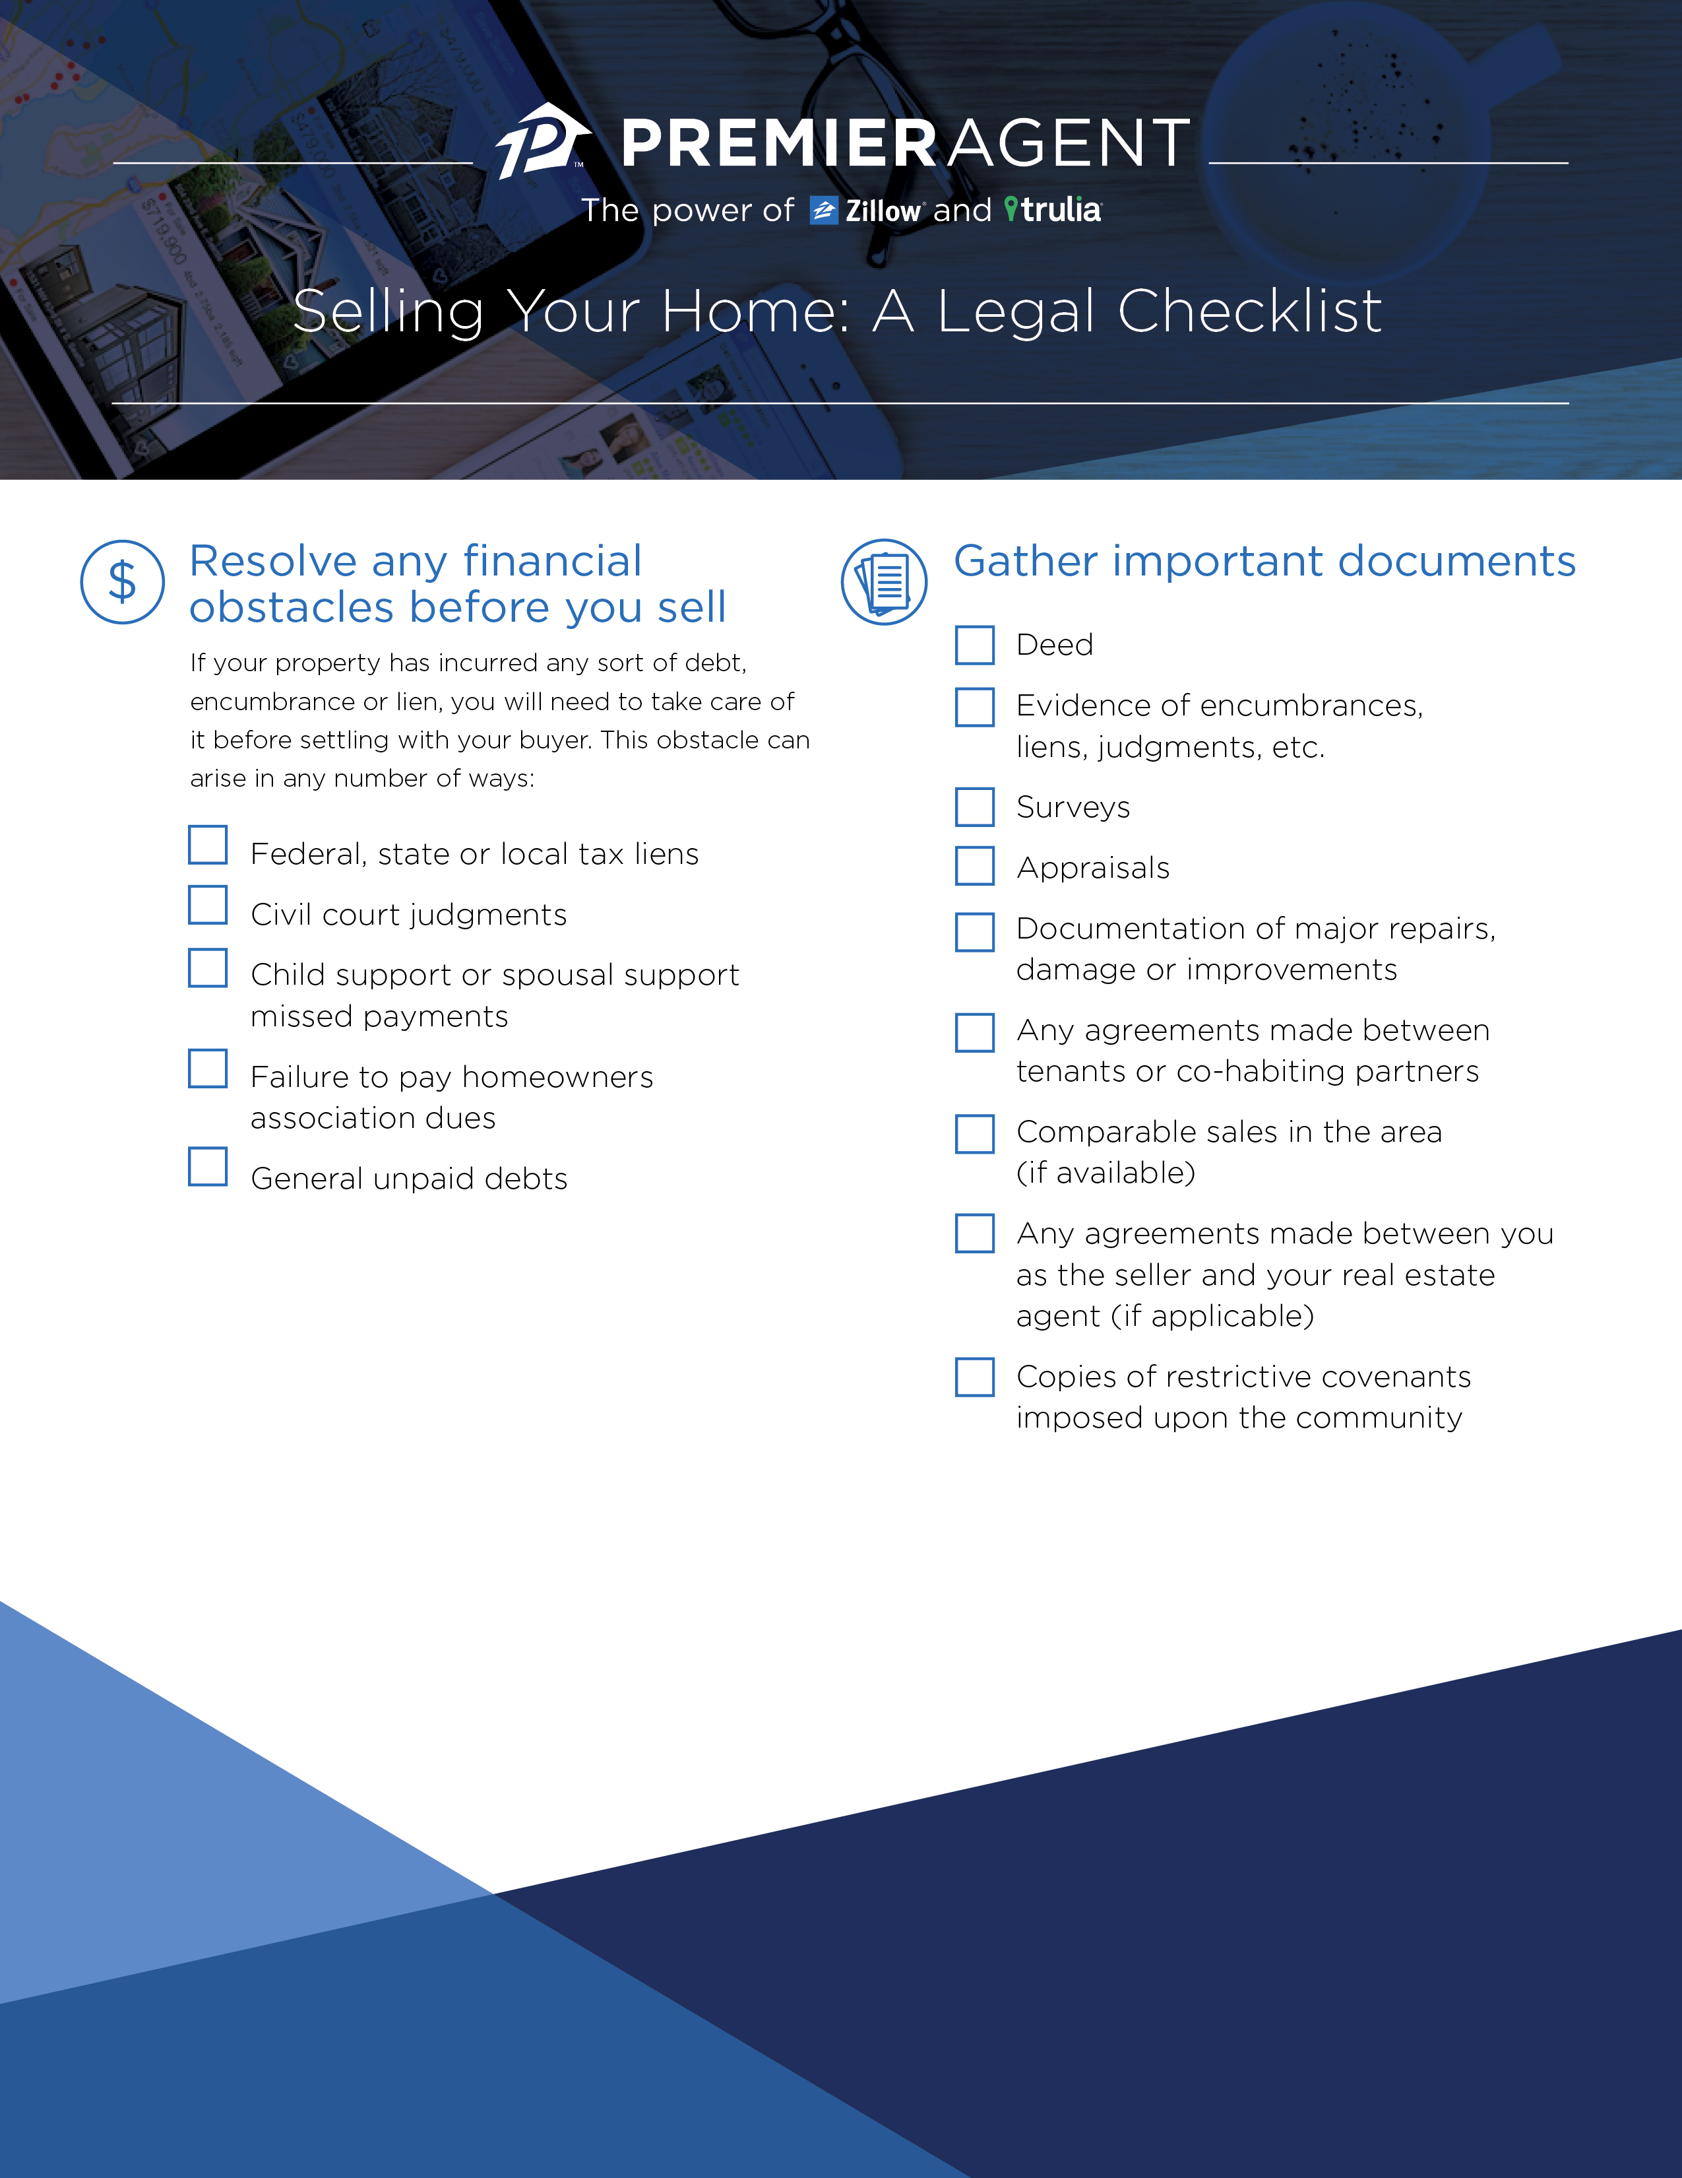
Resolve any financial obstacles before you sell
Gather important documents
If your property has incurred any sort of debt, encumbrance or lien, you will need to take care of them before settling with your buyer. These obstacles can arise any number of ways:
Deed
Evidence of encumbrances, liens, judgements, etc.
Surveys
Appraisals
Documentation of major repairs, damage or improvements
Any agreements made between tenants or cohabiting partners
Comparable sales in the areas (if available)
Any agreements made between you, as the seller, and your real estate agent (if applicable)
Copies of restrictive covenants imposed up upon the community
Federal, state or local tax liens
Civil court judgements
Missed child support or spousal support payments
Failure to pay homeowners association dues
General unpaid debts
Chris McKenty
chrismckenty@comcast.net
Cell (856) 889-4455

Slide 2
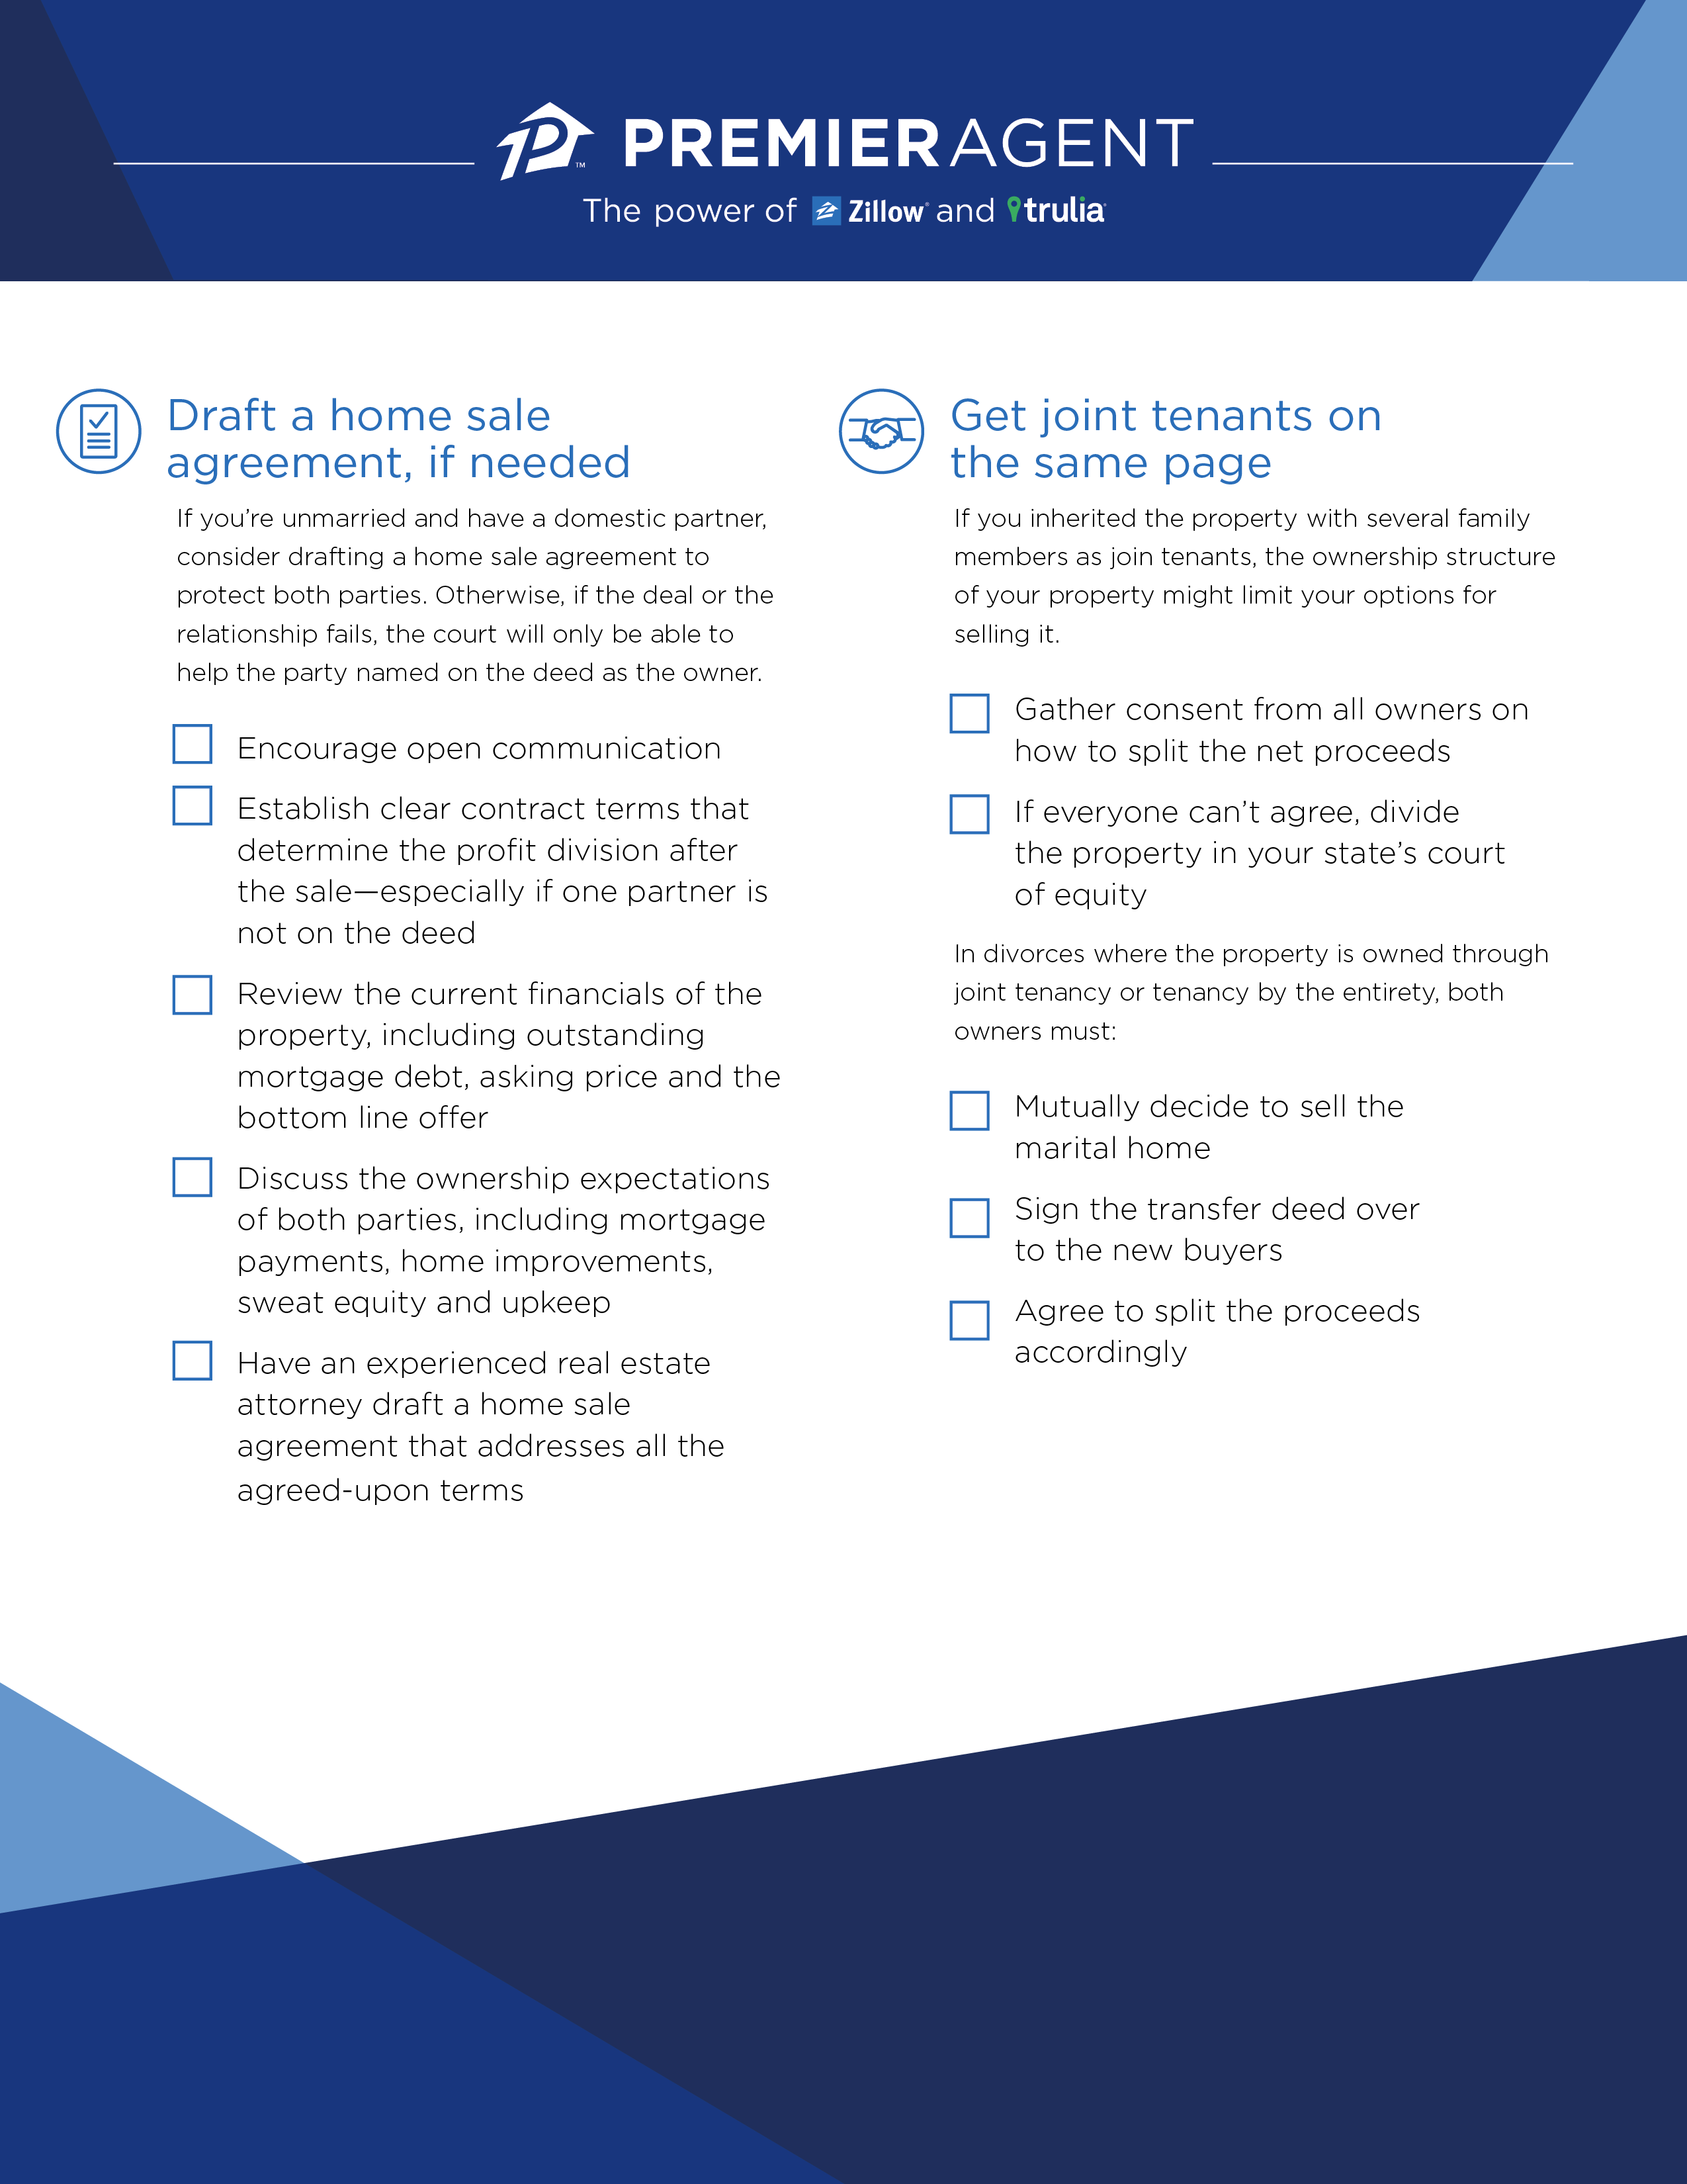
Draft a home sale agreement, if needed
Get joint tenants on the same page
If you’re unmarried and have a domestic partner, consider drafting a home sale agreement to protect both parties. Otherwise, if the deal or the relationship fails, the court will only be able to help the party named on the deed as the owner.
If you inherited the property with several family members as joint tenants, the ownership structure of your property might limit your options for selling.
Encourage open communication
Establish clear contract terms that determine the profit division after the sale—especially if one partner is not on the deed
Review the current financials of the property, including outstanding mortgage debt, asking price and the bottom line offer
Discuss the ownership expectations of both parties, including mortgage payments, home improvements, sweat equity and upkeep
Have an experienced real estate attorney draft a home sale agreement that addresses all the agreed-upon terms
Gather consent from all owners on how to split the net proceeds
If everyone can’t agree, divide the property in your state’s court of equity
In divorces where the property is owned through joint tenancy or tenancy by the entirety, both owners must:
Mutually decide to sell the martial home
Sign the transfer deed over to the new buyers
Agree to split the proceeds
Chris McKenty
Offie (856) 228-7990

