Slide 1

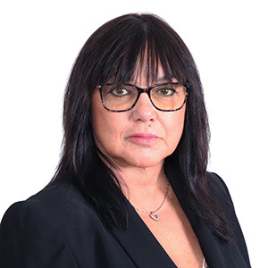
Betty DeVinney
Regional Sales Manager
C214.498.5053| O 214.498.5053

