Slide 1
Marketing
Consultation
Donna Elder
Associate Broker
859-983-9107
donnaelder@remax.net
donnaelder.remax.com
Lana Rovinelli
Associate Broker
859-421-7636
Lrovinelli@remax.net
paramountkentucky.com

Slide 2
Who is Donna Elder?
“I am a consultant NOT a salesperson. By definition: a consultant gives expert/professional advice... a salesperson is hired to sell merchandise to customers. 90% to 95% of my business is repeat and referral because I always put my clients first. I believe hard work combined with market research, experience, and continual education serve my client’s best interest. Real estate is a major investment and should be trusted by an experienced professional. I stay up-to-date on financing options that can make a difference in buying or selling a house. I work with a team, so we are available on your schedule. ”
Who is Lana Rovinelli?
“I use technology and my professional real estate experience to make your next move as seamless as possible and help it be enjoyable. I help buyers search and find Central Kentucky homes for sale, negotiate to the buyer’s advantage, and make their next move as easy as possible. I help Central Kentucky sellers prepare their homes to show on the market, set a pricing strategy, and find pre-approved buyers through innovative effective marketing. My promise to my clients is to always be with them before, during, and after the real estate transaction. “
As business partners, our unique differences create a professional, powerful team.

Slide 3
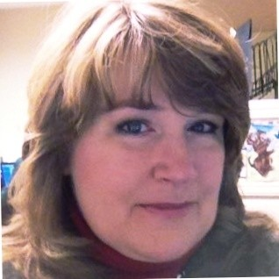
Meet Our Team
Mary Kittinger
Director of Operations
With over 30 years of experience in real estate operations, Mary plays a key role in ensuring the smooth daily functioning of our real estate transactions.
As Director of Operations, she oversees everything from streamlining administrative processes to managing a dedicated team focused on providing exceptional service to clients.
Known for her collaborative approach, Mary works closely with clients, agents, lenders, and title companies, ensuring that every aspect of each transaction runs smoothly, on time, and with precision. Her commitment to excellence is evident in every aspect of her role.
Outside the office, Mary enjoys walking her dog, needlepointing, exploring genealogy, and spending time with family and friends.
Thomas Elder,
Director of Technology
Thomas grew up in real estate. He has a degree in Computer Science and does our virtual tours, floor plans, and puts them on the marketing pages.
Research show the consumers will click on listings with virtual tours & floor plans before other listings and spend more time on the site.
Thomas ensures that the technology enhances each home listing and that our office has the latest tools to increase productivity.

Slide 4
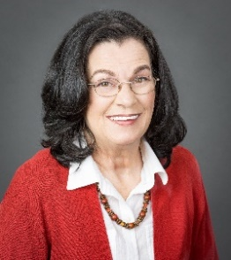
Donna Elder
(859) 983-9107
donnaelder@remax.net
donnaelder.remax.com
Social Media and Recommendations
www.zillow.com/profile/Lexington-Realtor/
General Information
• Associate real estate license 1988
• Broker real estate license in 1991
• Top 1% of closed transactions in Central KY
• RE/MAX International Hall of Fame (top 5% of Realtors internationally)
• RE/MAX International Platinum Club 2014 (top 5% of Realtors internationally)
• Recognized as one of America’s Top Real Estate Professionals by REAL Trends
• 90% to 95% of my business is repeat and referral
Designations
• ABR: Accredited Buyers Representative • CRS: Certified Residential Specialist
• ABRM: Accredited Buyers Rep Manager • CRS: Certified Residential Specialist
• AHWD: At Home With Diversity • e-PRO: Certified Internet Professional
• ASR: Accredited Seller Representative • EcoBroker Certified
• C-CREC: Certified Consumer Real Estate Consultant • GRI: Graduate, Realtors Institute
• Certified Dementia Friendly • MRP: Military Relocation Professional
• CNE: Certified Negotiation Expert • RFC: Residential Financial Consultant
• CNHS: Certified New Homes Specialist • SRES: Seniors Real Estate Specialist
• CPE: Certified Probate Expert • Certified Senior Advisors
• CPRES: Certified Probate Real Estate Specialist • Certified Senior Housing Professional
• CRFS: Counsel of Residential Finance Specialist
I am a real estate consultant NOT a SALESPERSON.
I give expert advice so my clients can make informed decisions.
RE/MAX Creative Realty

Slide 5
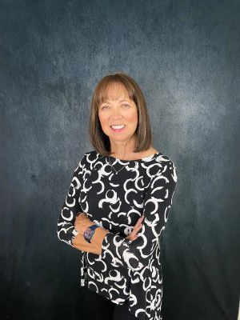
Lana Rovinelli
(859) 421-7636 cell
lrovinelli@remax.net
Paramountky.com
Personal Data:
Born in Prestonsburg, Kentucky
B.S. in Accounting, University of Kentucky
A resident of Central Kentucky for over 35 years
__________________________
Professional Qualifications: Business Experience
Quality Service Certified Software Company Owner
Member of Luxury Home Specialists Retail Sale Experience
Member of the National Association of Realtors Accountant
Bluegrass Realtors Association Broker/Owner of Paramount R.E. Group
Member of the Kentucky Association of REALTORS Associate Broker and Realtor for 20/+ years
Certified Full-Service Professional
__________________________
Community Involvement Volunteer for Children’s Miracle Network for UK Hospital
Donate Money to Children’s Miracle Network after each home closing
Habitat for Humanity
Repair Affair
Hurricane Volunteer in SW Florida
My strategy is: “Personal service on an individual basis”.
RE/MAX CREATIVE REALTY

Slide 6
Community Involvement
UK Children’s Hospital – donation for every transaction
https://ukhealthcare.uky.edu/kentucky-childrens-hospital/philanthropy/ways-give
Habitat for Humanity – Volunteer since the early 1990’s
– Currently finds building lots to purchase. In 2024, six lots purchased https://www.lexhabitat.org/
Moveable Feast – Original Board Member
https://www.feastlex.org/
Realtor Community Housing Foundation – Donate and Volunteer
https://www.bluegrassrealtors.com/rchf-foundation/about/
Kentucky Refugee Ministries – Sponsored several families moving to Kentucky fleeing genocide
https://kyrm.org/
Makenna Foundation – Fundraising
https://www.makennafoundation.com/
Sweet Blessings – Makes Birthday cakes for elementary children in need
https://www.facebook.com/SweetBlessingsCakesLex
Faith Community Housing Foundation – Original Board Member - since dissolved
I am a real estate consultant NOT a SALESPERSON.
I give expert advice so my clients can make informed decisions.
RE/MAX Creative Realty

Slide 7
Full-Service Excellence
Going beyond your expectations before, during, and after the transaction to deliver an extraordinary experience.
Donna Elder
Associate Broker
859-983-9107
donnaelder@remax.net
donnaelder.remax.com
Lana Rovinelli
Associate Broker
859-421-7636
Lrovinelli@remax.net
paramountkentucky.com

Slide 8
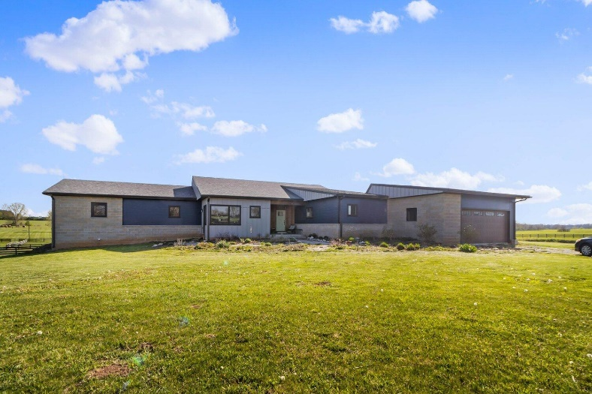
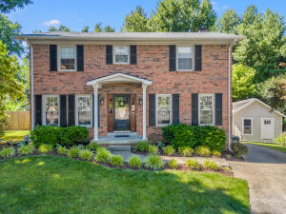
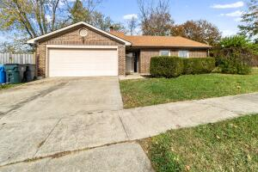
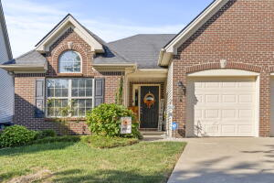
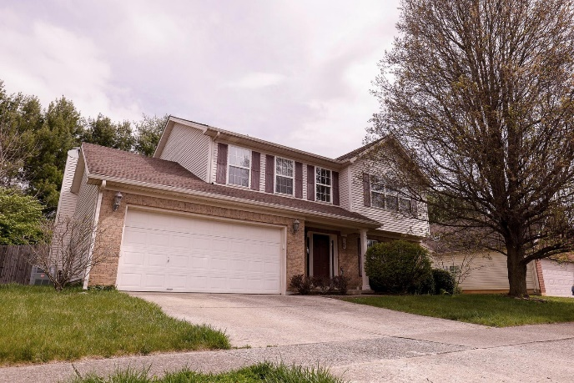
Recent Sales
Old Richmond Road
Ecton Road
Jason Court
Crossen Way
Merluna Drive
Old Post Road

Slide 9
We will put your home to be viewed by potential buyers on multiple websites.
Who Uses the Internet to Search for Homes?
All buyers 97%
Younger Millennials 99%
Older Millennials 99%
Gen Xers 99%
Younger Boomers 97%
Older Boomers 95%
Silent Generation 87%

Slide 10
Home Selling 101
1
Work With a
LISTING AGENT.
2
3
Set the Best Price
4
Decide When to Sell
Prepare Your Home for Sale
Consider work, school schedules, and other key factors.
Use Market Research
Make any necessary and essential repairs, declutter., etc.
to determine the price.
5
6
Market Your Home
Use staging, photos, videos, online and traditional marketing
7
8
List Your Home
Review Offers
Assess the pros and cons of the offers and negotiate for the
Close the Sale
Create an eye-catching
Sign paperwork, close the deal, and receive
property listing prior
to private showings
your funds.
and open houses.
to attract buyers.
best terms for you.
Donna Elder
Associate Broker
859-983-9107
donnaelder@remax.net
donnaelder.remax.com
Lana Rovinelli
Associate Broker
859-421-7636
Lrovinelli@remax.net
paramountkentucky.com

Slide 11
As Your Listing Agents,
here are some of the most important tasks we’ll handle for you.
Conduct market research.
Competitively
Create a complete home marketing plan.
Coordinate
SHOWING TIMES.
Negotiate all offers per your instructions.
Provide complete
Keep you informed every step of the way.
price your
transaction management.
home to sell.
Some of our other tasks...
Research MLS sales activity.
Confirm total square footage.
Design property marketing flyers.
Provide weekly progress reports.
If needed, order and supervise inspections such as lead paint, asbestos, termite, mold/ mould, and sewer systems.
Help resolve any issues with buyer after the sale.
Research Days on Market for similar properties.
Compile list of completed repairs and items to be maintained.
Create buyer feedback
report.
Review MLS regularly to
ensure property remains
competitive.
Notify our referral network
about listing.
Evaluate feedback from buyer’s agents.
Staying in touch with you after the sale with pertinent information.
Complete curb appeal
assessment.
Discuss print/online ads.
Explain each offer’s pros and cons.
Confirm verification of escrow money.
Discuss how qualified buyers will be vetted.
Assess interior decor and suggest changes.
...and much more
Establish timeline for loan approval and closing.
Verify with buyer’s agent that the loan process is confirmed and going smoothly.
Explain brokerage’s role in the transaction.
Place For Sale signs in yard.
Donna Elder
Associate Broker
859-983-9107
donnaelder@remax.net
donnaelder.remax.com
Lana Rovinelli
Associate Broker
859-421-7636
Lrovinelli@remax.net
paramountkentucky.com

Slide 12
Historical Real Estate
Offers of Compensation
(Previously)
Listing
Buyer
Agreement
Agreement
COMPENSATION OFFER
Listing Broker
Buyer
Broker
Seller
Buyer
The MLS
Donna Elder
Associate Broker
859-983-9107
donnaelder@remax.net
donnaelder.remax.com
Lana Rovinelli
Associate Broker
859-421-7636
Lrovinelli@remax.net
paramountkentucky.com

Slide 13
Post-Settlement Real Estate
Offers of Compensation
Listing
Buyer
Agreement
LISTING AGENT MARKETING PLAN
Agreement
Listing Broker
Buyer
(Website, social media, For Sale signs, calls, emails and referrals.)
Broker
Seller
Buyer
The MLS
Donna Elder
Associate Broker
859-983-9107
donnaelder@remax.net
donnaelder.remax.com
Lana Rovinelli
Associate Broker
859-421-7636
Lrovinelli@remax.net
paramountkentucky.com

Slide 14
What a Buyer’s Agent Does
Brings a bigger pool of stronger buyers.
Reduces the
Encourages the buyer to make a fair and strong offer.
Helps expedite the entire process ensuring the deal doesn’t fall through and closes on time.
Recommends professionals (mortgage lenders, title, insurance, etc.) to ensure a smooth closing.
number of those
“just looking.”
Donna Elder
Associate Broker
859-983-9107
donnaelder@remax.net
donnaelder.remax.com
Lana Rovinelli
Associate Broker
859-421-7636
Lrovinelli@remax.net
paramountkentucky.com

Slide 15
THE COMPLETE HOME MARKETING PLAN
Donna Elder
Associate Broker
859-983-9107
donnaelder@remax.net
donnaelder.remax.com
Lana Rovinelli
Associate Broker
859-421-7636
Lrovinelli@remax.net
paramountkentucky.com

Slide 16
Marketing Your Home
We are committed to getting your home sold to the strongest buyer in a timely manner. Below are the steps we will take:
Competitively price your home.
Optimize condition and viewing of the home.
Prepare and submit accurate information to the MLS.
Proactively promote the property to our database.
Create maximum exposure for the property.
Connect with the best agents and tap into our nationwide network.
Donna Elder
Associate Broker
859-983-9107
donnaelder@remax.net
donnaelder.remax.com
Lana Rovinelli
Associate Broker
859-421-7636
Lrovinelli@remax.net
paramountkentucky.com

Slide 17
Property Enhancement
Next up, we will maximize the value of your home with:
Property Enhancement Checklist — small tasks to get your home in top shape. Examples include painting the living room, repairing the back gate or power washing the siding.
Recommendations for minor and essential repairs, as well as improvements to help sell your property for the highest price possible.
Access to a list of the most reliable and dependable home improvement professionals in the marketplace.

Slide 18
Leveraging Our Expertise
Our business is built on referrals. Our goals are to serve you in such a way that you will be delighted enough to refer your friends and family for years to come.
Connecting you to others
Not only are we experts in our local market, we’re also part of a network of top agents — expanding access to local and out- of-area buyers in the U.S. and Canada.
Our Experience/Expertise:
• We’ll negotiate the best deal for you. • We’re trained by the top business coaching company in North America. • We have a fiduciary duty of care for you and will be your advocate during the entire transaction.

Slide 19
Property Enhancement Checklist
You can rely on our network of the most reliable
home improvement professionals in the marketplace.
LIVING AREAS
BEDROOMS
OTHER ROOMS
HERE COMES A BUYER
TIDY UP!
TIDY UP!
TIDY UP!
Before each showing, be sure to complete these last-minute touches to make your home stand out and look great!
Remove piles of papers and magazines from tables.
Straighten children’s play area and store extra toys.
Organize all areas: laundry area, family area, workshop, garden equipment, etc.
Rearrange furniture; discard worn furniture and store “extra” pieces.
Remove extra furniture and rearrange to define areas.
Box up and store (or dispose) of
any unnecessary items.
EXTERIOR
Straighten bookshelves.
Make closets more appealing by storing seasonal clothes elsewhere.
CLEAN UP!
Pick up after pets.
CLEAN UP!
Be sure all clothes are hung up.
Sweep and clean floors.
Pick up lawn tools, toys, etc. lying around the yard.
Clean and deodorize carpets, spot clean where necessary; wash all floors.
Remove cobwebs from walls, window-sills, and ceilings.
Clear driveways and walk areas.
Polish all furniture.
CLEAN UP!
Wash windows, inside and out.
INTERIOR
Wipe down lighting fixtures, making sure all bulbs are working.
Clean and deodorize all carpet, spot cleaning where necessary.
PATCH UP!
Open curtains for daytime showings and close curtains for nighttime showings.
Wash window treatments.
Make sure furnace, air conditioning and hot water heater are in working order.
Open windows to “freshen up” your home.
Do a quick tidy up.
Play instrumental music.
Wash window treatments.
Wipe down lighting fixtures, making sure all bulbs are working.
Clean fireplace, if applicable.
PATCH UP!
PATCH UP!
Patch and paint walls and ceilings, if necessary.
Patch and paint walls and ceilings, if necessary.
ADDITIONAL OBSERVATIONS:
THE FINISHING TOUCH!
THE FINISHING TOUCH!
Display linens on table.
Add flowers, potpourri, etc.
Rearrange pictures to highlight areas. Add lamps if room is dark.
Add decorative pillows to beds. Add a plant.
Donna Elder
Associate Broker
859-983-9107
donnaelder@remax.net
donnaelder.remax.com
Lana Rovinelli
Associate Broker
859-421-7636
Lrovinelli@remax.net
paramountkentucky.com

Slide 20
Clear and Open Communication
Once your home is on the market, I'll be there to guide you every step of the way.
You’ll receive a copy
We’ll call regularly: to report showing activity and give buyer feedback.
We’ll meet/talk periodically:
to review market conditions and adjust our marketing strategy as needed to get your home sold.
Transparency is key. We’ll keep communication lines open to ensure you are comfortable and confident with every part of the transaction.
of the MLS printout: to review for accuracy.
Donna Elder
Associate Broker
859-983-9107
donnaelder@remax.net
donnaelder.remax.com
Lana Rovinelli
Associate Broker
859-421-7636
Lrovinelli@remax.net
paramountkentucky.com

Slide 21
Negotiating and Structuring
the Sale
OUR PROMISE TO YOU:
Carefully review and
Qualify prospective buyers and research
Negotiate the strongest
present all offers: for your consideration.
Terms:
to create a solid
their lending options: to increase the likelihood that they can secure financing.
transaction that will close on time without any surprises.
Donna Elder
Associate Broker
859-983-9107
donnaelder@remax.net
donnaelder.remax.com
Lana Rovinelli
Associate Broker
859-421-7636
Lrovinelli@remax.net
paramountkentucky.com

Slide 22
Complete Transaction Management
Once we’ve secured a qualified buyer, we promise to smoothly navigate you through the transaction.
Count on us to manage all the details of your real estate transaction on a daily basis.
We’ll make sure your home closes
in a timely fashion and with as
little stress as possible.
Donna Elder
Associate Broker
859-983-9107
donnaelder@remax.net
donnaelder.remax.com
Lana Rovinelli
Associate Broker
859-421-7636
Lrovinelli@remax.net
paramountkentucky.com

Slide 23
Service After the Sale
Our business is built on relationships, so we aim to provide you with outstanding service and care before, during, and after the sale! Even after your closing, we’ll be there to assist you with all your real estate needs
.
Consider us your source of referrals for all types of businesses, whether related to a real estate transaction or not. We’ve partnered with competent professionals who would be happy to serve you.
You’ll receive valuable information from us via email on a weekly basis to keep you educated and informed.
Donna Elder, Realtor
859-983-9107
donnaelder@remax.net
donnaelder.remax.com
Donna Elder
Associate Broker
859-983-9107
donnaelder@remax.net
donnaelder.remax.com
Lana Rovinelli
Associate Broker
859-421-7636
Lrovinelli@remax.net
paramountkentucky.com

